Slide 1

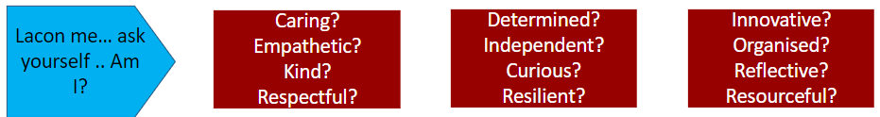
Lesson Intention
Learning outcomes:
Learning is successful when I know:
-Recall information about carbohydrates
-Address any misconceptions
-Apply knowledge to exam questions
Macronutrients Carbohydrates- FNH
Friday 28th March 2025

Slide 2


Lesson Entrance
- Straight to your seat and sit down in silence
- Get desk ready
- Write title and date
- Prepare for retrieval activity
Do now - retrieval activity-
Dietary fibre helps to lower blood cholesterol levels? True/ False [1 mark]
Dietary fibre can help to prevent diverticulitis? True/False [1 mark]
Identify three sources of dietary fibre [3 marks]
Define what a ‘monosaccharide’ is. [1 mark]

Slide 3
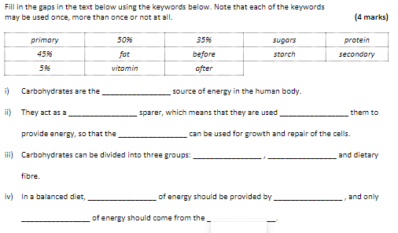
Starter- Question 5, write out and identify the correct information

Slide 4
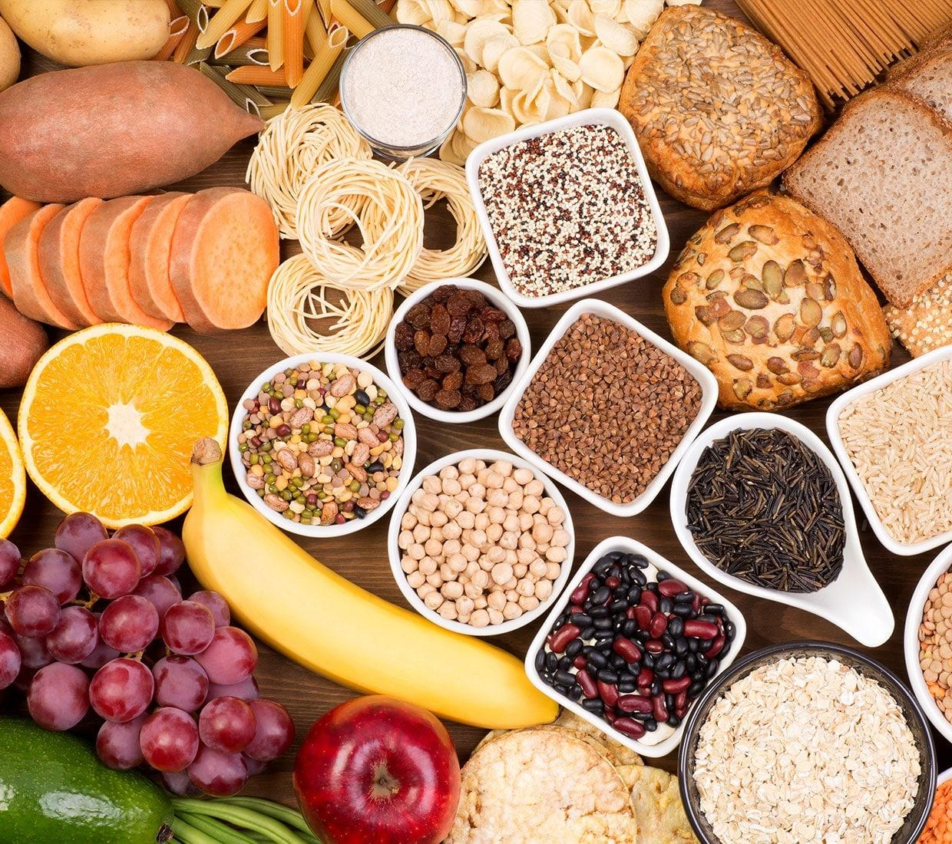

Revisiting Carbohydrates
Functions- main energy source, ‘protein sparer’
Sources- sugars (simple, mono and disaccharides, fast acting)
starches (polysaccharides, energy over time)
dietary fibre (polysaccharide- cell walls of veg/cereals)
Excess- tooth decay, obesity
Deficiency- weight loss, constipation, increased risk of bowel cancer

Slide 5
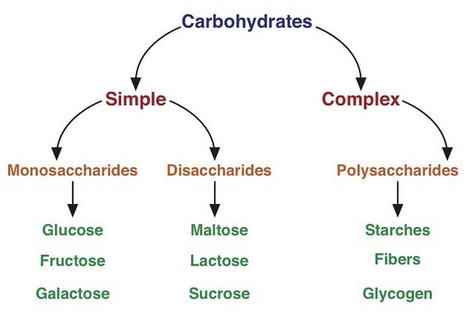
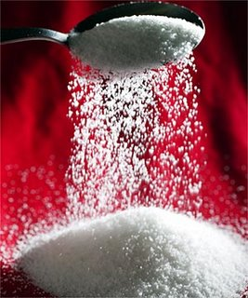
In depth look- Sugars
Easily broken down by the body
Simple sugars- monosaccharides→ glucose (fruits and veg) and fructose (fruits and honey)
‘Double sugars’- disaccharides →sucrose(table sugar), lactose (milk), maltose (cereals, beer)
Free sugars-
Sugar added to food or found OUTSIDE cell structures= free sugars (usually processed, includes honey and unsweetened fruit juice)
Sugar- needed for energy, NO NUTRIENTS. Should be restricted to 5% of RDA
Notes:
Recommended daily allowance
Simple- fast acticting
Complex- starha nd dietary fibre over time

Slide 6
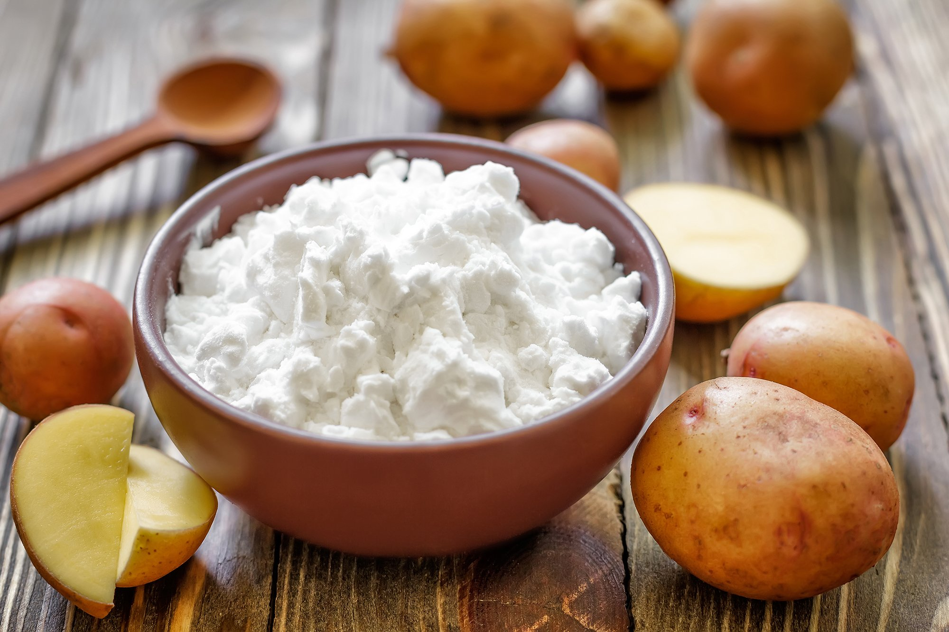
In depth look- Starches
Complex carbohydrates= polysaccharides
Starch- found in plants (size and shape of starch is different in each plant)
Pectin – found in some fruits, forms gel in water (jam)
Glycogen- made from glucose BY HUMANS- stored in muscle as energy reserve
Sources- root veg, cereals and cereal products.
RDA- 50% of total food energy from carbs, 45% starches, milk sugar and fruit sugar.

Slide 7
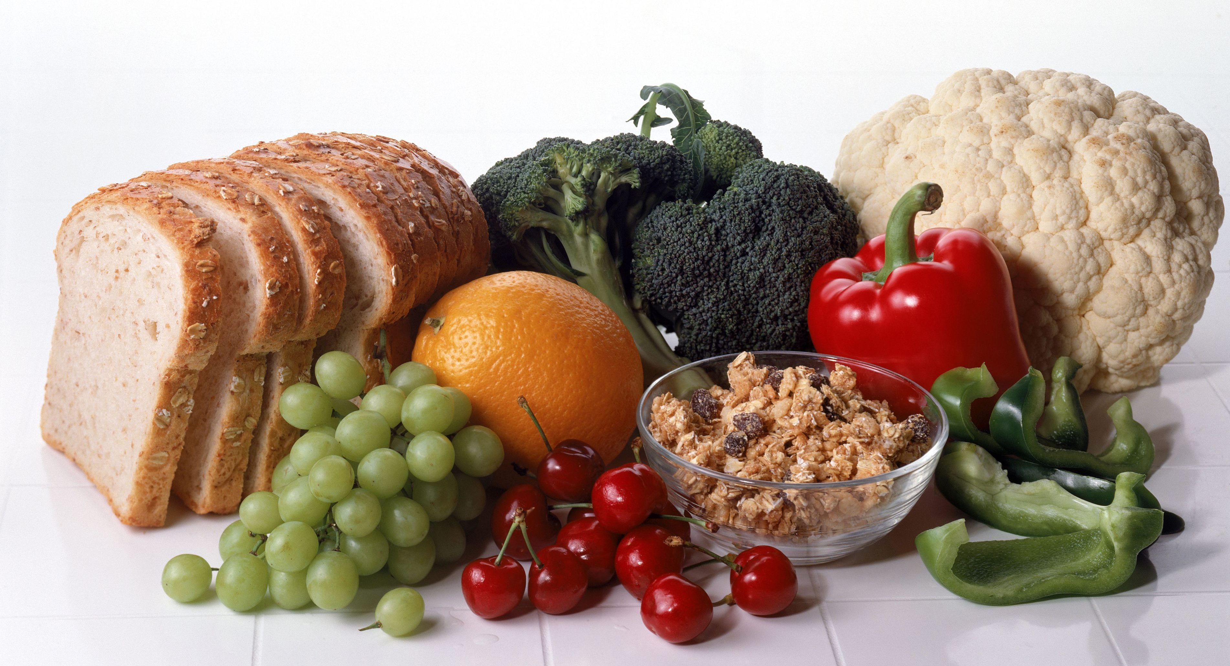

In depth look- Dietary Fibre
Polysaccharide found in cell walls of plants, pulses and cereal grains.
Not broken down by digestive system easily
Function- healthy digestive system
weight control (fuller for longer, slow energy release)
prevent bowel disease (constipation, DIVERTICULITIS, cancer)
provides soluble fibre= reduces cholesterol levels
Sources- insoluble- not digested, bulk of poop- wholegrain foods, veg peelings and skin
soluble- slows down digestion and absorption of carbs= controls blood sugar levels- oats, nuts, legumes, some fruit and veg
Notes:
Diverticular disease and diverticulitis are conditions that affect the large intestine (bowel), causing tummy (abdominal) pain and other symptoms. They're caused by small bulges or pouches in the walls of the intestine called diverticula.

Slide 8

Plenary- Exam question
Discuss how excessive consumption of sugars can affect the health of an individual and suggest two ways an individual can prevent these negative health effects. (6 marks)
Plan? What do you need to include?
P- Point
E- Evidence
E- Explain
L- Link

Slide 9
Mark Scheme
The answer identifies and describes at least two health effects of excessive sugar consumption (4 marks)and provides two ways of preventing them(2 marks).
Health effects from:
Obesity –excessive sugar consumption will lead to obesity as unused sugar will be transformed into fatty tissue and stored in the body.
Type 2 diabetes –excessive sugar consumption will raise blood sugar levels, which will put stress on the pancreas. As the pancreas cannot produce enough insulin to lower the blood sugar level, the sugar will continue to damage the tissues around the body.
Tooth decay –sugars feed mouth bacteria, which thrive on them and cause tooth enamel to dissolve.
Ways of preventing them:
Avoid eating free sugars from sweets, sweetened beverages, etc.
Choose foods rich in polysaccharides as they are absorbed more slowly into the bloodstream.
Choose foods rich in fibre as they lower blood sugar levels
Increase physical activity to burn more calories.
Physical activity is also helpful in preventing (or even reversing!) type 2 diabetes as it allows the body to use the extra glucose and lower its amount in the blood. Accept any other suitable answer.
Do NOT accept answers which refer to systematic/governmental actions –only accept answers that refer to individuals.

