Slide 1
Starter:
How much energy should be provided from protein in a balanced diet? [1 mark]
List two functions of proteins in the human body [2 marks]
Define protein complementation [1 mark]
Identify two plant sources of high biological value protein [2 marks]

Slide 2
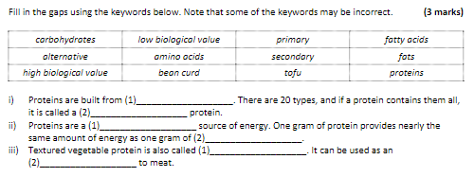
Starter- Question 5, write out and identify the correct information

Slide 3
Revision-
Macronutrients
Protein
Learning Objectives:
Recall information about protein
Address any misconceptions
Apply knowledge to exam questions

Slide 4

Revisiting Protein
Functions- growth and repair (tissues and cells), secondary energy sources, making hormones, enzymes and antibodies
Sources- HBV- animal products (meat, fish, milk, yoghurt, cheese)- plants (soya beans- tofu etc, quinoa)
LBV- cereals, peas, legumes, seeds
Excess- harmful to kidneys and liver, can be stored as fat
Deficiency- Kwashiorkor- children in developing countries, lack of essential amino acids.
RDA- 50g men, 45g women

Slide 5
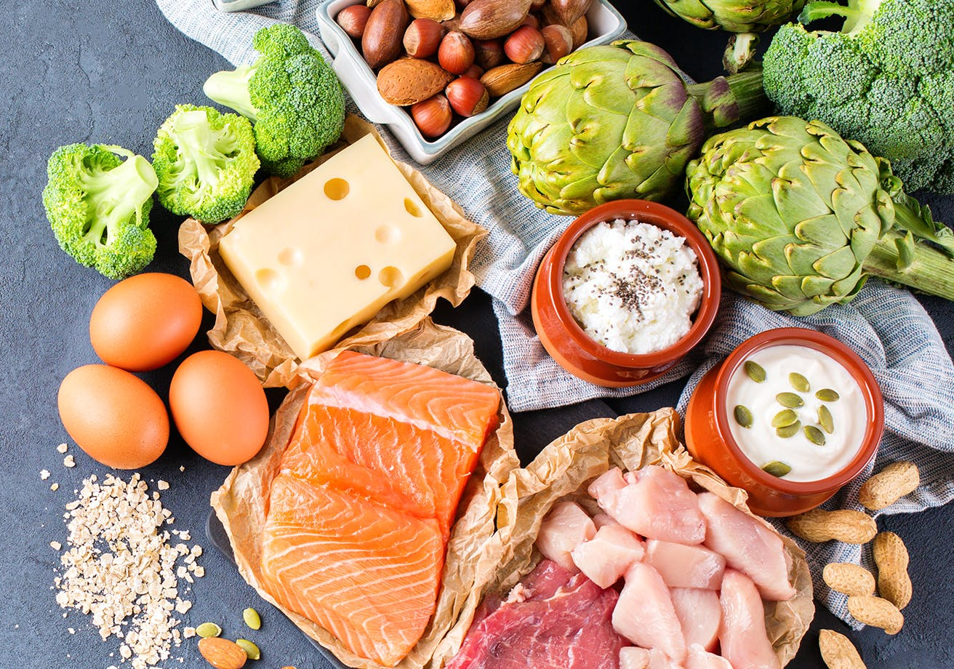
In depth look- Biological value
Building blocks of life!
Long chain molecules of amino acids
20 different amino acids.
Non-essential amino acids= made by the body
8 Essential amino acids- need to be taken in, in diet.
HBV- High biological value (contain 8 essential amino acids)
LBV- Low biological value (DO NOT CONTAIN essential amino acids)

Slide 6
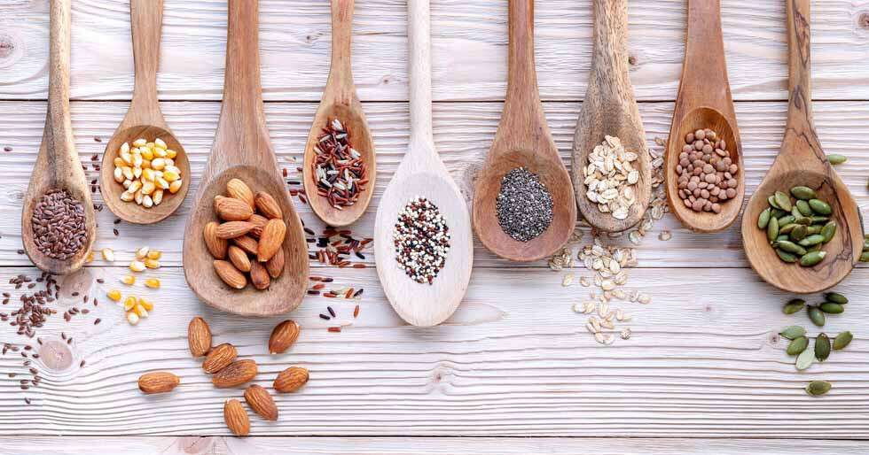
In depth look- Protein Complementation
Combining two LBV proteins to ensure that there are enough HBV amino acids available.
Examples:
  Lentil dhal and chapatis
  Rice and peas
  Baked beans on toast
  Hummous with pitta bread
Protein complementation is needed to ensure that vegetarians get all the essential amino acids, it can save money because LBVs tend to be cheaper than HBV (LINK FOOD CHOICE)

Slide 7
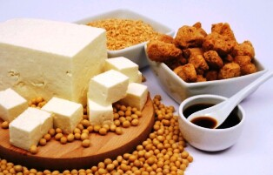
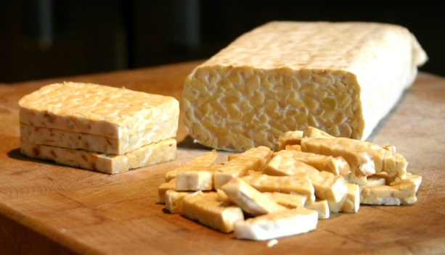
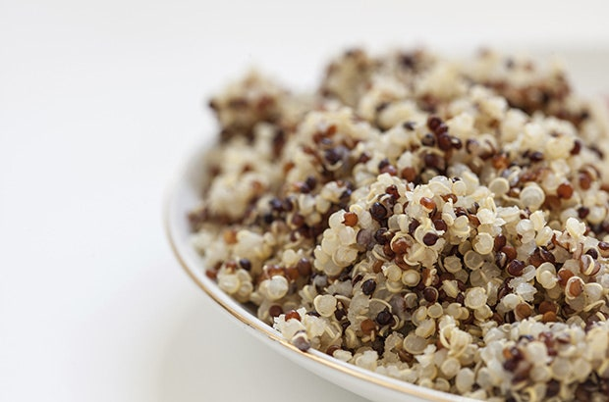

In depth look- Protein Alternatives
Soya
  Edamame beans
  TVP (Textured Vegetable Protein)
  Tofu
  Soya milk
  Tempeh (cultured with mould to form a solid meat substitute)
  Miso (fermented paste made from soya beans, rice/barley grains, salt and water)
Mycoprotein (Quorn- fungus similarly grown to yeast in bread)
Quinoa

Slide 8
Plenary- Exam question
Explain why protein deficiency may put a stop to growth in children. (4 marks)
Plan? What do you need to include?
P- Point
E- Evidence
E- Explain
L- Link

Slide 9
Mark Scheme
Any two reasons with a possible mechanism behind it; for example:
(1 mark for each reason and 1 mark for each correct explanation, max. 4 marks)
Lack of protein means that there is no building material to build new cells, so the body cannot grow or develop new tissues.
Lack of protein means that there is no material to repair old tissues, so the body will use whatever is available to rebuild damaged cells, at the cost of growth and development of new ones.
Lack of protein means that growth hormone cannot be built, so growth will be stopped by the lack of hormone.
Lack of protein means that the enzymes cannot be built, so the food will not be broken down properly and there will be no energy or building material to build new tissues.
Accept any other suitable answer.

