Slide 1
Starter:
Explain what the function of fat is in the diet? [2 marks]
Identify an animal source of fat and a vegetable source of fat. [2 marks]
Define the term hydrogenation [2 marks]
What is the scientific term for a fat molecule? [1 mark]
How many calories are provided by 1g of fat? [1 mark]

Slide 2
Hydrogenation converts liquid vegetable oils into solid or semi-solid fats, such as those present in margarine. Changing the degree of saturation of the fat changes some important physical properties, such as the melting range, which is why liquid oils become semi-solid.

Slide 3
Revision-
Macronutrients
Fats
Learning Objectives:
Recall information about protein
Address any misconceptions
Apply knowledge to exam questions

Slide 4
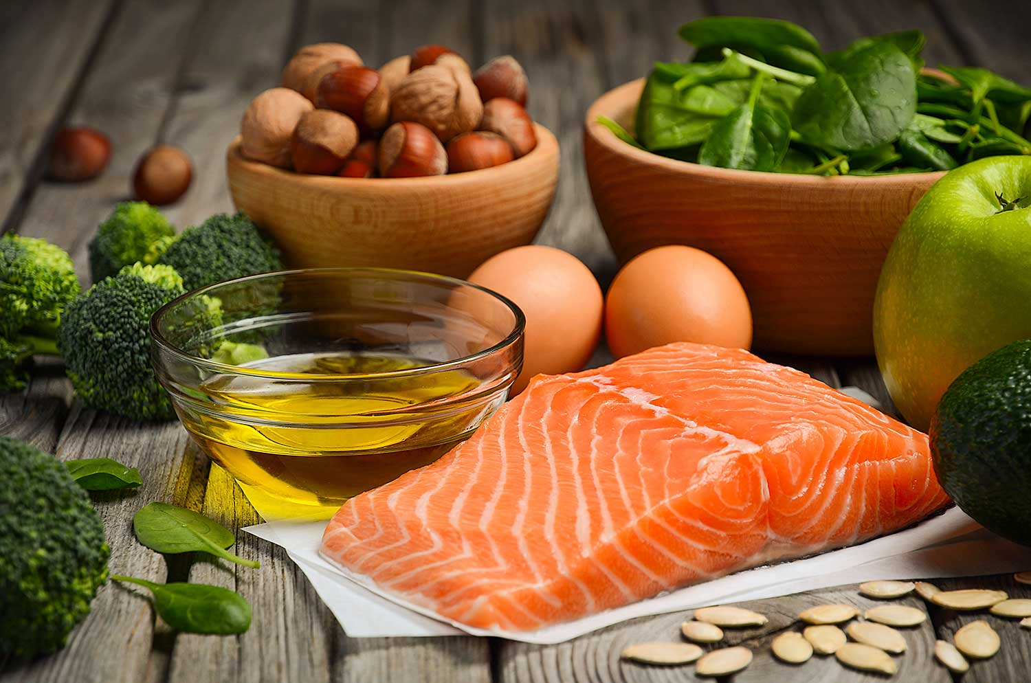
Revisiting Fats
Functions- concentrated source of energy 1g= 9kcals
making all body cells
keeping the body warm (adipose tissue)
protection of vital organs (kidneys)
providing fat soluble vitamins (A,D,E,K)
providing essential fatty acids
Sources- Visible: you can see fat layers on the outside of lamb and pork, or marbling within a steak. Butter on bread is another example.
Invisible: you can’t see it, because they have been used to make a product, e.g. crisps, biscuits, cakes, milk, egg yolks, mayonnaise.

Slide 5
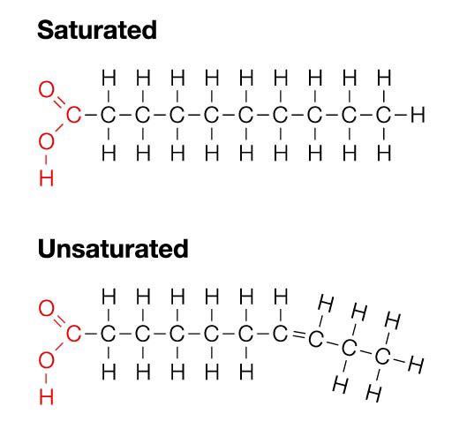
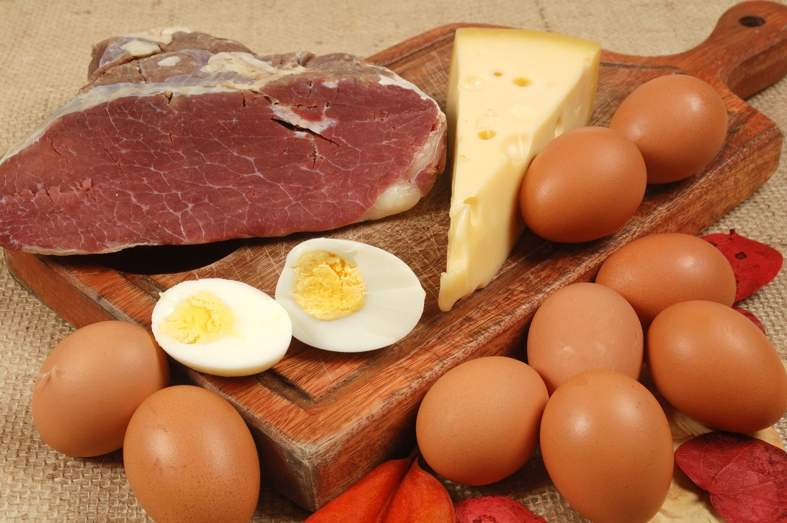
In depth look- Saturated Fats
Single bond between all carbon atoms in chain.
Solid at room temperature
Generally found in animal products
Linked to heart disease
Contain cholesterol
RDA 30g men, 20g women

Slide 6
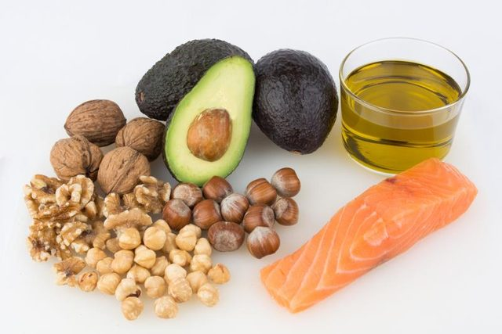
In depth look- Unsaturated fats
Double bond in carbon chain, means it’s flexible (PLASTICITY)
Liquids at room temperature
Found in- oily fish, nuts, seeds, sunflower and olive oils
May lower blood cholesterol levels, reduce risk of heart disease
Monounsaturated fatty acids- one double bond, avocados, cashews, peanuts
Polyunsaturated fatty acids- two or more double bonds- corn, soya, sunflower oils

Slide 7
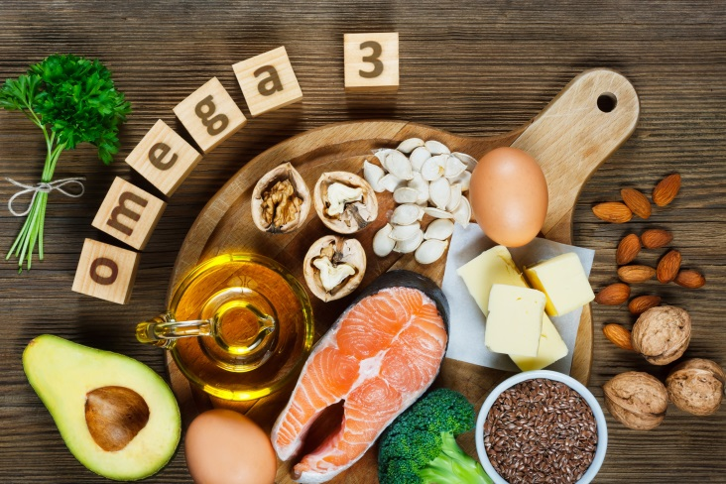
In depth look- Essential Fatty Acids
Omega 3 polyunsaturated fatty acid- oily fish, seeds and green leafy vegetables
Omega 6 found in vegetables, grains, seeds and chicken.
Needed for proper functioning of the brain, heart and development of nervous system.

Slide 8
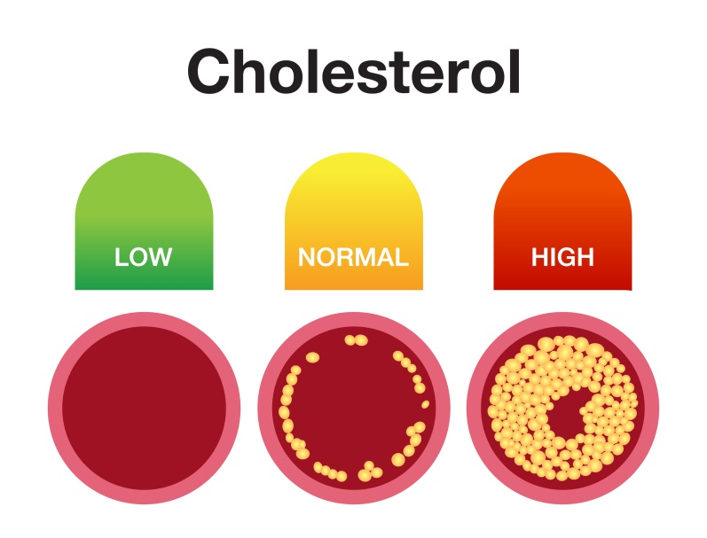
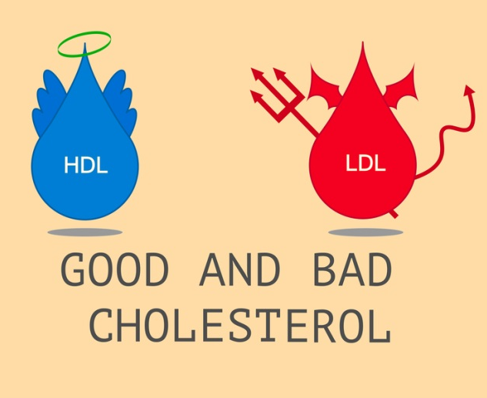
In depth look- Cholesterol
Fatty substance needed for normal functioning body
Essential part of cell membranes and helps digestion of fats.
Eating foods high in fat, means high cholesterol levels
Cholesterol is carried around the body by LIPOPROTEINS.
  Low Density Lipoprotein (LDL)- BAD cholesterol (it’s going DOOOOOOOOOWN)- builds up in arteries and causes heart disease
  High Density Lipoprotein (HDL)- GOOD cholesterol- protects against heart disease

Slide 9
Plenary- Exam question
Consider how excessive intakes of fats can affect the health of population.(4 marks)
Plan? What do you need to include?
P- Point
E- Evidence
E- Explain
L- Link

Slide 10
Mark Scheme
The answer includes a reference to:
Eating too much saturated fats/trans fats/total fat, and too little polyunsaturated fats/omega-3 fatty acids increases the risk of many conditions and diseases, such as (one from):
Obesity type 2 diabetes coronary heart disease heart attack stroke cancer
Eating adequate amounts of polyunsaturated fats/fats rich in omega-3 fatty acids, and low levels of saturated fats/trans fats/total fat may help to reduce the risk of(one from):
coronary heart disease heart attack stroke cancer and support proper functioning of the brain and nervous system.
(1 mark for identifying types of fat and their effect; 1 mark for each correctly linked disease or condition the risk of which they increase/lower; max. 4 marks)

