Slide 1



Lesson Entrance
- Straight to your seat and sit down in silence
- Get desk ready
- Write title and date
- Prepare for retrieval activity
Wednesday 20th November 2024
Do now - retrieval activity
Define BMR [1 mark]
Define PAL [1 mark]
Explain how BMR and PAL affect the total energy expenditure of an individual [1 mark]
Explain the dietary requirements of The Elderly [2 marks]
Notes:
Basal metabolic rate-The BMR refers to the amount of energy your body needs to maintain homeostasis (at rest)
Phyisical activity level- a way to express a person's daily physical activity as a number and is used to estimate their total energy expenditure.
BMR represents roughly 75% of daily energy expenditure. This can influence the energy an individual requires depending on their age, gender, body size and composition
Reduce salt- to prevent chd and more calcium for osteoposis

Slide 2
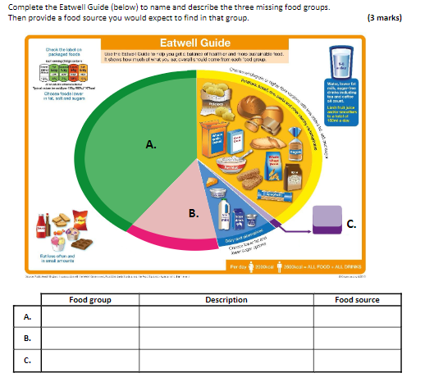
Starter:

Slide 3
Revision-
Nutritional needs and health
Learning Objectives:
Recall information about nutritional needs
Address any misconceptions
Apply knowledge to exam questions

Slide 4
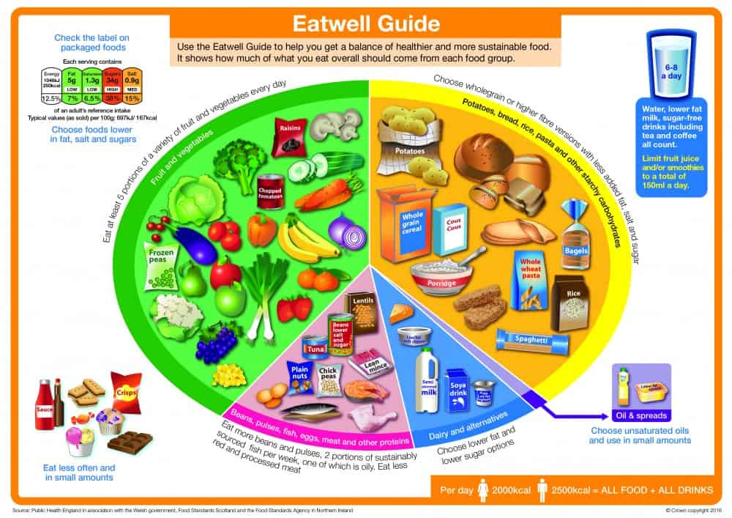
In depth look- Eatwell Guide
5 a day:
5-a-day is the number of portions of fruit and vegetables that should be eaten on a daily basis.
• 5-a-day includes eating 5 fruit and vegetables from the green segment of the Eatwell guide/as part of a balanced diet.
• provides vitamins, minerals and fibre.
• One portion is 80 g / a handful (30 g for dried fruit)
Public Health England produced the EWG to support the general public in making healthy diet choices
They produced 8 ‘healthy eating tips’:
  Base your meals on starchy foods
  Eat lots of fruit and vegetables (at least 5 portions a day)
  Eat more fish- at least one portion of oily fish a week
  Cut down on sugar and saturated fat
  Eat less salt (6g adults)
  Get active and be a healthy weight
  Don’t get thirsty
  Don’t skip breakfast

Slide 5
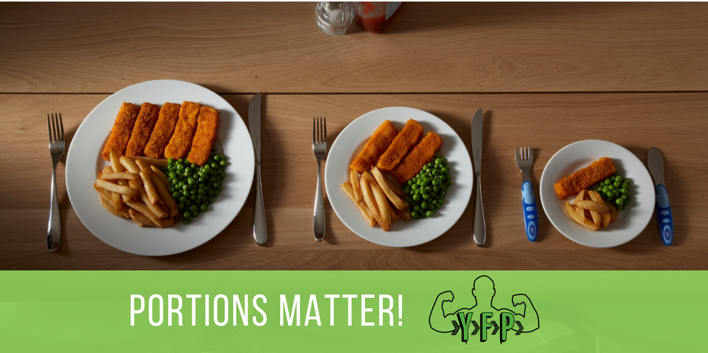
In depth look- Meal planning/portion size
Portion sizes
  Children should have smaller plates, to prevent over eating
  Teenagers need relatively large portions due to growth spurts and physical activity
  Elderly people are less active so don’t need to eat as much
Cost of food
  People should meal plan more to ensure that they are not wasting food
  Cost of food has gone up, so ensuring you’re getting more for your money and planning is important

Slide 6
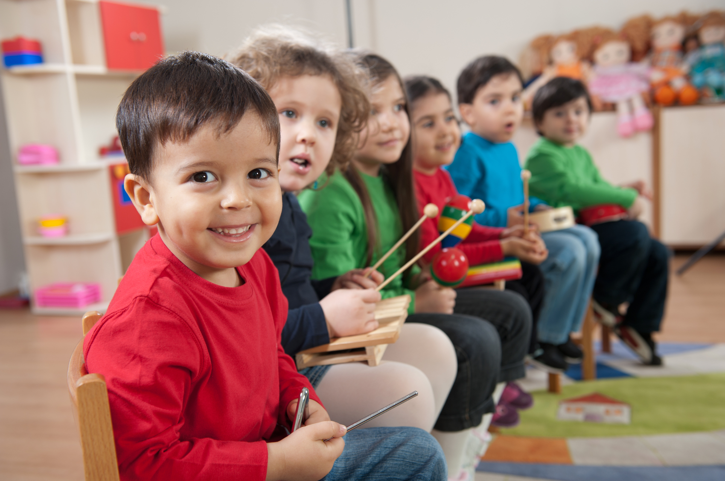
In depth look- Young children (1 to 4 years)
Children cannot eat lots of food due to small stomachs
To ensure they have enough energy throughout the day, they should have snacks and drinks
Should have whole milk available to ensure they have enough calcium
Regularly try new foods
Drink water with meals
Sit together as a family to eat, to instil healthy eating choices and routine
Fresh fruit and vegetables should be used as snacks rather than biscuits and similar items

Slide 7
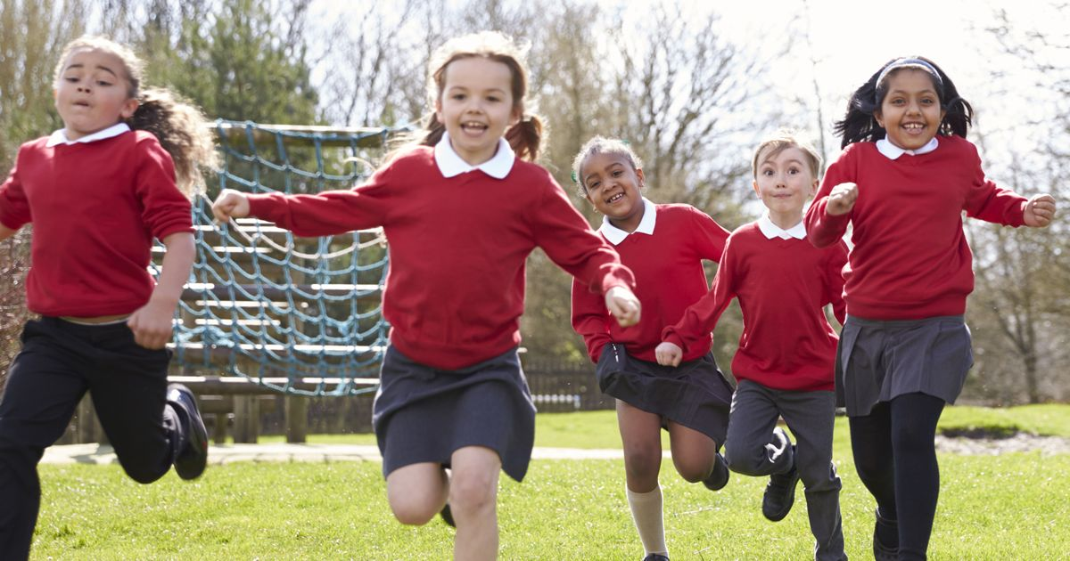
In depth look- School children (5 to 12 years)
Growing fast and physically active every day, therefore need an increase of calories in their diets
Should follow the EWG
Reduce the amount of sweet and sugar snacks
Encourage trying of new foods
Drinks such as diluted fruit juices should be consumed at meal times, due to amount of free sugars, tap water is preferred
Avoid junk foods

Slide 8
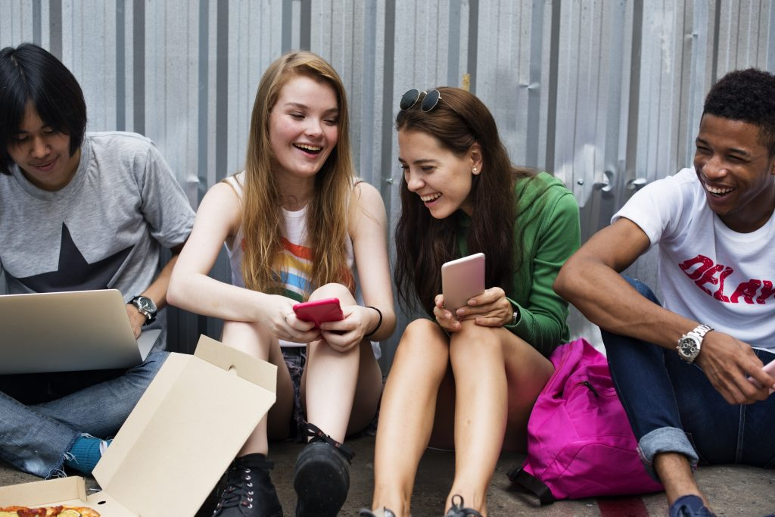
In depth look- Teenagers
Should have a balanced diet- avoid fixation on particular foods.
Protein is required due to growth
Teenage boys require more protein and calcium due to muscle growth
Teenage girls need more iron than boys due to menstruation
Need to have enough calcium and Vit D to ensure skeletons are developed appropriately
Follow EWG
Avoid processed foods and fizzy drinks
Main nutrients needed: protein, calcium, Vitamin D, Iron and Vitamin C (absorption), Vitamins A (boys- muscle mass), B vitamins (energy release),.

Slide 9


In depth look- Adults
Balanced diet, follow EWG
Calcium, Vitamin D, keep bones and teeth strong- prevent osteoporosis
Iron and Vitamin C- red blood cells healthy by making haemoglobin, prevent anaemia
In depth look- the Elderly (over 65)
Balanced diet, follow EWG
Avoid sugary, fatty foods due to being energy dense- less active
Ensure lots of anti-oxidants (prevents heart disease and some cancers)
Keep up Vit D and calcium to prevent osteoperosis
Eat more fibre- to ensure digestive system keeps working well (diverticulitis)
Need Vit C, to ensure body absorbs iron
High blood pressure common in elderly- reduce salt intake.

Slide 10
Physical activity level (PAL)
Celebration/occasion
Food availability
income
Lifestyles
Cost of food
Preferences
enjoyment
Healthy eating
Seasonality
Time of day
Time available to prepare and cook
Religion/beliefs
Factors effecting food choice
Notes:
Pal- the amount of energy they need per day, how active they are
The media- advertiments
Nutritionals needs- stages of life
Knowledge from home school…
State of health- allergy and intolerances
Desire to eat healthy from family….
Islam- no pork, Ramadan
Judaism- no animals with split hooves and that eat grass, no seafood
Ethical and moral beliefs- how food is produced (organic/fairtrade)- no animals (vegetarian)

Slide 11
Plenary- Exam question
Lisa wants to maintain a healthy body weight and stay fit.
i) What foods should she avoid? Give two examples. (1 mark).
ii)What foods should she eat in larger amounts? Give two examples.
(1 mark)
iii)What else can she do to keep her body fit? Give one example.
(1 mark)

Slide 12
Mark Scheme
i) Any two from: (1 mark for all correct, max. 1 mark)
sugary and savoury snacks fast foods sweets sweetened beverages
highly processed foods deep-fried foods
ii) Any two from: (1 mark for all correct, max. 1 mark)
fresh fruit and vegetables wholegrain bread brown rice wholegrain pasta Legumes
iii) Anyone from:(1 mark for any correct, max. 1 mark)
Be physically active(to increase the amount of energy used, and limit the amount of energy stored in the body).
Drink sufficient amounts of water(to increase the feeling of satiety, enable the dietary fibre from food to work properly, and prevent dehydration).

