Slide 1
Starter:
Explain why it is important to use a wide variety of ingredients when planning meals. [2 marks]
Give two ways in which a recipe may be adapted to make it healthier. [2 marks]
Explain why wholegrain cereals are better than refined cereals [1 mark]
Name three factors to consider about your target group when meal planning [3 marks]
Describe three different reasons you body needs energy [3 marks]

Slide 2
Revision-
Energy Requirements and Nutritional Analysis
Learning Objectives:
Recall information about nutritional needs
Address any misconceptions
Apply knowledge to exam questions

Slide 3
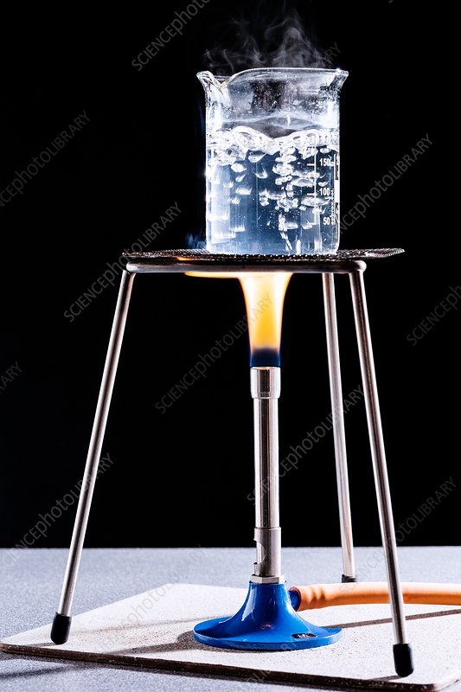
How is it measured?
Kilocalories (kcal) this is how most food is measured
Or
kilojoules (kj) this is used in some countries instead of kilocalories (1 kcal =4.2kj)
A kilocalorie is the amount of heat energy that is needed to raise the temperature of 1kg of pure water by 1⁰C
Energy and nutrients – CCEA - Video - GCSE Home Economics: Food and Nutrition (CCEA) - BBC Bitesize

Slide 4
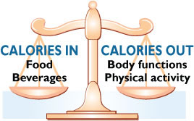
In depth look- Energy Needs
Energy is measured in kilocalories (kcal) or kilojoules (kj- science)
Definition: A kilocalorie is the amount of heat energy that is needed to raise the temperature of 1kg of pure water by 1⁰C.
1g of protein = 4.0 kcal
1g of carbohydrate = 3.75 (4) kcal
1g of fat = 9 kcal
Energy dense foods are those which contain a high number of calories per gram (e.g. biscuits, chocolate etc)
Low energy foods= food low in energy and high in water
Depending on your genetic make up and time of life, your energy needs will change

Slide 5

Kilocalorie requirements through the lifecycle
25-34yrs 2175
45-54yrs 2103
18yrs 2462
55-64yrs
1950
65-74+ yrs
1912
Pregnancy and breast feeding increases needs
10yrs
1936
4yrs - 1291
Female
Male
4yrs - 1386
65-74+ yrs
2432
10yrs
2032
45-54yrs 2581
55-64yrs
2500
18yrs 3155
25-34yrs 2749

Slide 6
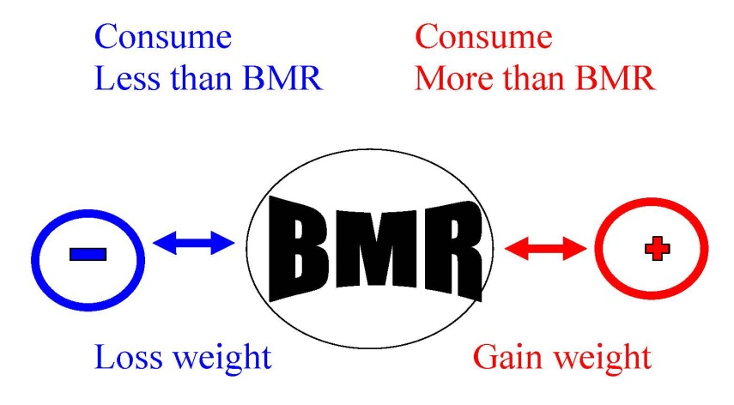
In depth look- BMR and PAL
Definition= BMR- Basal Metabolic Rate is how many kilocalories you need to just stay alive for 24 hours
Everyone has a different BMR- depends on various factors, to calculate, needs to be done in a lab, this is ONLY for complete rest
Definition= PAL- Physical Activity Level is a measurement of how active you are.
PAL= Total energy expenditure (over 24 hours)/ BMR (over 24 hours)
Recommended energy sources from nutrients in the UK
  Protein= 15% of total food energy from proteins
  Fat= No more than 35% of total food energy from fats- No more than 11% from saturated fats
  Carbohydrates= 50% of total food energy from carbs- 45% from fibre rich starchy carbs- 5% from free sugars

Slide 7
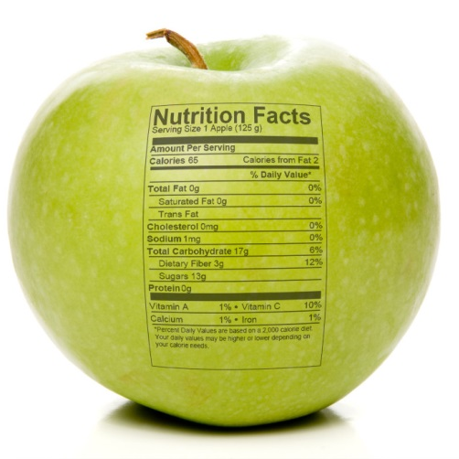
In depth look- Nutritional Analysis
Sometimes you will need to adapt a recipe to improve its nutritional values, and to meet the current healthy eating guidelines
  Sweet recipes can be reduced in sugar by 20% without many people noticing
  Fat can be swapped for unsaturated (butter for sunflower spread)
  Salt can be removed/ reduced, replaced with other flavourings
  Fibre can be increased by using wholegrain versions of foods
Meals should follow government guidance (Eatwell Guide) along with BMR and PAL.
How could you adapt a lasagne for a teenage girl who’s into gymnastics?

Slide 8
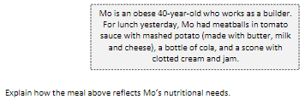
Plenary- Exam question
[6 marks]

Slide 9
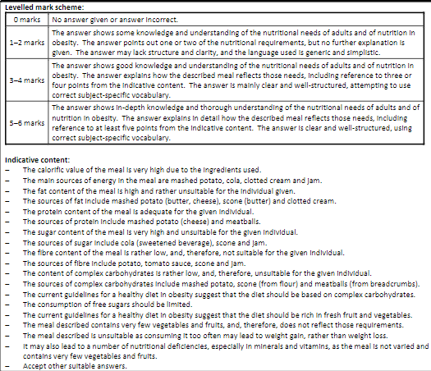
Mark Scheme

