Slide 1
Starter:
Obesity is a risk factor of developing many other diseases True/ False [1 mark]
Suggest two dietary recommendations for people with osteoporosis [2 marks]
Describe how a high intake of fats may affect cardiovascular health [2 marks]
Hypotension is a disease in which blood pressure is too low. True/ False [1 mark]
Explain the relationship between diet, nutrition and health [2 marks]

Slide 2
Revision-
Diet, Nutrition and Health
Learning Objectives:
Recall information about nutritional needs
Address any misconceptions
Apply knowledge to exam questions

Slide 3
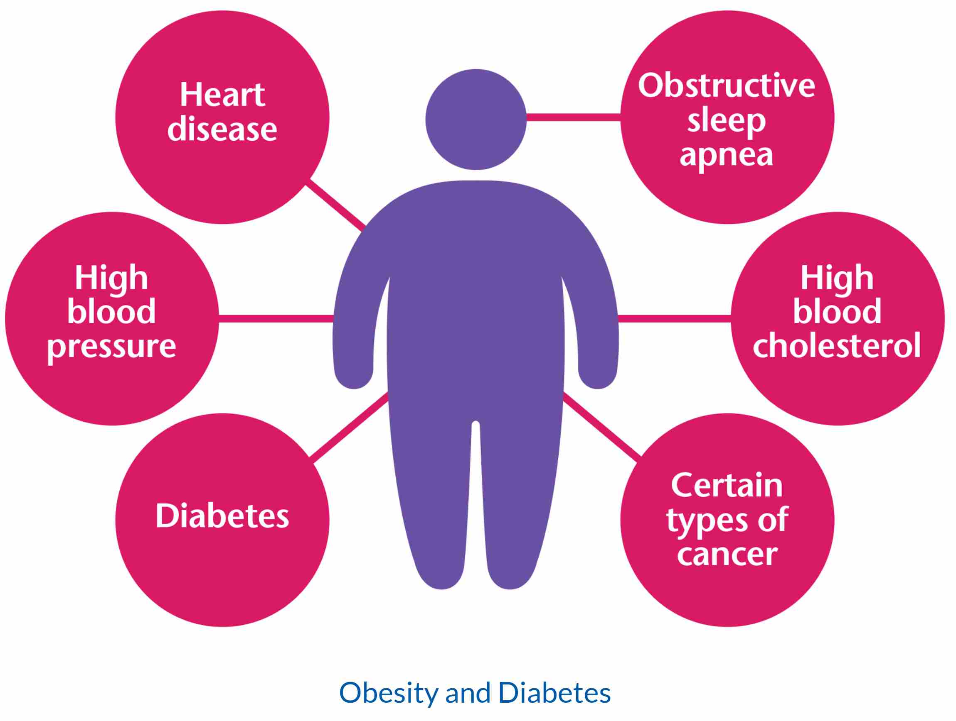
In depth look- Obesity
Obesity is defined as being very overweight, 1 in 4 adults and 1 in 5 children in the UK are classed as obese.
These levels are based on your BMI= Body Mass Index
  BMI= weight (in kilograms/kg) / height (in metres squared, m₂)
Health problems linked to obesity are: Type 2 diabetes, CHD, Stroke, some Cancers, Arthritis and Depression (these can be considered RISKS)
How to treat?
  Children should exercise 1 hr a day, adults 4 hrs a week
  Eating correct portions and not over eating

Slide 4
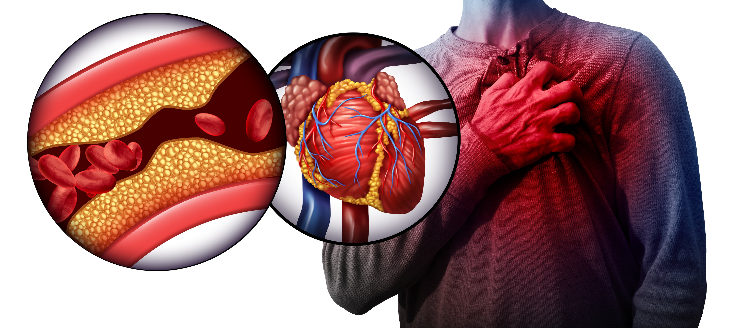
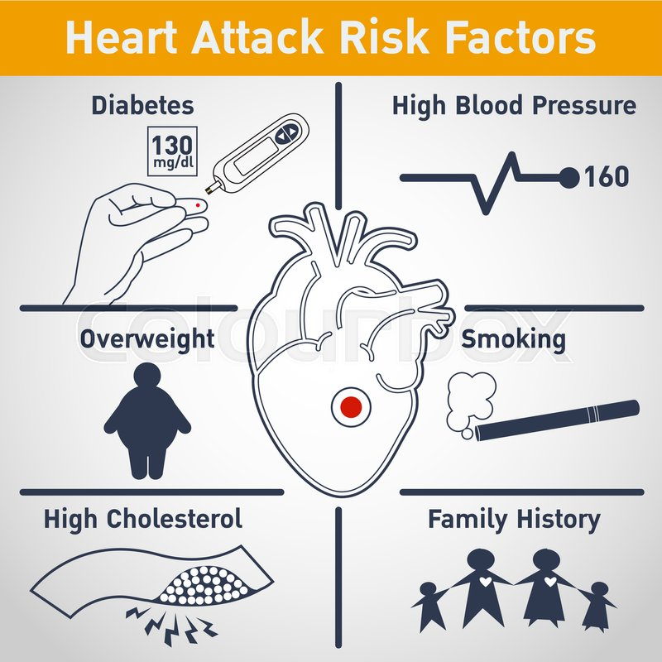
In depth look- Cardiovascular issues
Cardiovascular disease= Coronary Heart Disease (CHD) and stroke
If blood flow is reduced or stopped by a BLOOD CLOT or narrowing of BLOOD VESSELS damage can be caused to the body, this can lead to a HEART ATTACK. If this happens in the brain it can lead to STROKE.
CHD- blood vessels in heart get blocked with fatty deposits (plaque). Angina is when the blood flow is restricted, if cut off completely- heart attack.
Stroke- blood supply to brain cut off.
Risk factors= high blood pressure (hypotension), smoking, high cholesterol, diabetes, lack of exercise, obesity, genetics.

Slide 5
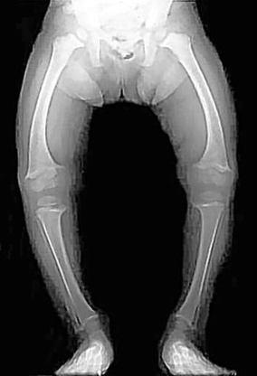
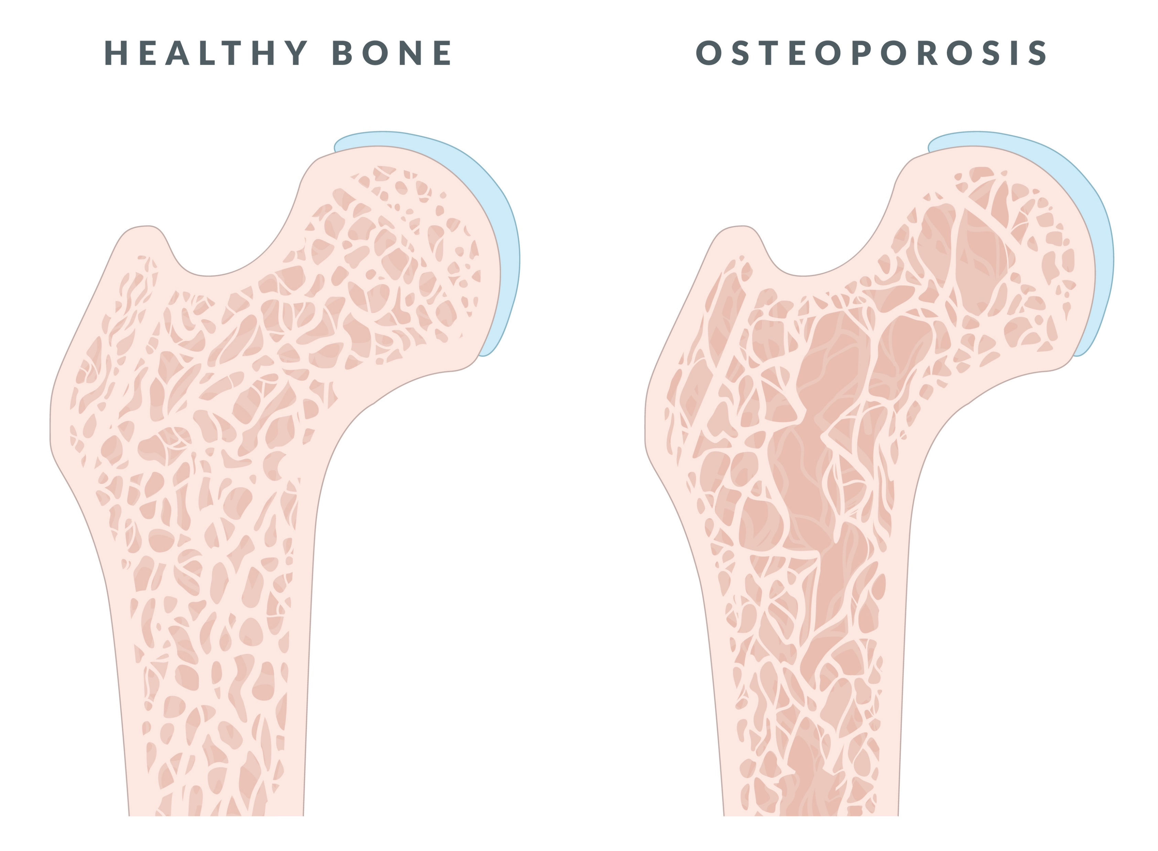
In depth look- Bone Health
Strength of bones depends on diet, exposure to sunlight and exercise.
Rickets= lack of Vitamin D and Calcium in diet. Leads to weak and soft bones (bow legs) Might be due to lack of exposure to sunlight (kids playing indoors more) Children aged 6m-5yrs can have vitamin drops.
Osteoporosis= Lack of Vit D and calcium from childhood to early adulthood More likely to break bones- weaker, more brittle Healthy diet include calcium and Vit D Most likely to effect women over 50+

Slide 6
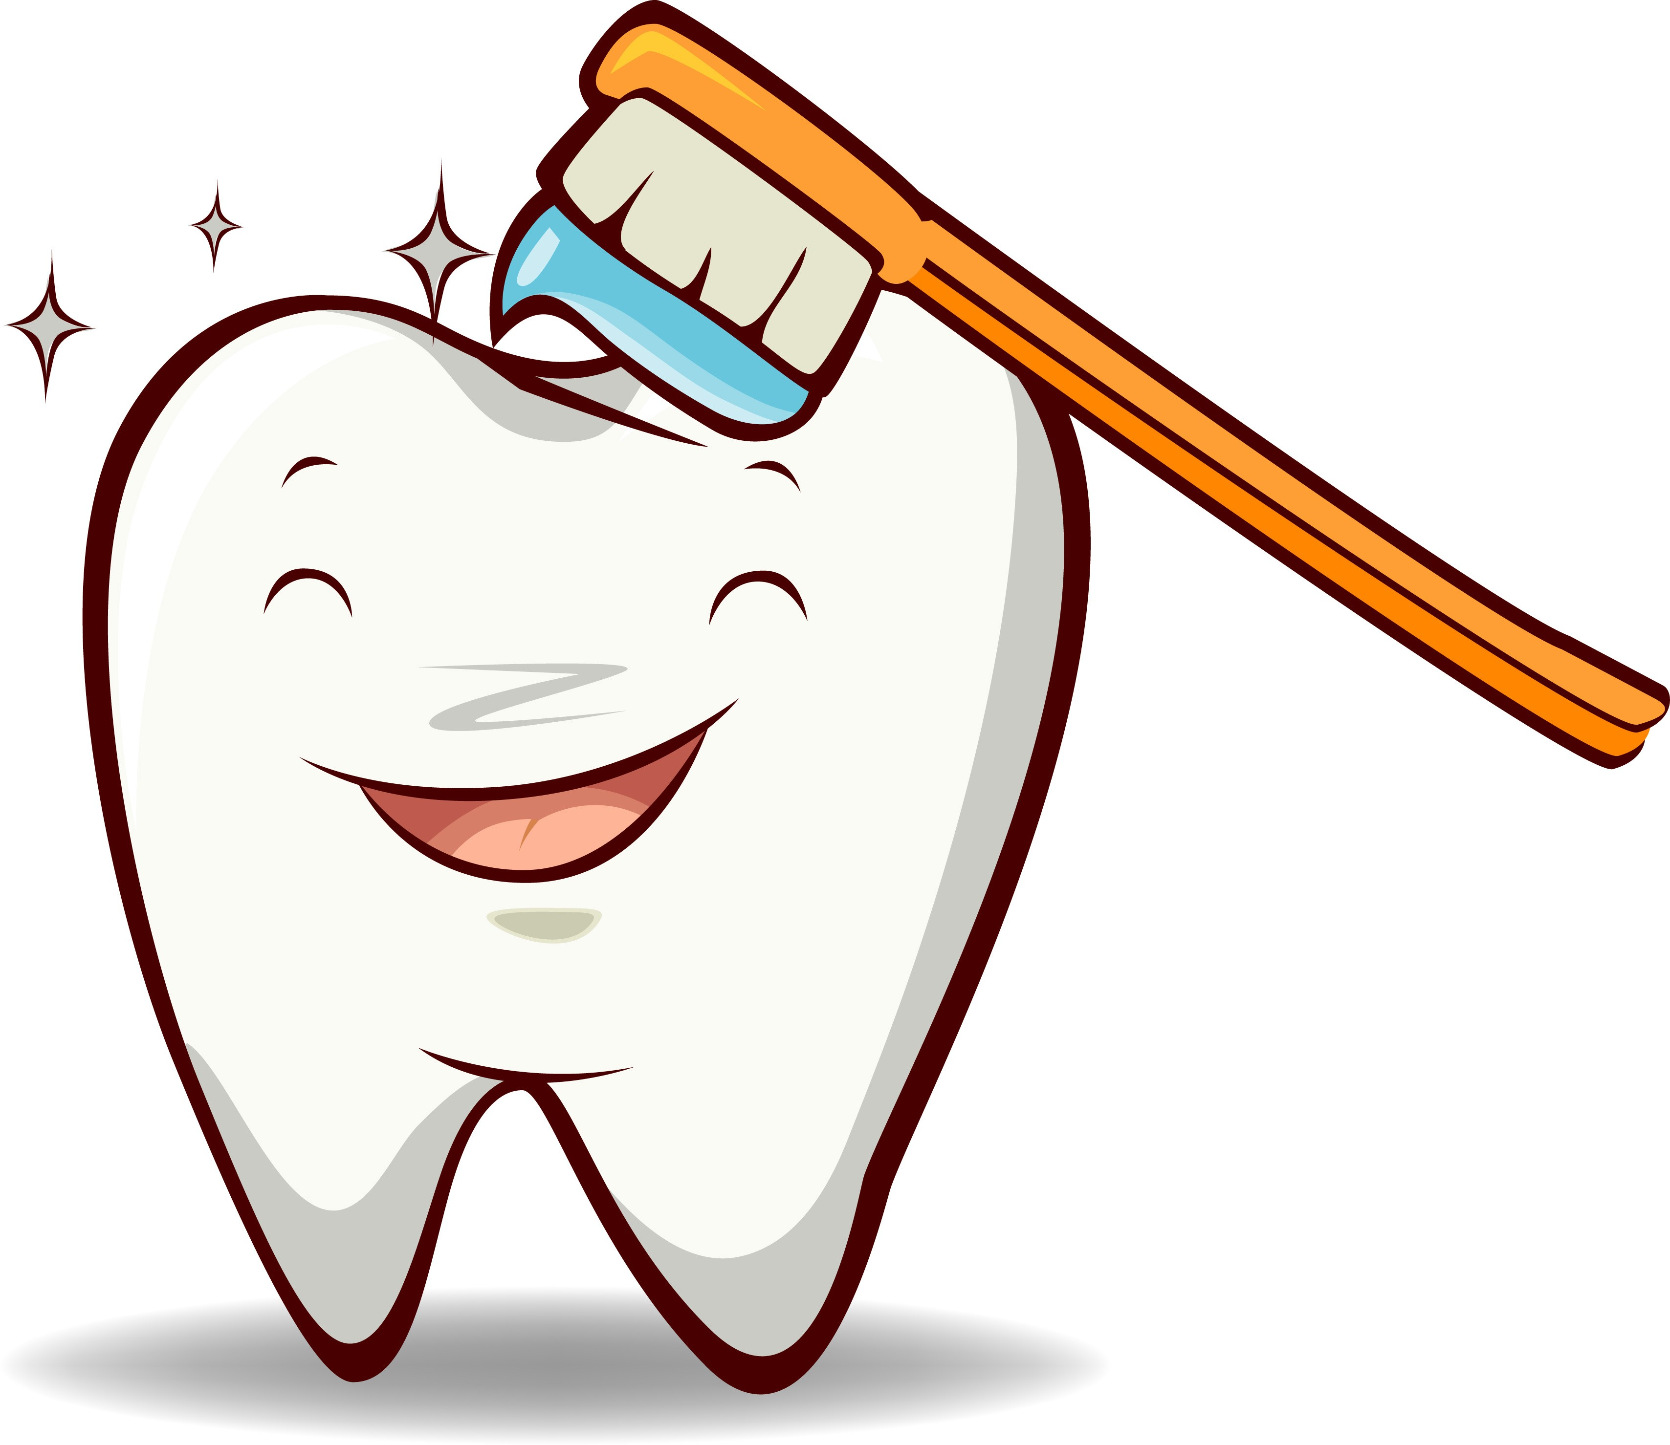
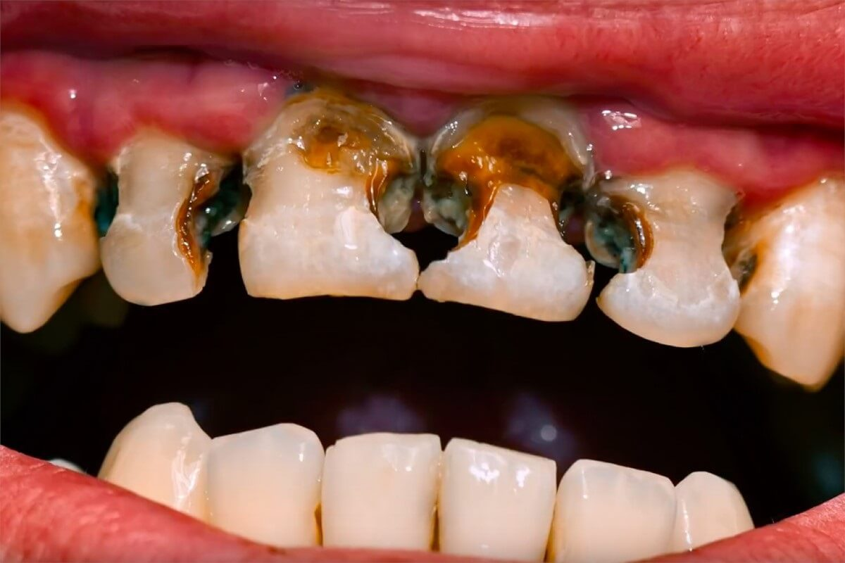
In depth look- Dental Health
Dental health is important, to keep your teeth and gums healthy.
Should have regular check ups with the dentist
Brushing should start from the first tooth being visible in babies.
Teeth should be cleaned twice daily for 2 mins a time. A FLUORIDE toothpaste should be used (why?)
Sugar
  Eating foods with high sugar content/ free sugars in can encourage tooth decay
  0-3 year olds should not have sugar in their diets
  RDA 30g a day 11+
  Tooth decay is when plaque forms on your teeth which contains bacteria- this interacts with food, producing acid which erodes teeth

Slide 7
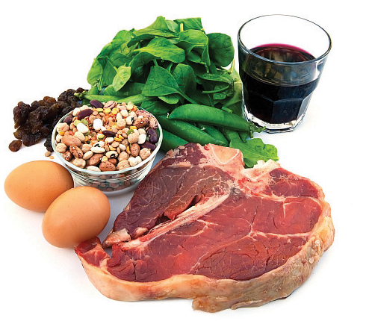
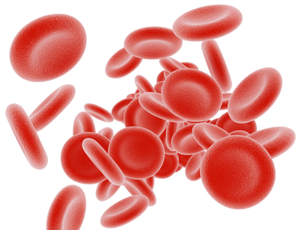

In depth look- Anaemia
Iron-deficiency anaemia
  Symptoms: a pale complexion, breathlessness, heart palpitations, tiredness, dizziness and fainting
  Cause: menstruation, pregnancy, not eating enough iron in diet
  Treatment: iron tablets, iron absorbed easily when combined with Vitamin C
Pernicious Anaemia (lack of B12 in diet)
  Cause: lack of B12 in diet, affects mainly vegans as they don’t have animal sources in diet
  Treatment: tablets or injections given

Slide 8
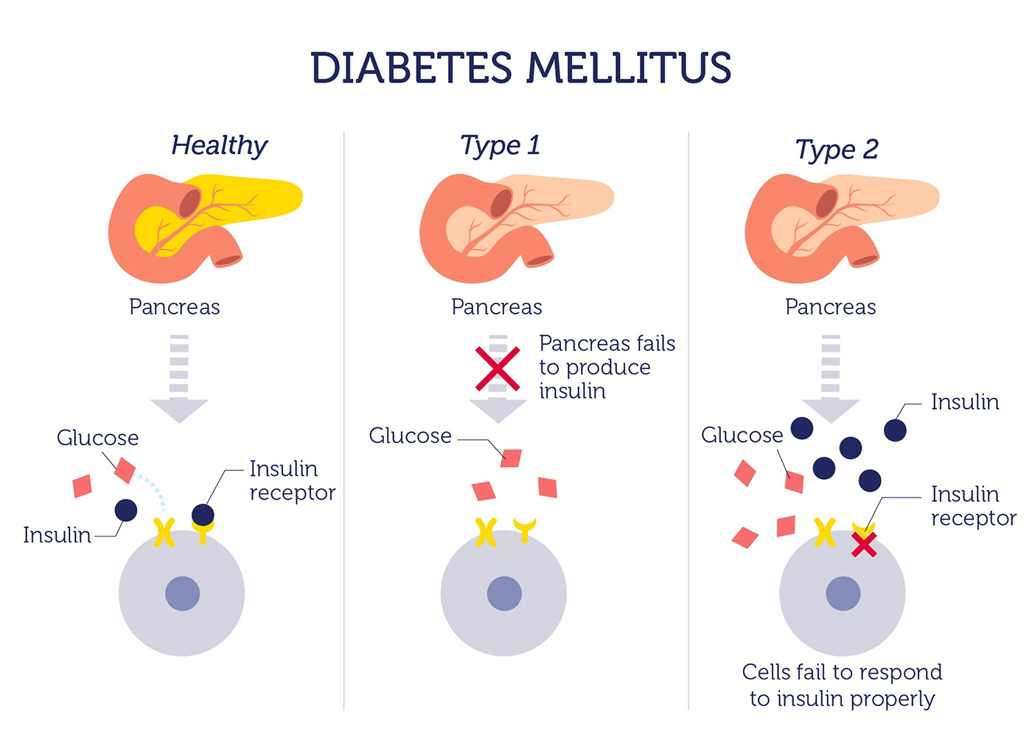
In depth look- Type 2 diabetes
Condition that affects the blood sugar levels in a person
Type 2 diabetes is the most common in the UK (usually controlled by the diet)
Likely to develop it (risk factors)- overweight, over 40, eat fatty/salty/sugary foods often, hypotension, lack of exercise.
Symptoms: tiredness, thirsty, peeing more
Treatment: food diary→ starchy carbohydrates (slow release energy)

Slide 9
Plenary- Exam question
Assess dietary needs of a teenage girl in order to prevent iron deficiency anaemia. [6 marks]
P-Point
E-Evidence
E- Explain
L-Link

Slide 10
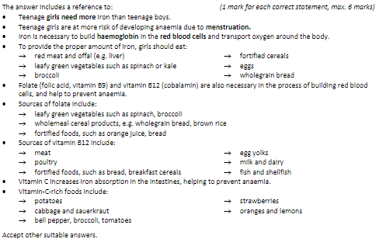
Mark Scheme

