Slide 1
Starter:
Definite protein denaturation [1 mark]
Define protein coagulation [1 mark]
Define syneresis and indicate when it takes place. [2 marks]
Describe how foams are formed [2 marks]
Explain why corn starch cannot be used instead of strong flour in bread production [2 marks]

Slide 2
Revision-
Food Science- Proteins
Learning Objectives:
Recall information about proteins
Address any misconceptions
Apply knowledge to exam questions

Slide 3
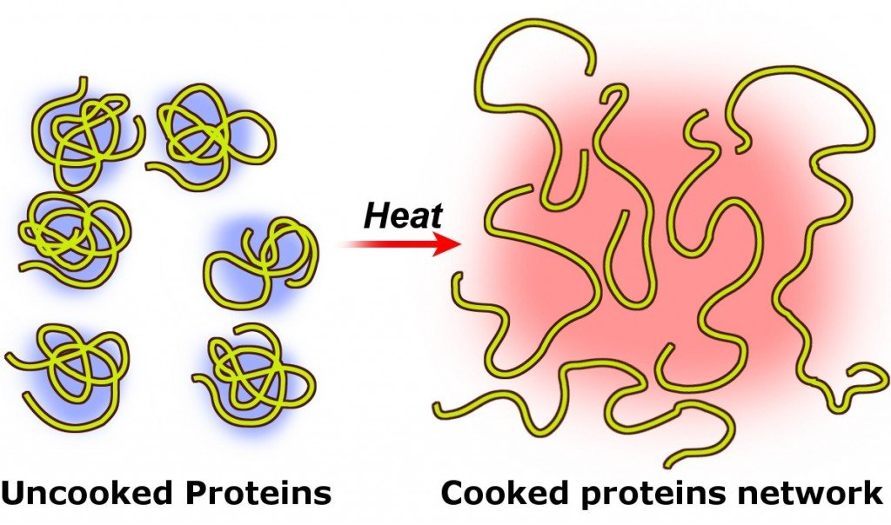
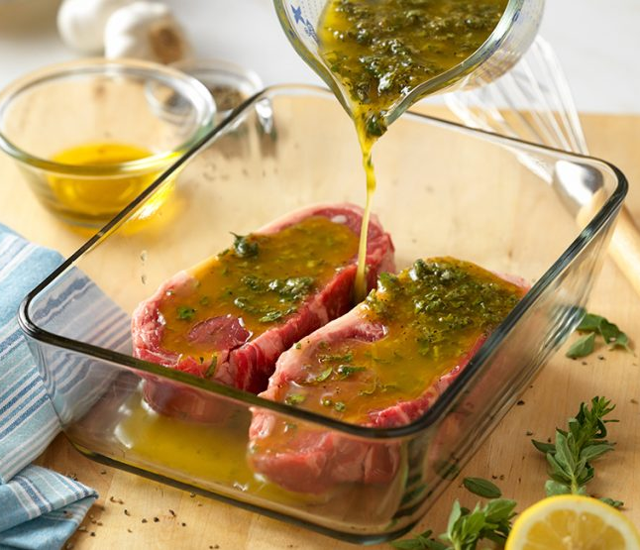
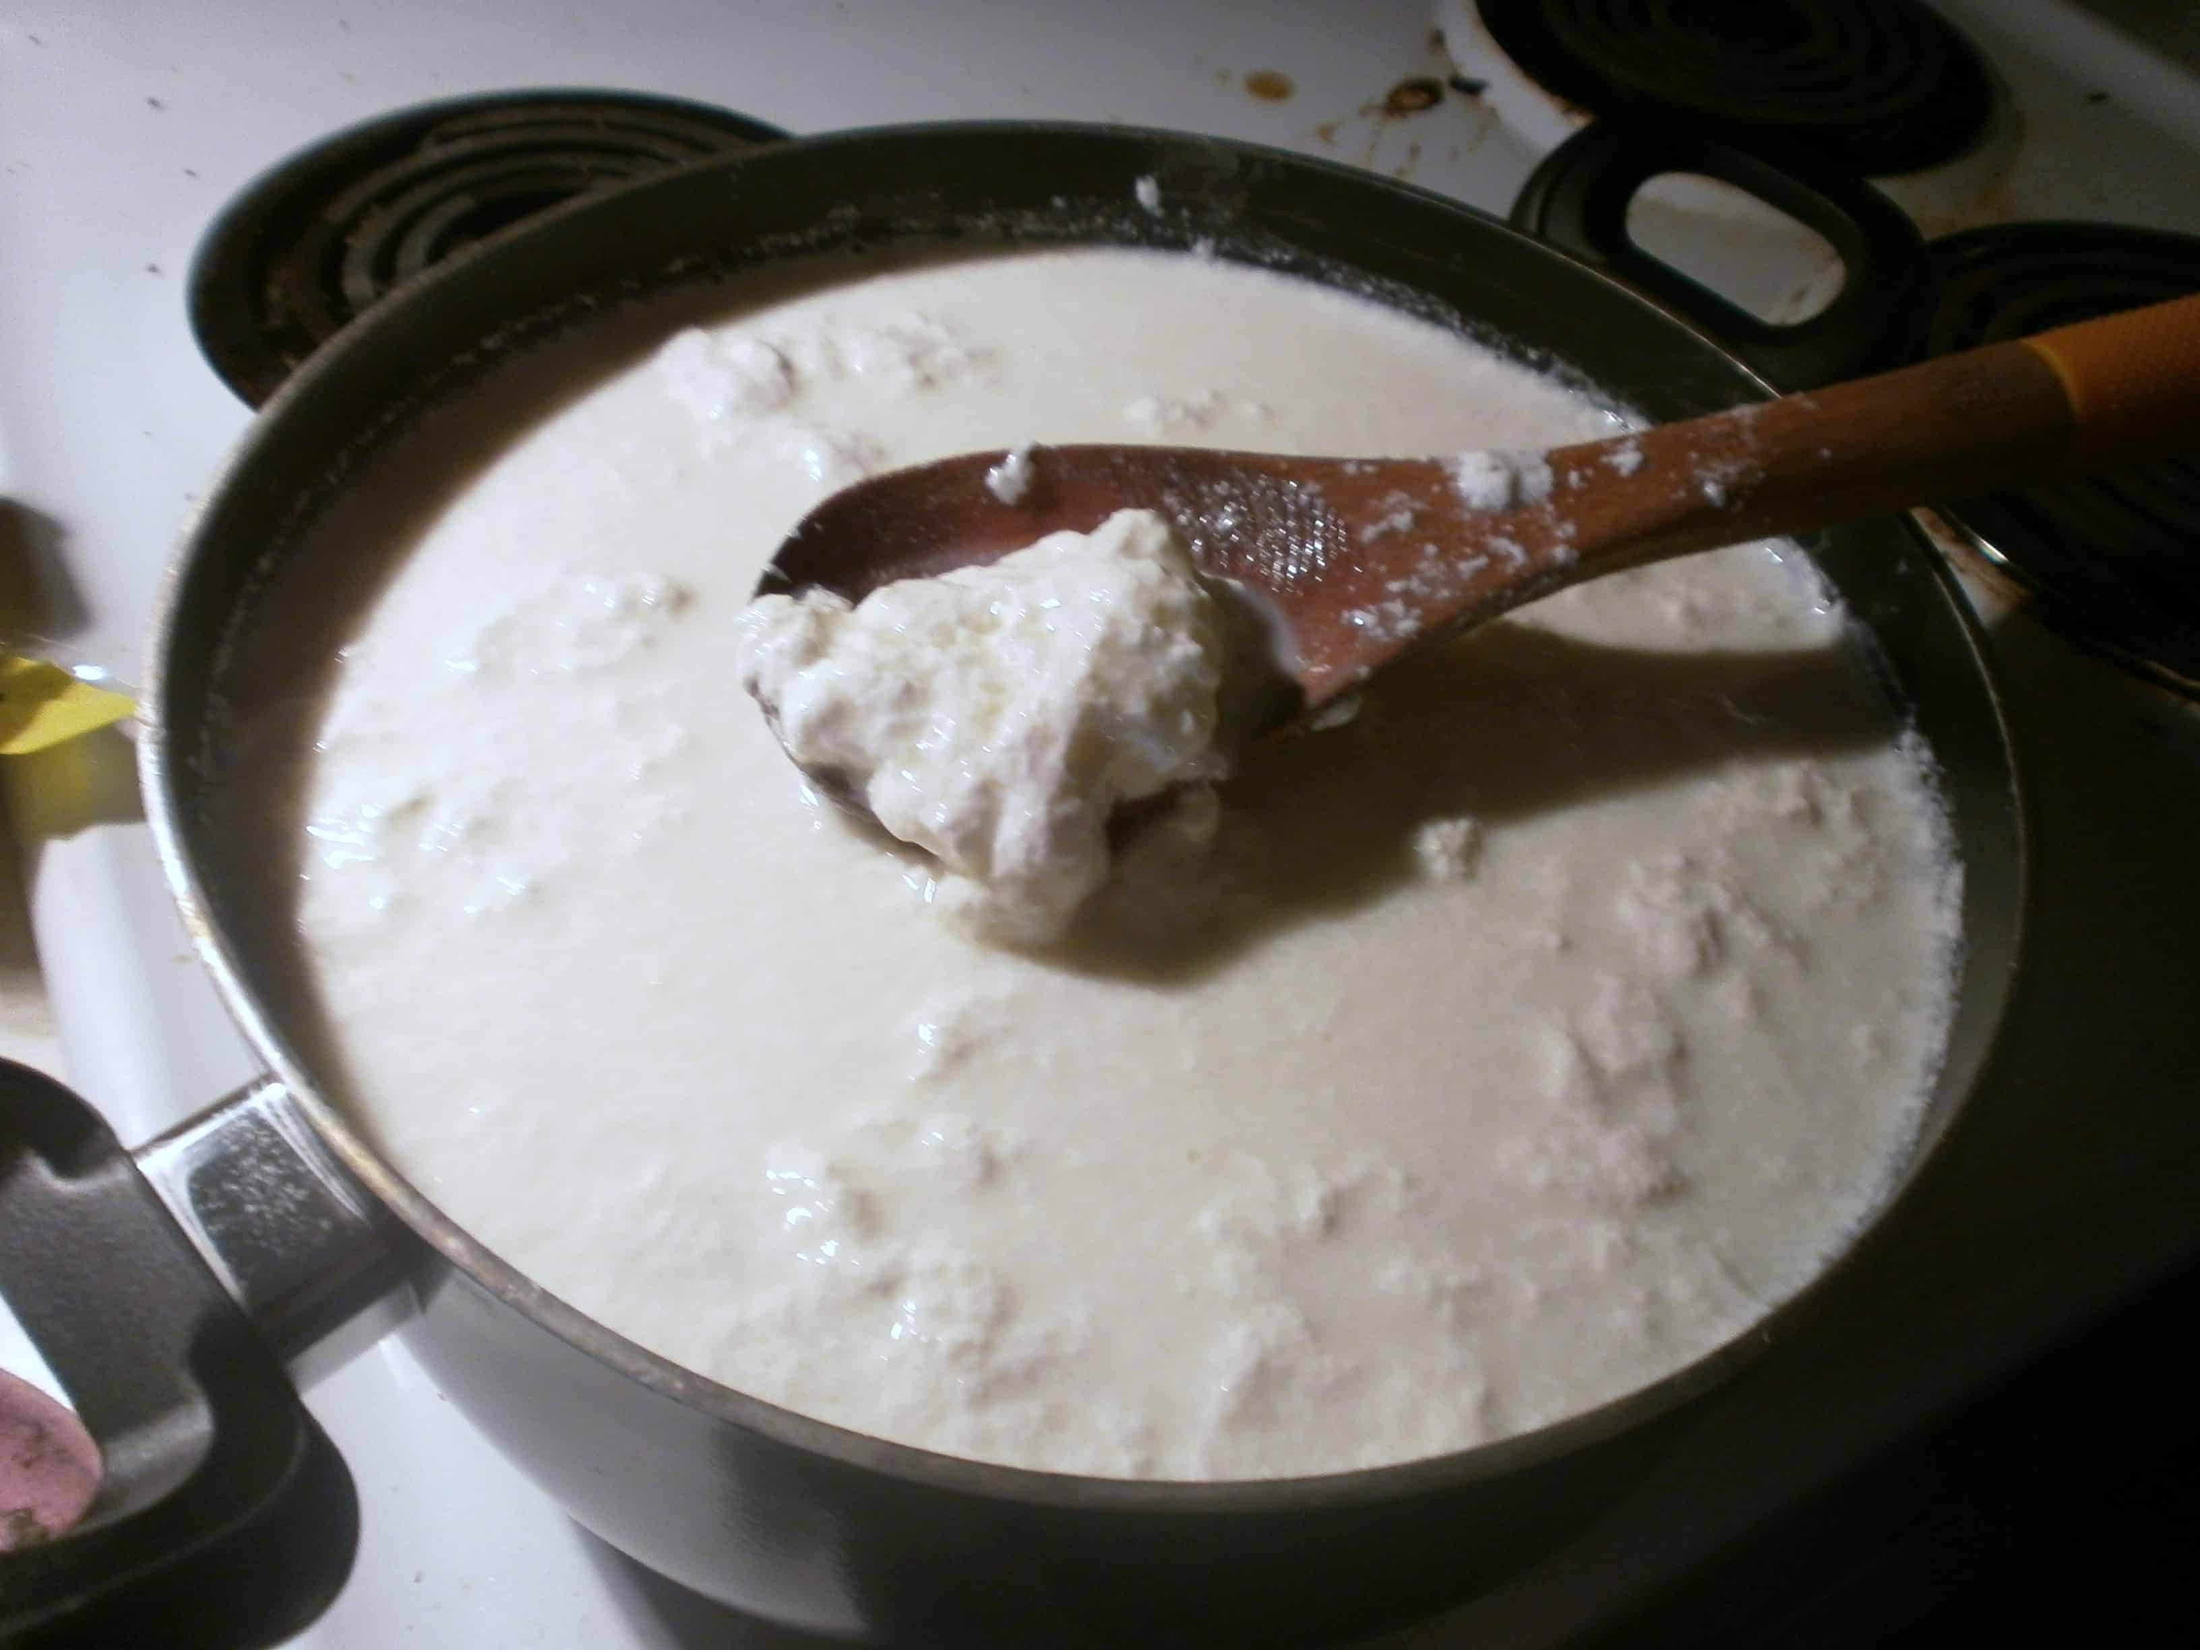
In depth look- Protein Denaturation
Definition= Denaturation is the change in structure of protein molecules. Long chains of coiled amino acids unravel and are then set in a new form (coagulation).
Proteins can be denatured by= Acids (marinating and curdling) Mechanical action (whisking egg whites) Heat (cooking a quiche)
Marinating→ highly seasoned liquid, tenderise tougher cuts of meat, acid allows meat fibres to breakdown= juicy and tender food
Curdling→ think back to making cheese, curds attracted to each other and become lumpy= curds pressed into cheese
Notes:
The physical act of beating causes the protein strands to stretch, thereby causing the protein to denature (the internal bonds are broken as a result of the application of physical force). So, rather than the protein chains being bound up into tight balls, they become long strands.

Slide 4
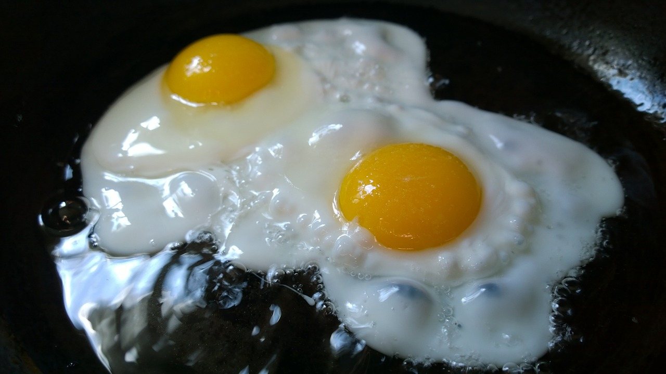
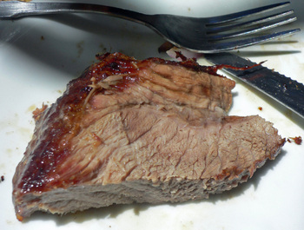
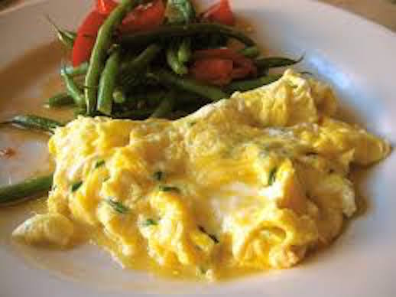
In depth look- Protein Coagulation
Definition= the setting of a protein bought about by heat and acids- this change is irreversible (can’t go back to original form)
If protein heated too much= hard, tough and difficult to digest (well done steak)
Definition- SYNERESIS= usually refers to eggs if overcooked- proteins shrink as they coagulate and separate from the watery liquid
Explain what effect heat has on the following foods-
  Meat and poultry, fish, eggs, wheat, milk, cheese

Slide 5
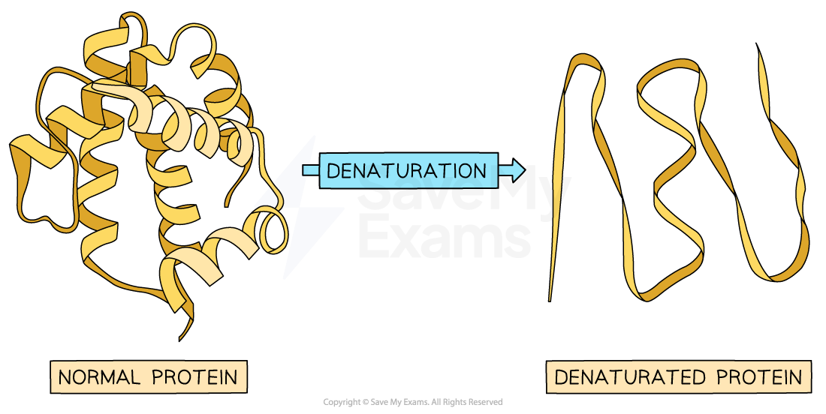
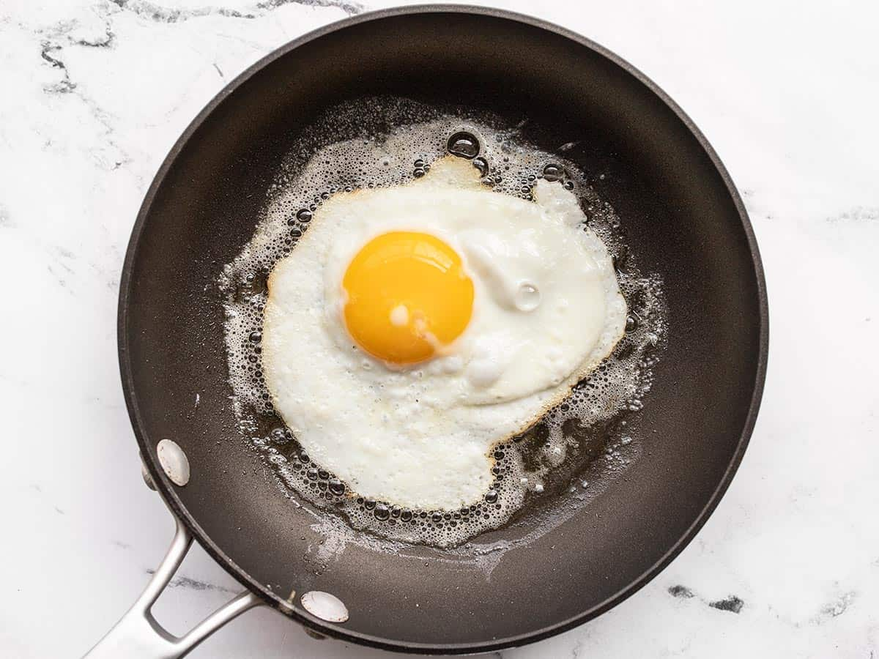
Notes:
n many situations, denaturation is reversible. Proteins can not regain their native structure until the denaturing agent is removed. However, there can be some situations when denaturation is irreversible like the exposure of proteins to extreme heat.

Slide 6
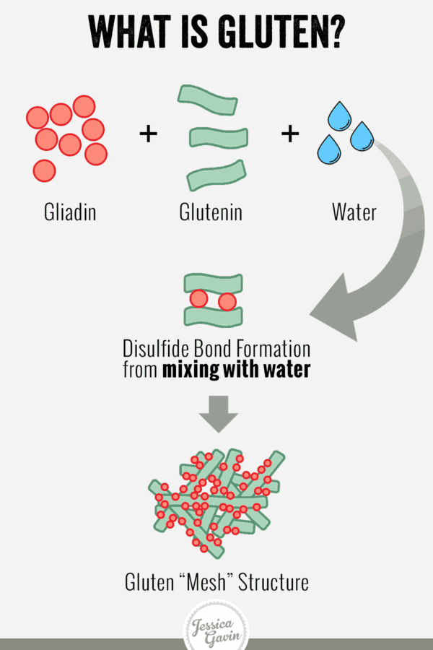
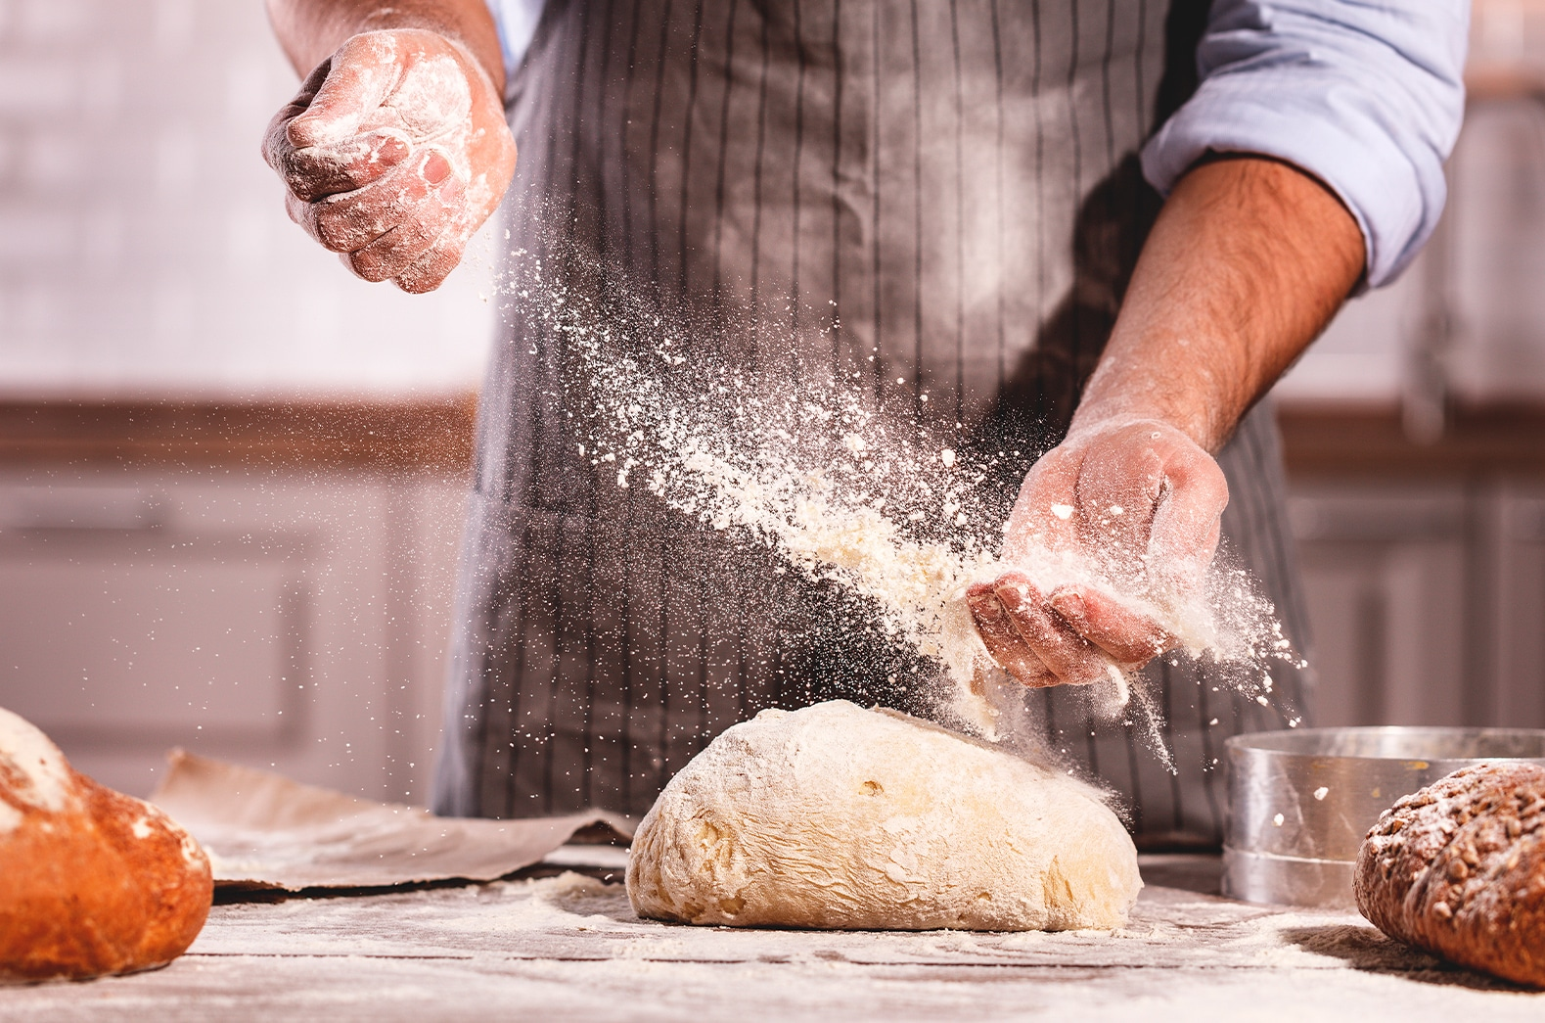
In depth look- Gluten formation
Gluten= gliadin + glutenin (two different protein)
Gliadin= sticky mass
Glutenin= gives strength and elasticity to dough
Water activates gluten→
  kneading builds up gluten (framework for bread)→
  yeast releases CO₂ (trapped by gluten)→
  gluten (protein) sets in oven= coagulation

Slide 7
In depth look- Foam formation
Definition= A foam is when a gas is spread throughout a liquid to produce a gas-in liquid foam.
E.g. Eggs→ Whisking (mechanical denaturing) allows tiny bubbles or air to be incorporated to the egg white (this is reversible as it can collapse)
When heat is applied it will coagulate and set (meringue)

Slide 8
Plenary- Exam question
Discuss why acids are used in meat marinades [4 marks]
Identify three gluten-containing cereals [3 marks]
Name one type of pastry which is made in a way that prevents gluten formation [1 marks]

Slide 9
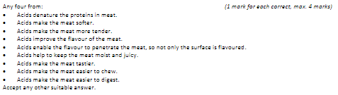
Mark Scheme

