Slide 1
Starter:
Saturated fats are liquids at room temperature. True/False. [1 mark]
Plasticity of fats means that all fats become oils at the same temperature. True/False [1 mark]
What does it mean that fat is immiscible? [1 mark]
Suggest two reasons for which fat is creamed with sugar (aerated) when making a sponge cake [2 marks]

Slide 2
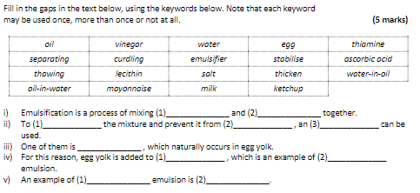
Starter- write out the following missing gap exercise

Slide 3
Revision-
Food Science- Fats and Oils
Learning Objectives:
Recall information about fats and oils
Address any misconceptions
Apply knowledge to exam questions

Slide 4
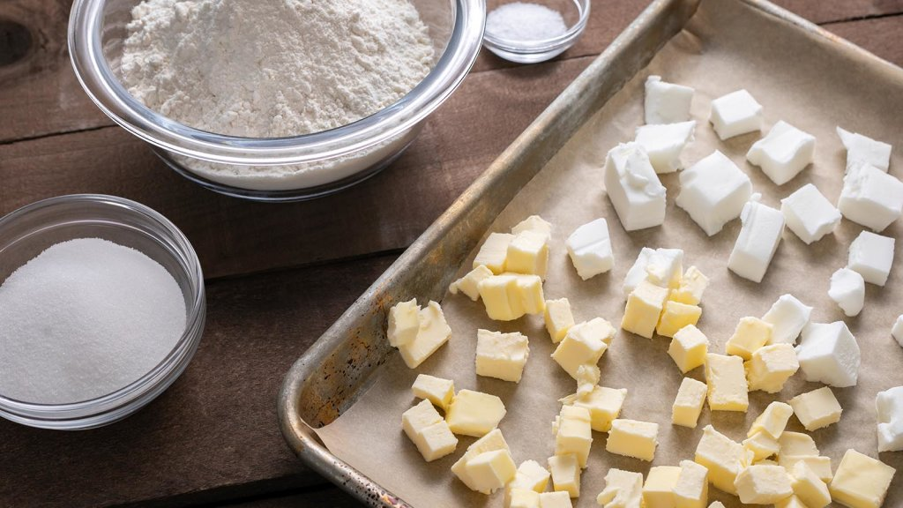
In depth look- Shortening
Definition- SHORTENING= is the process in which fat coats the flour particles, preventing absorption of water, resulting in a crumbly mixture.
Fat gives foods- such as biscuits and pastry a crumbly/flaky texture.
When fat and flour combine it does 3 things: gives flour a waterproof coating, prevents water being absorbed, reduces development of gluten.
If a quiche (made from shortcrust pastry) has shrunk in the oven and there was fat that had leaked on to the tray, what would you advise the person to do next time?

Slide 5
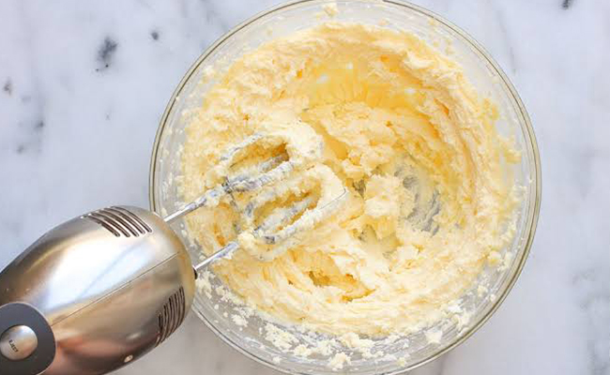
In depth look- Aeration
Aeration is when air has been trapped into a mixture.
When the fat and sugar are beaten together (creaming), they enclose tiny bubbles of air. The bubbles of air make a stable foam, which can be baked to give the springy texture in baked goods.
Caster sugar is used rather than granulated because it has a finer texture when creamed with fat and helps aeration.

Slide 6
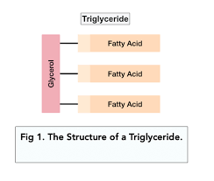
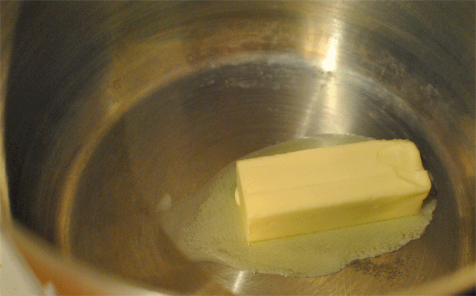
In depth look- Plasticity
Definition- PLASTICITY= is the ability of a solid fat to soften over a range of temperatures.
The plasticity of a fat can depend on whether it is saturated or unsaturated.
Saturated fats tend to have a good range of plasticity.
A fat chosen for shortening must have good plasticity as in needs to spread and coat a large area of flour, coating in a waterproof layer- oil will make the flour clump- creating a sandy textured product.
Fats can be processed to change their chemical structure to alter their melting point- straight from fridge spreads, chocolate.
Notes:
Fats are made up of triglycerides (three individual fatty acids bound together through their reaction with glycerol in a single large molecule). Triglycerides have different melting points, with some fatty acids staying solid for longer than other. This feature gives the fat its plasticity. Heating causes the triglycerides to break down into their component parts and decompose.

Slide 7
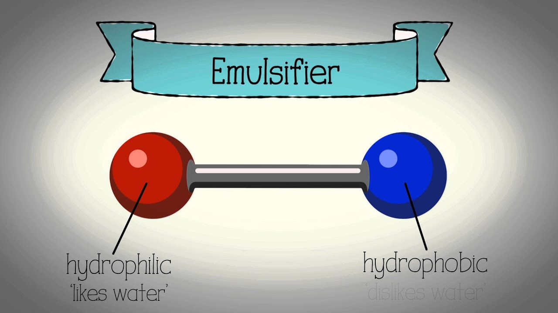
In depth look- Emulsification
Definition- Immiscible= two liquids that do not mix (oil and water)
An emulsion is a liquid where two liquids are suspended together . There are two types: an oil in water emulsion- milk/ salad dressing a water in oil- butter and fat spreads
How do emulsifiers work?
Examples: lecithin (soya and egg yolks)

Slide 8
Plenary- Exam question
Explain how the chemical structure of fats affects their physical state. (4 marks)
Describe the process of shortening. (4 marks)
Name one kind of pastry which uses shortening. (1 mark)
The cook prepared two kinds of pastry: one was made with plain flour and lard, and the other was made with plain flour and butter. State which one of the pastries will be crumblier and explain why.(2 marks)

Slide 9
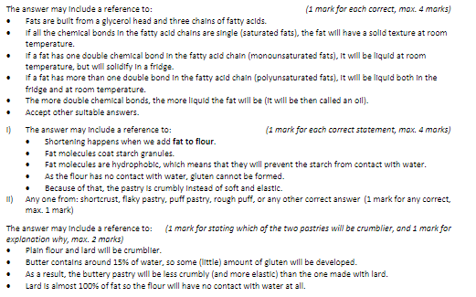
Mark Scheme

