Slide 1
Starter:
Identify two methods of controlling enzymatic action in foods [2 marks]
Define ‘high-risk’ food [1 mark]
Provide three examples of high-risk foods [3 marks]
Explain how bacteria work in the production of yoghurt [2 marks]
Identify one product, other than bread, which is made with the use of yeast. [1 mark]

Slide 2
Revision-
Food Safety-
Micro-oganisms
Learning Objectives:
Recall information about Food Safety
Address any misconceptions
Apply knowledge to exam questions

Slide 3
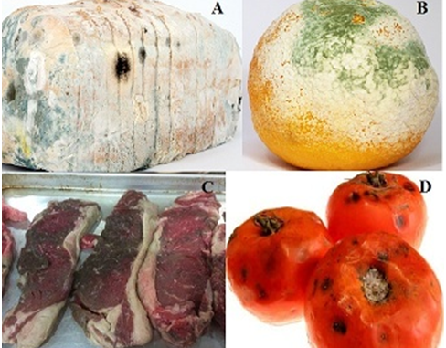
In depth look- Food Spoilage
Definition- Enzymic browning- is when enzymes in food react with oxygen in the air to cause the food to turn brown.
Yeast action- Yeast can grow both aerobic and anaerobically. They prefer acidic, sweet foods. Yeast FERMENTS sugars and produces alcohol and carbon dioxide.
Mould growth- Mould like moist and warm conditions, but can grow at low temperatures if given time. When mould grows on food, it extracts the nutrients- this is why you should throw it away.

Slide 4
In depth look- Micro-organisms in food
Yeast- Biological raising agent (in bread), ferments grapes and hops into wine and beer.
Moulds- Improve flavour and colour (cheese). Ripen surface of sausages (salami)- extends shelf life. Soy sauce – ferments to make MSG.
Bacteria- cheese and yoghurt (lacto bacillius- turns lactose into lactic acid). Lactic acid DENATURES and COAGULATES protein in milk= thickened.

Slide 5
Plenary- Exam question
Identify one sign of spoilage caused by:
Enzymatic action
Mould growth
Yeast action [3 marks]
Explain why yeast is useful in the production of bread. [4 marks]

Slide 6
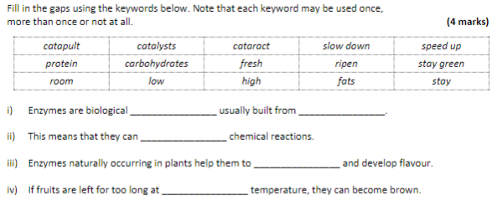
Plenary- Exam question

Slide 7



Mark Scheme

