Slide 1
Starter:
What type of bacterium is responsible for the most cases of food poisoning in the UK? [1 mark]
Staphylococcus aureus is only found in faeces. True/False. [1 mark]
Listeria is often found in soil and, therefore, eating raw vegetables might increase the risk of food poisoning. True/False. [1 mark]
Definite the term cross- contamination. [1 mark]
List three symptoms of food poisoning. [3 marks]
Notes:
Campylobacter is the most common cause of food poisoning in the UK. Although thorough cooking kills campylobacter, it is not just poorly cooked poultry such as chicken and turkey that can spread it. Splashing water from washing the meat can spread it as well.
False in the nose and skin
Vegetables can become contaminated from the soil or from manure used as fertilizer. While Listeria is killed by pasteurization and cooking, pregnant people and at-risk consumers can reduce their risk for listeriosis by eating only raw vegetables that are thoroughly washed.

Slide 2
Revision-
Food Safety-
Bacterial Contamination
Learning Objectives:
Recall information about Bacterial Contamination
Address any misconceptions
Apply knowledge to exam questions

Slide 3
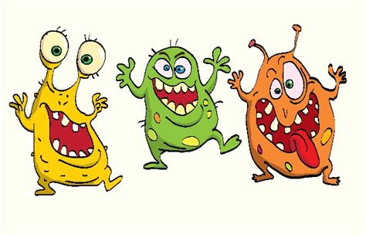
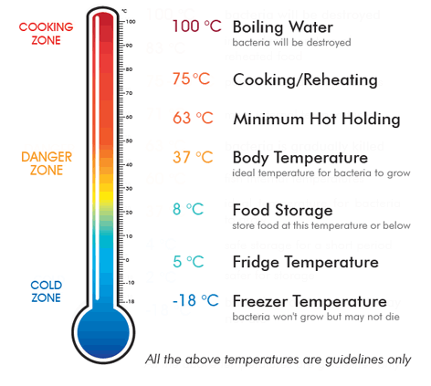
Bacterial growth

Slide 4
In depth look- preparing food
Preparing
Avoid cross contamination – chopping boards should be coloured coded so that raw meat is never cut on the same board as fruit and vegetables. Utensils should be washed after being in contact with raw meat to avoid cross-contamination.
Wash fruit and vegetables – all fruit and vegetables (especially root vegetables that may have excess soil) should be thoroughly washed to prevent the risk of spreading harmful bacteria such as E. coli.
Take care when defrosting foods – ideally, plan ahead and leave enough time to defrost food. Safe thawing should be done in small amounts in the fridge. Ensure meat and poultry are defrosted on the bottom shelf. If meat is thawed in the microwave, cook it immediately. Foods should be thoroughly defrosted before being cooked.
Keep work surfaces clean – it is important for food safety that all worktops are kept clean and free of bacteria. Use a clean cloth and anti-bacterial sprays. Ensure any surfaces are wiped clear of cleaning residue before preparing food.

Slide 5
In depth look- cooking and serving food
Cooking
Temperature control when cooking food – all foods should be cooked for the correct amount of time and temperature. A food thermometer is the only safe way to check the core temperature of a food to ensure safety - especially when cooking meat, poultry and seafood. The core temperature of a food should reach 75°C instantaneously. The equivalent – for example 70°C for two minutes – is acceptable.
Follow label instructions – when cooking food it is important to follow the cooking instructions displayed on the label. This is especially important for foods cooked in the microwave as stirring and standing times are vital to ensure the core of the food has reached the required temperature.
Serving and reheating
Serving cooked foods – when a food is cooked it must be kept at 63°C and covered until it is ready to eat.
Reheating foods – When reheating a food, it should reach a core temperature of 70°C for two minutes. A food should not be reheated more than once. HIGH RISK FOODS should be reheated once and until piping hot.
Notes:
High risk food- high in moisture and high in protein

Slide 6
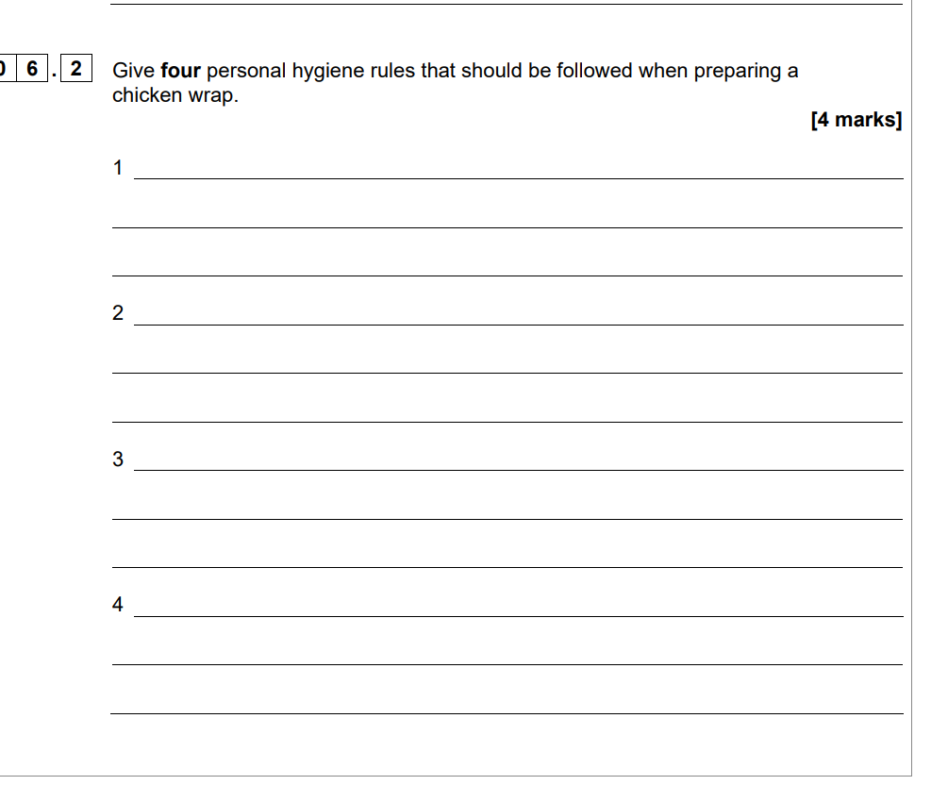

Slide 7
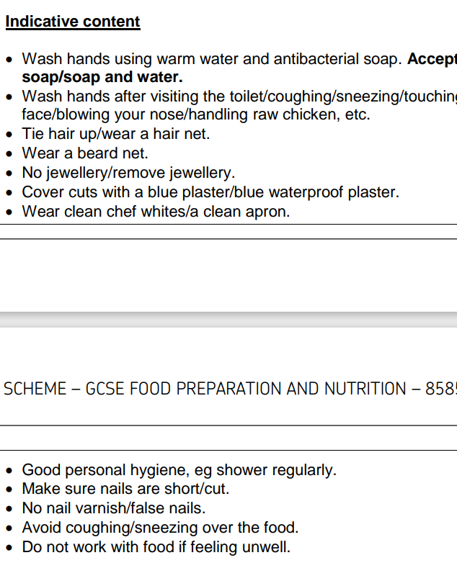

Slide 8
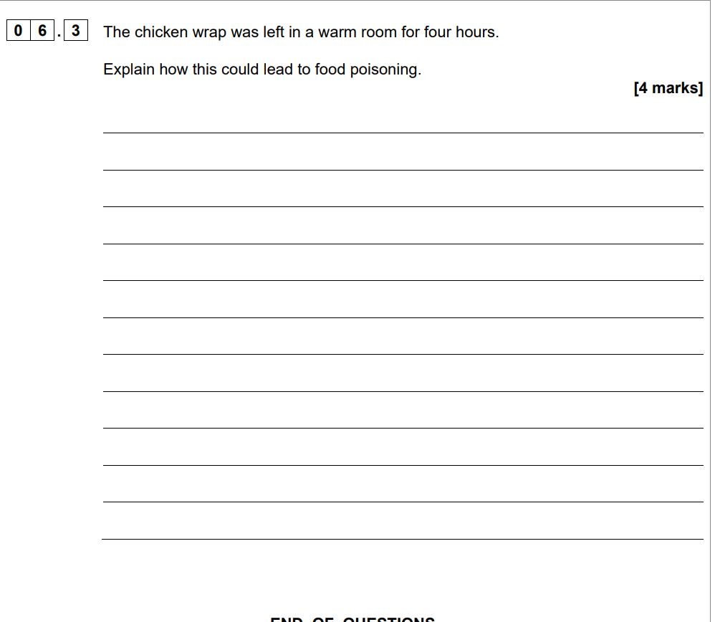

Slide 9
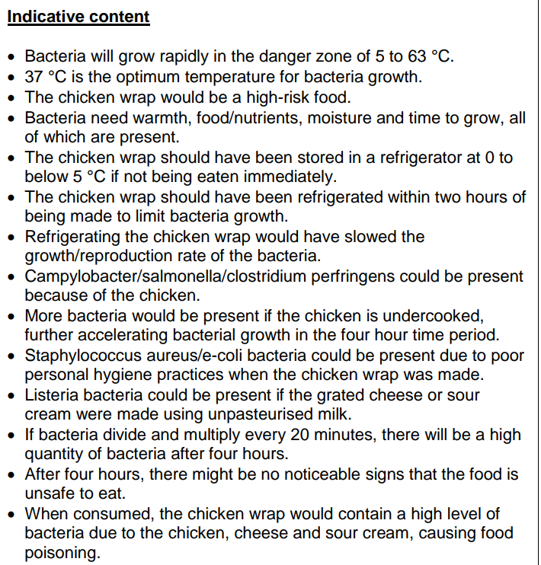

Slide 10
In depth look- Sources
Raw food contamination- many different types of bacteria lives in the intestine of animals. When an animal is slaughtered, bacteria can get onto the meat. Raw eggs may have bacteria on the inside and outside of their shells, as well as shellfish.

Slide 11
In depth look- Micro-organisms in food
Yeast- Biological raising agent (in bread), ferments grapes and hops into wine and beer.
Moulds- Improve flavour and colour (cheese). Ripen surface of sausages (salami)- extends shelf life. Soy sauce – ferments to make MSG.
Bacteria- cheese and yoghurt (lacto bacillius- turns lactose into lactic acid). Lactic acid DENATURES and COAGULATES protein in milk= thickened.

Slide 12
Plenary- Exam question
Identify one sign of spoilage caused by:
Enzymatic action
Mould growth
Yeast action [3 marks]
Explain why yeast is useful in the production of bread. [4 marks]

Slide 13
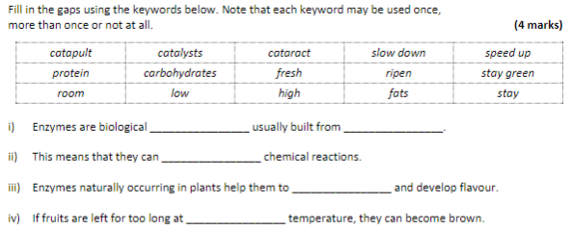
Plenary- Exam question

Slide 14



Mark Scheme

