Slide 1
Year 11 mock revision
2024

Slide 2



Lesson Entrance
- Straight to your seat and sit down in silence
- Get desk ready
- Write title and date
- Prepare for retrieval activity
Do now - retrieval activity
In your book write the number 1-11
Can you identify the tools using the correct terminology?

Slide 3
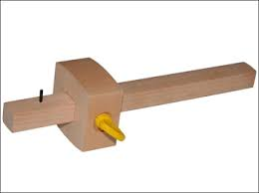


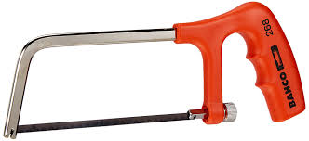
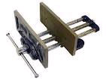
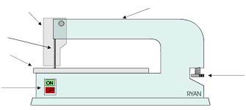
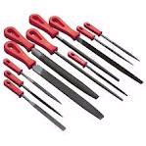

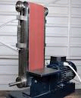


Can you list the tools?
9
1
3
5
7
10
2
4
6
8
11

Slide 4
Lesson Entrance
- Straight to your seat and sit down in silence
- Get desk ready
- Write title and date
- Prepare for retrieval activity
Do now - retrieval activity
What is the definition of these key terms?
Specifications
Ergonomics
Anthropometrics

Slide 5
Batch production- making a certain number of products
Scales of production
Pg 47-48
One off production- making one product at a time
Continuous production- non-stop
Just in time production
Mass production- making loads of the same product

Slide 6
Planned obsolescence | Fossil fuels | Composite materials | Smart materials
Fair trade | Global warming | Jigs/moulds/templates | Ergonomics
Rotary | Linear | Reciprocating | Oscillating
Prototypes | Modelling | Health and safety | Natural timbers
Aesthetics | User centre design | Manufactured board | Polymers
Anthropometrics | Crowd funding | Market pull | Technology push

Slide 7
Planned obsolescence | Fossil fuels | Composite materials | Smart materials
Fair trade | Global warming | Jigs/moulds/templates | Ergonomics
Rotary | Linear | Reciprocating | Oscillating
Prototypes | Modelling | Health and safety | Natural timbers
Aesthetics | User centre design | Manufactured board | Polymers
Anthropometrics | Crowd funding | Market pull | Technology push

Slide 8
Exam layout
The first section of the exam is multiple choice- this will test all areas of knowledge
Maths related questions- don’t be thrown by the fact maths is crossing over with technology!
Written response questions. Look at the marks awarded to each question.

Slide 9
Topics to cover- all previous work from KS4
Finite energy
Composite materials
Gears
Manufactured boards
Motions
Planned obsolescence
Fair trade
Global warming
Health and safety
Smart materials
Aesthetics-material selection
Design influence
Specifications
Ergonomics
Anthropometrics
Modelling
Use of CAD

Slide 10
Production aids (pg53)
Jigs, moulds and templates are used when we want to make more than one item accurately.
They help speed up production and assembly.
They can be expensive to make at first but the cost is soon covered by the speed that products are made using the jig, mould or template.
They help to ensure accuracy.

Slide 11

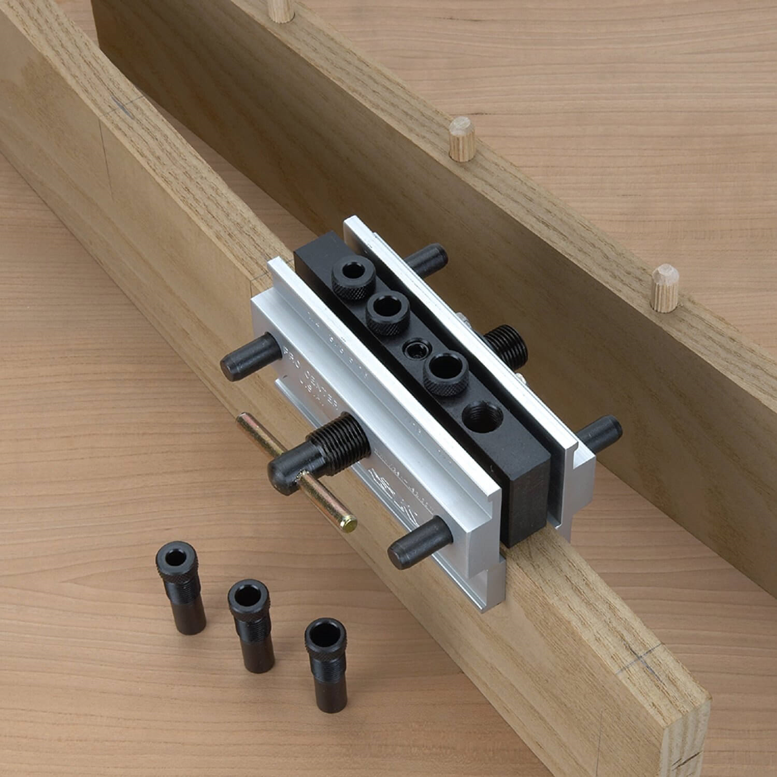
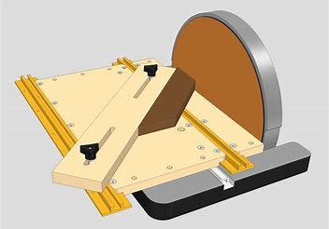
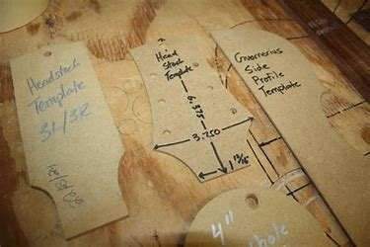
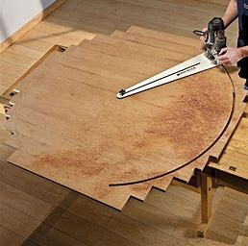
Production aids (pg53)
Drilling jig Sanding jig Templates Cutting Jig

Slide 12
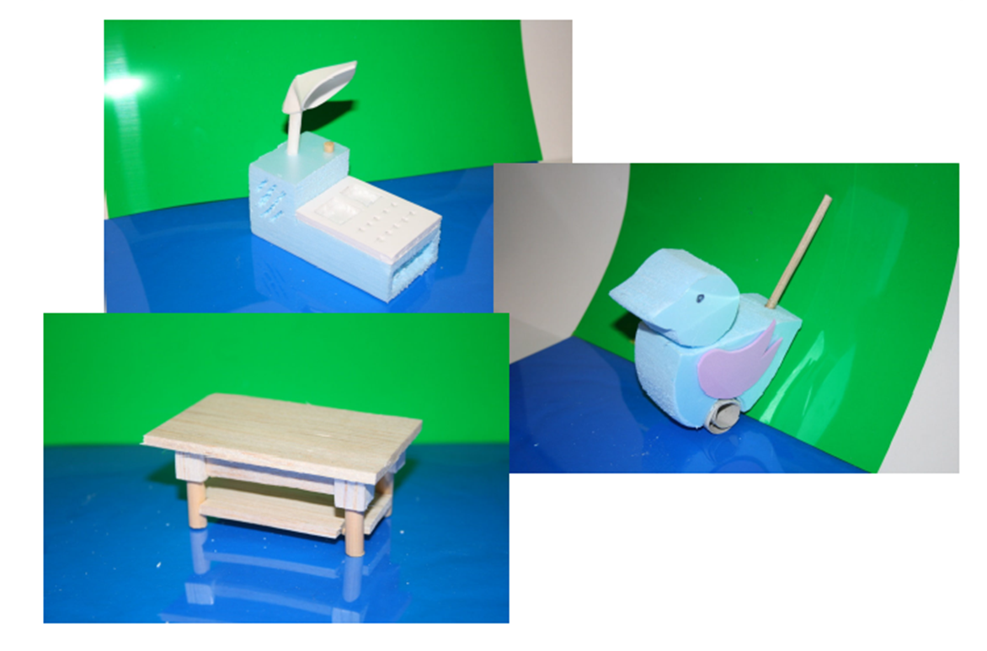
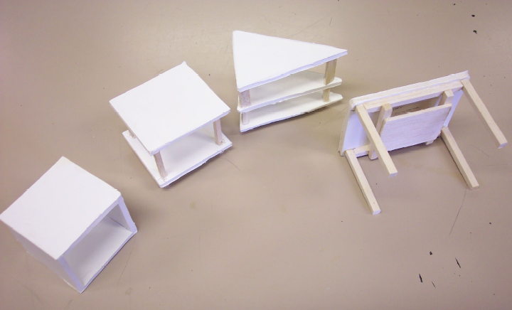
Modelling/prototyping
MDF, balsa wood
Plasticine
Blue modelling foam
Cardboard
Foam board

Slide 13
Reason to model/prototype…
Cheaper way to test different elements of your design.
Saves time in the long run.
Allow you to get feedback from the client.
Allows you to make changes to the design in a 3D form.
Test finishes and joints.
Check sizes.

Slide 14
Exam practice
Can you describe why we use modelling in the design process?
Can you discuss the pros and cons of using different types of modelling?

Slide 15
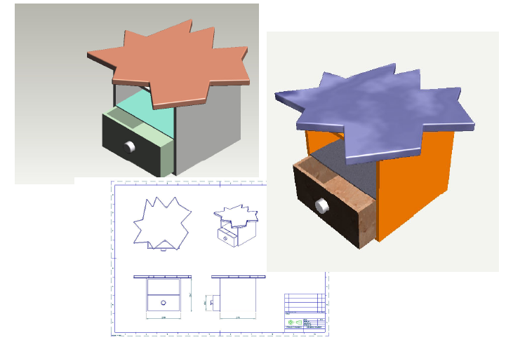
3D modelling vs Computer modelling
Expensive drawing programmes.
Highly skilled designers.( training costs)
Quick and easy to change.
Files can be easily transported.
Highly detailed, exploded drawing etc.
Cheap materials.
Good for testing sizes, balance etc.
3D good for showing potential clients.

Slide 16
Key words
Using the internet and your revision guides you need to find out what each of these key words mean and have an understanding of them.
Composite materials
Crowd funding
Planned obsolescence
Aesthetics
Ergonomics
Manufactured board
Global warming

Slide 17
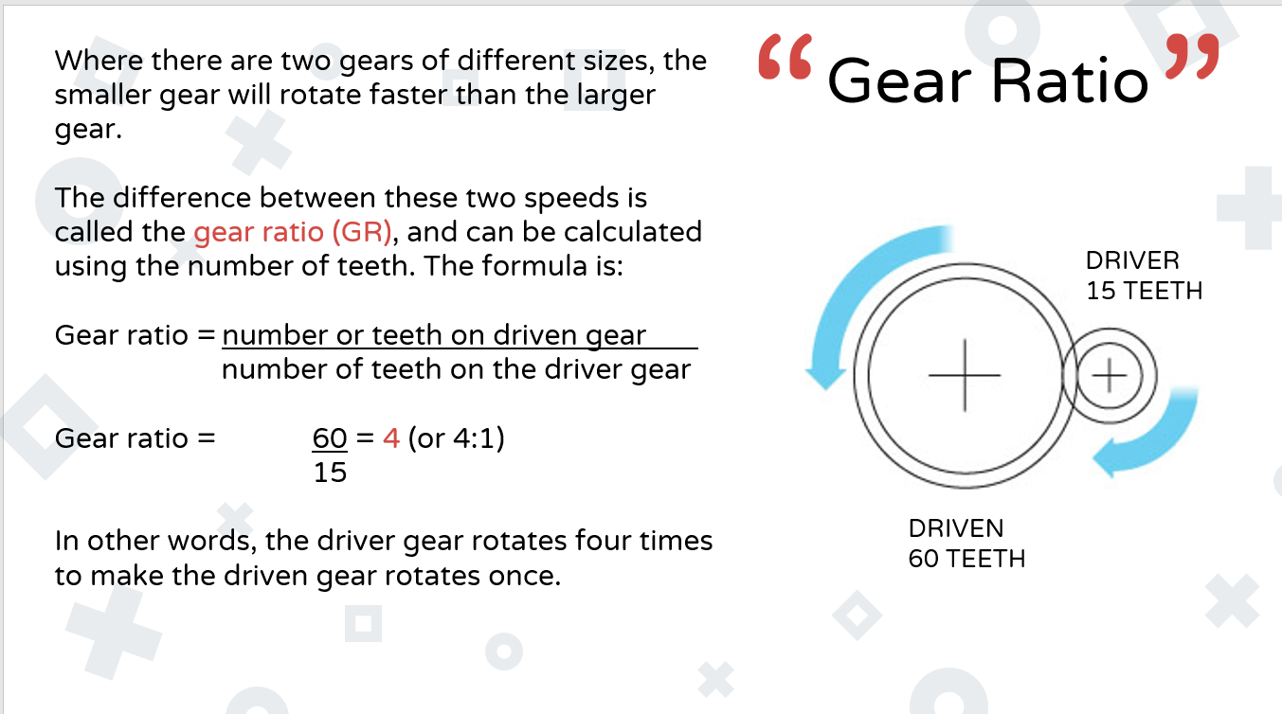

Slide 18
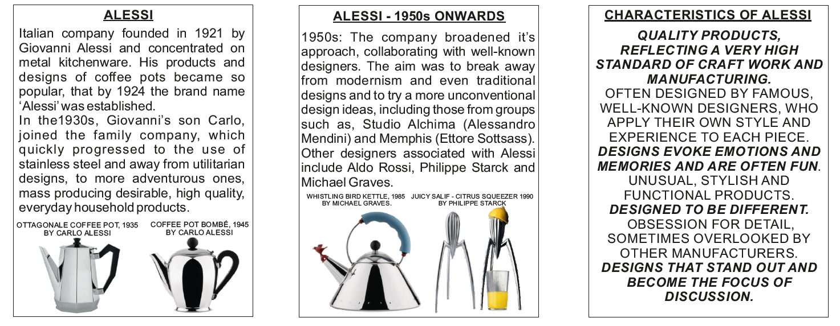
The work of iconic designers (pg 123)

Slide 19
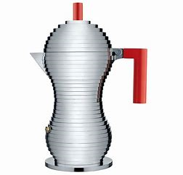
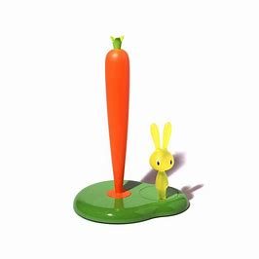
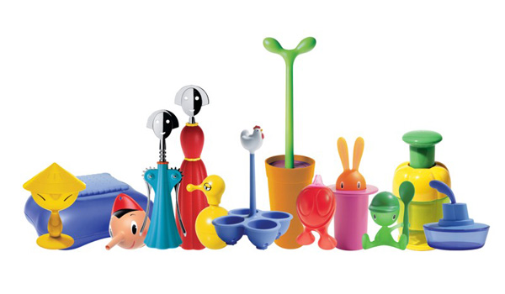
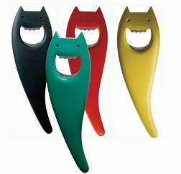
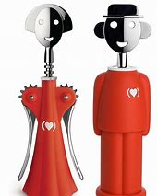
The work of iconic designers (pg 123)
Giovanni Alessi
High standard of finish
High quality materials
Quirky designs
Fun designs
Injection moulded parts

Slide 20
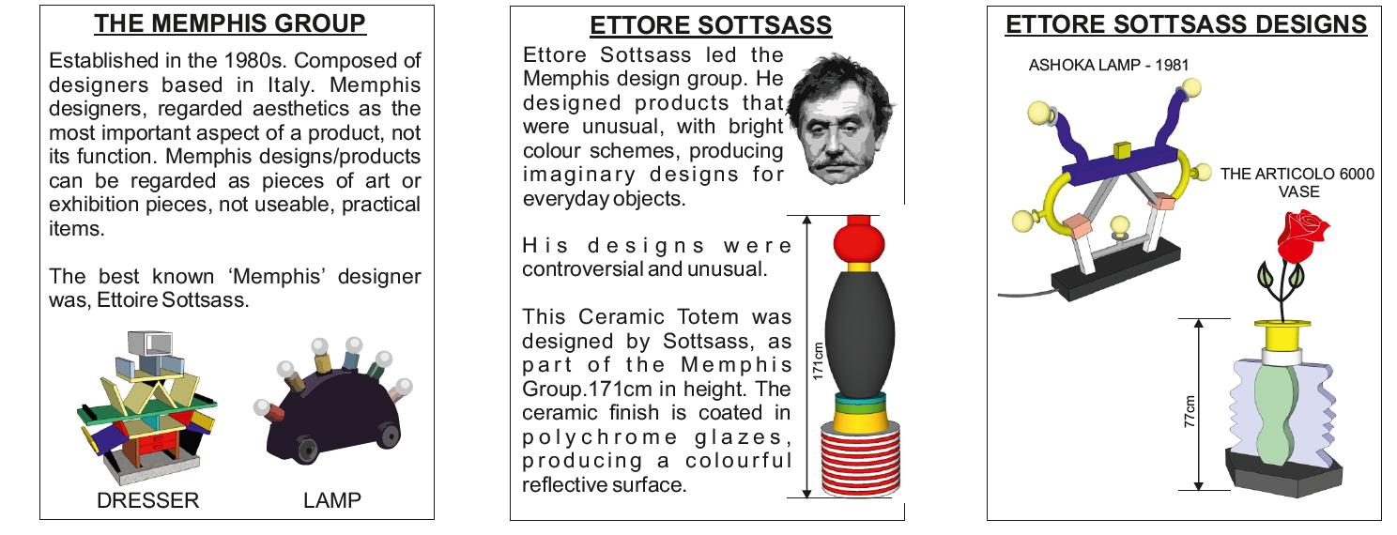
The work of iconic designers (pg 123)

Slide 21
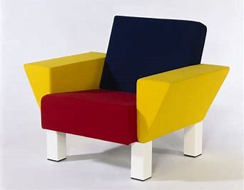
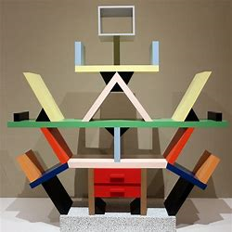
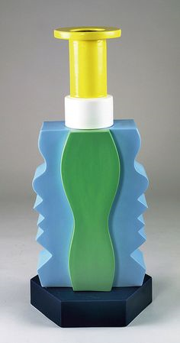
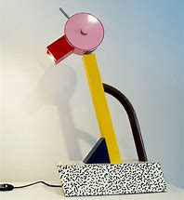
The work of iconic designers (pg 123)
Ettore Sottsass
The carlton Dresser
Westside lounge chair
The Articolo 6000 vase
Tahiti table lamp

Slide 22
Designer recall
Product analysis- what can we learn?
Can you tell me what inspired their work?
Why do we look at other designers?
Can you tell me an iconic designer?

Slide 23
Studying the work of others
Why do we look at other designers?
  Inspiration
  What’s popular
  What is selling
  What works/what doesn’t
Product analysis- what can we learn?
  Many of the above answers apply
  Materials available
  Manufacturing processes available
  Solutions to technical probelms

Slide 24
Evaluate (pg 135,138,147)
What does it mean to evaluate a product?
Discuss the pros and cons of the product.
Justify your opinions.
Discuss its suitability.
What has inspired the work of the designer.

Slide 25
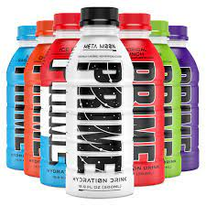
Evaluate how effective prime would be to a professional sports player.
The hydration version is sold in Blue Raspberry, Grape, Ice Pop, Lemon Lime, Meta Moon, Orange, Strawberry Watermelon and Tropical Punch.
The energy version, launched in 2023, is sold in Blue Raspberry, Lemon Lime, Orange Mango, Strawberry Watermelon, and Tropical Punch.
Prime is made up of 10 percent coconut water and contains electrolytes, B vitamins and BCAAs.
The manufacturers also state that it has zero sugar or caffeine and has around 20 calories per bottle.
The drink is sweetened with aspartame like many other no sugar beverages
Evaluate the aesthetics of the prime product.
Evaluate how effective prime would be to a teenager going about their normal day to day.

Slide 26
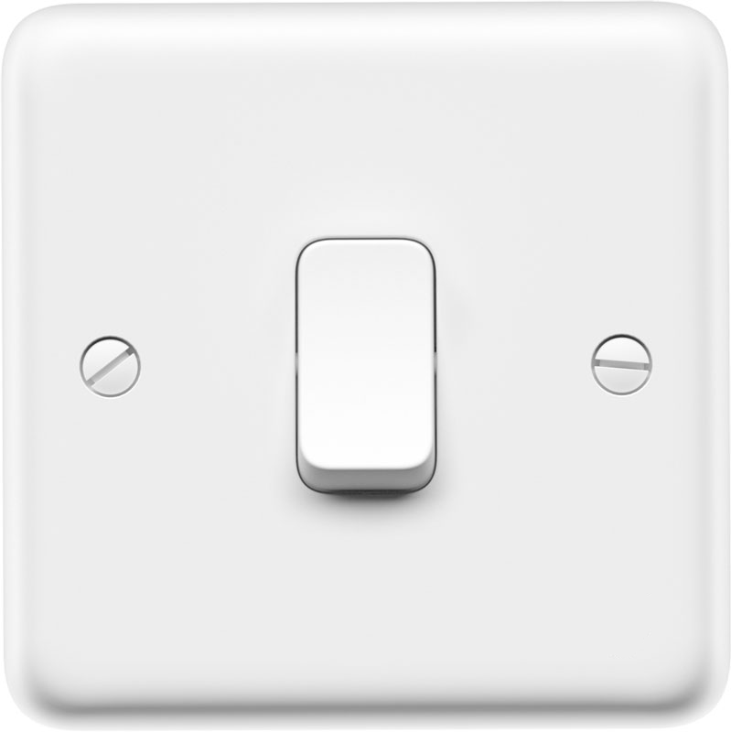
“ ”
INTRO
All mechanisms involve moving parts. They have been used by mankind for thousands of years to help make tasks easier.
Most of the mechanisms you use are so familiar that you never think about them. Simple things like light switches, door handles and tin openers are just some of the mechanisms you use every day.
These mechanisms have been designed to make tasks easier, and most of the time we never think about how they do it until they go wrong!
There are 4 main types of motion that you need to know.

Slide 27
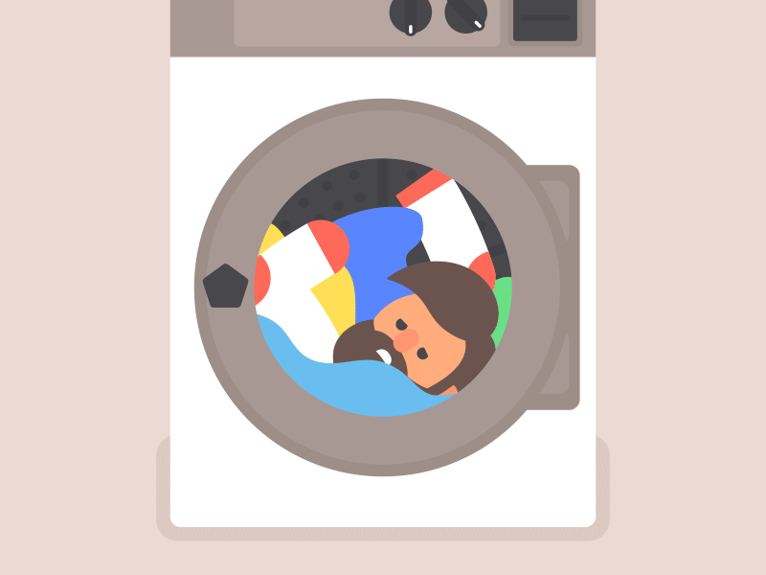

“ ”
rotary
This is a turning round in a circle motion, such as a washing machine drum.

Slide 28
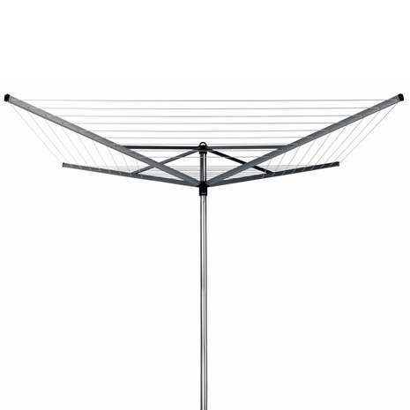

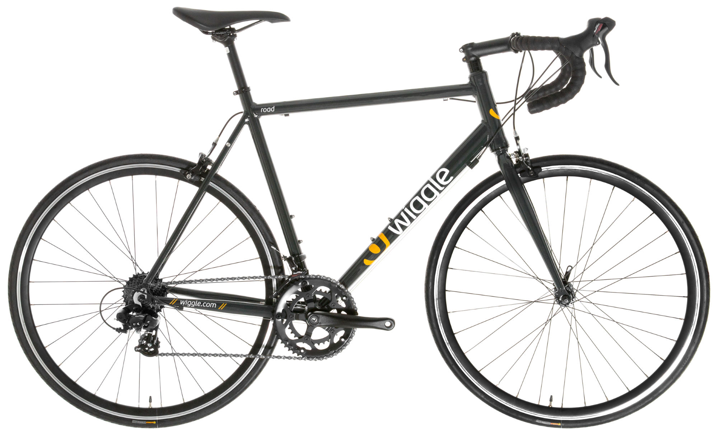
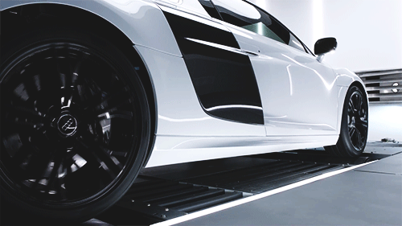
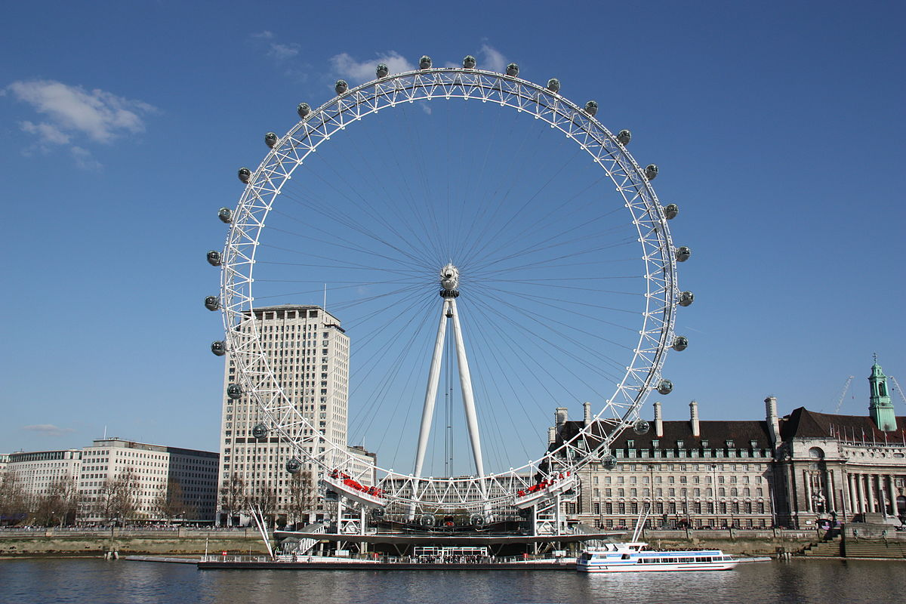
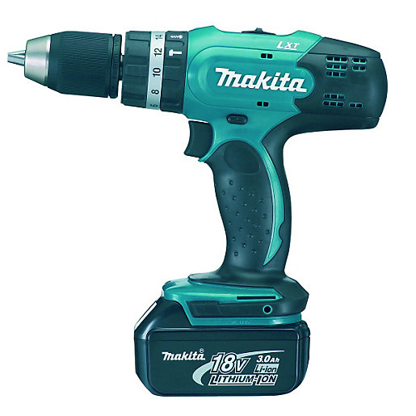
examples of rotary motion

Slide 29

Produce a list of 3 examples of rotary motion other than those already mentioned.

Slide 30

“ ”
linear
This is a moving in a straight line motion, such as zip on a jacket.
NOTE: only in one direction

Slide 31

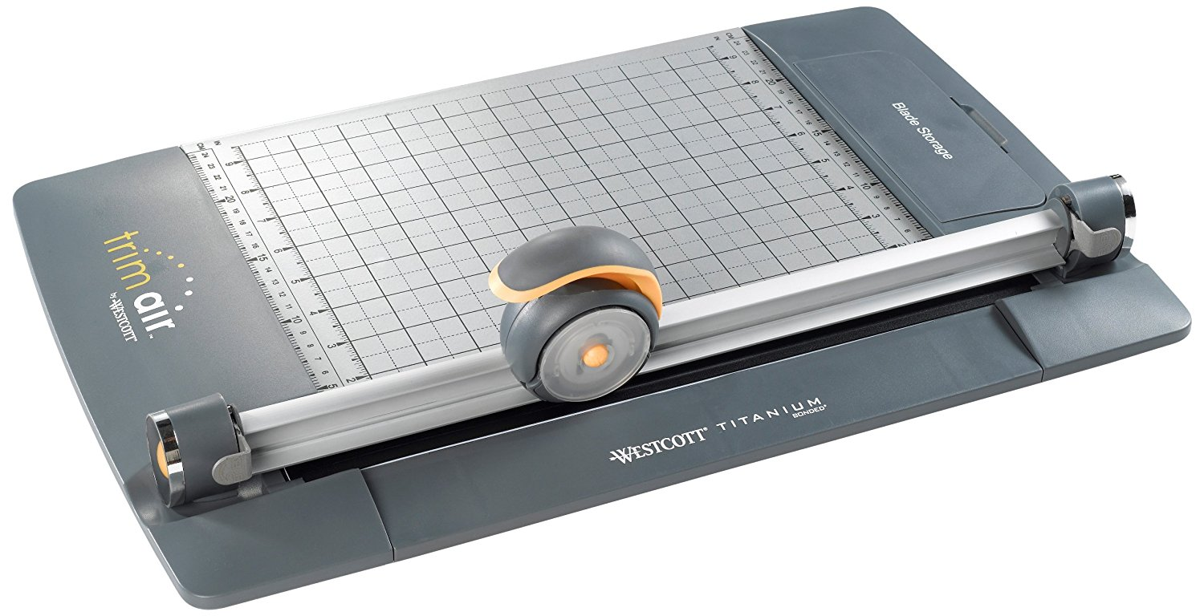
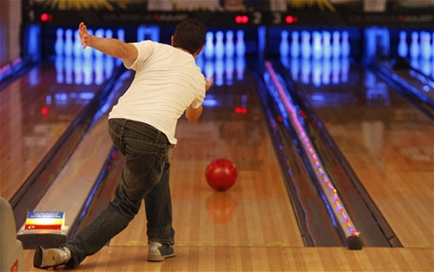
examples of linear motion

Slide 32
Produce a list of 3 examples of linear motion other than those already mentioned.

Slide 33

“ ”
reciprocating
This is a constantly alternating in a straight line motion, as in strumming a guitar
NOTE: from only one input

Slide 34
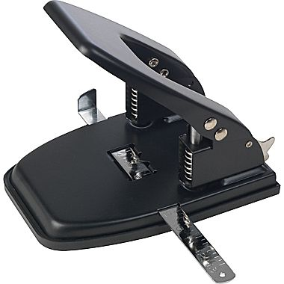
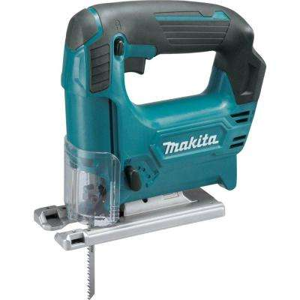
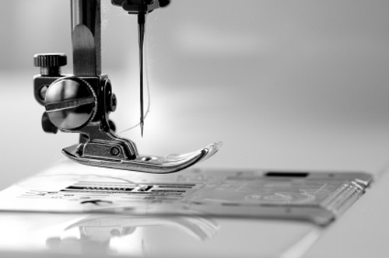
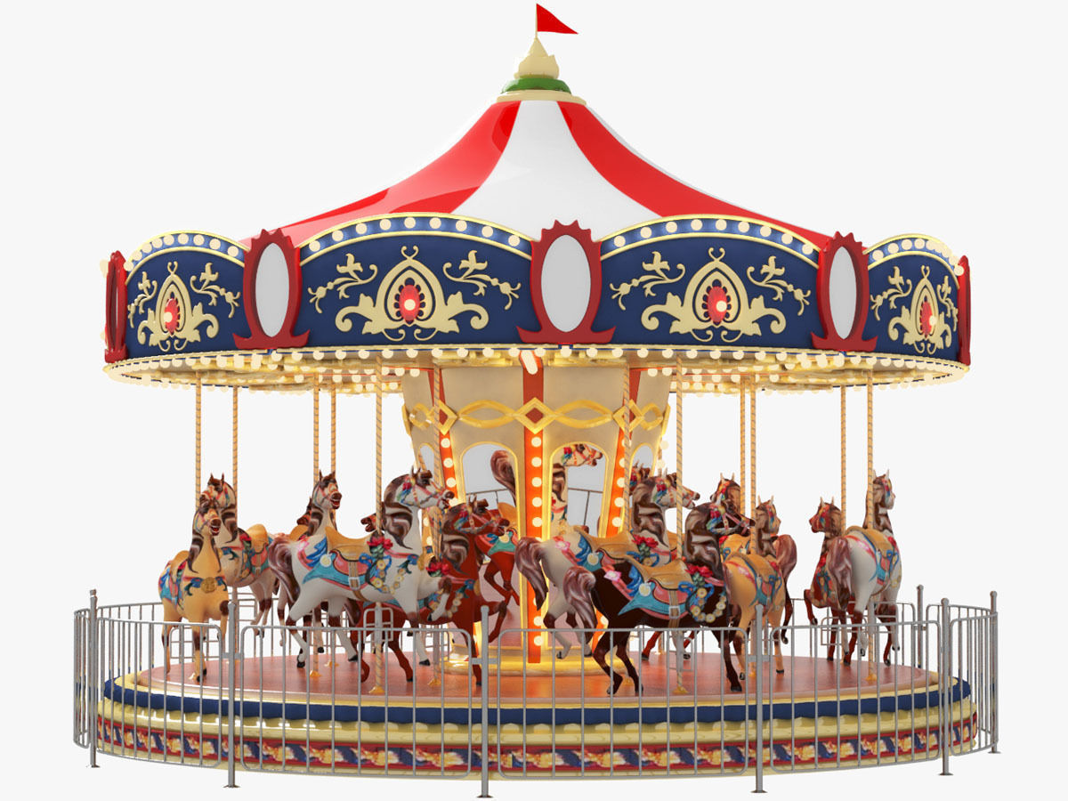
examples of reciprocating motion

Slide 35
Produce a list of 3 examples of reciprocating motion other than those already mentioned.

Slide 36

“ ”
oscillating
This is a arcing from side to side around a point type of motion, like a swing.

Slide 37

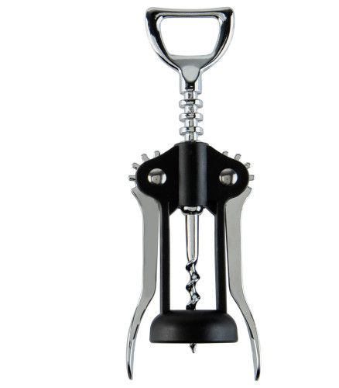
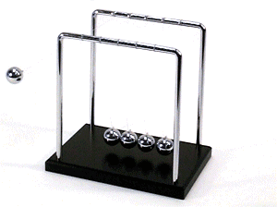
examples of oscillating motion

Slide 38
Produce a list of 3 examples of osciallating motion other than those already mentioned.

Slide 39
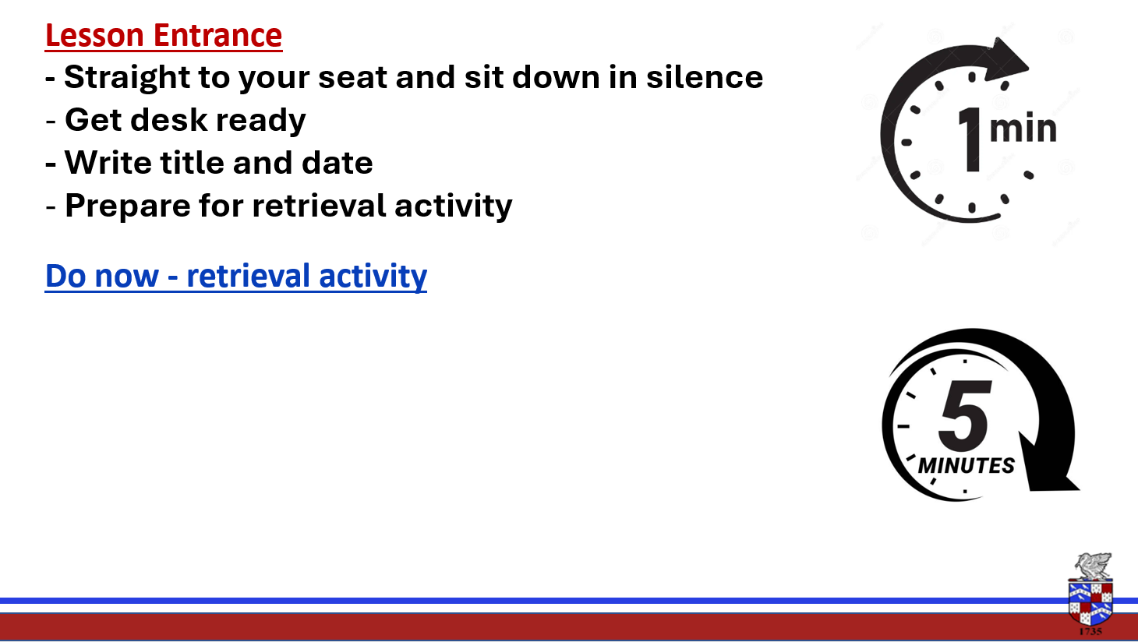
What is market pull?
What is technology push?

Slide 40
Market pull
Its all about what the consumers want.
We design and make products to satisfy the consumers.
Changing fashions can have a big influence.
E.g. take a look at your mobile phones and the changes they have made.

Slide 41
Technology push
New materials, products and technologies allow designers to meet the market pull.
E.g. the i-phone 4, touch screen, wi-fi etc
A good example of technology push are computers. They used to take up an entire room.

Slide 42

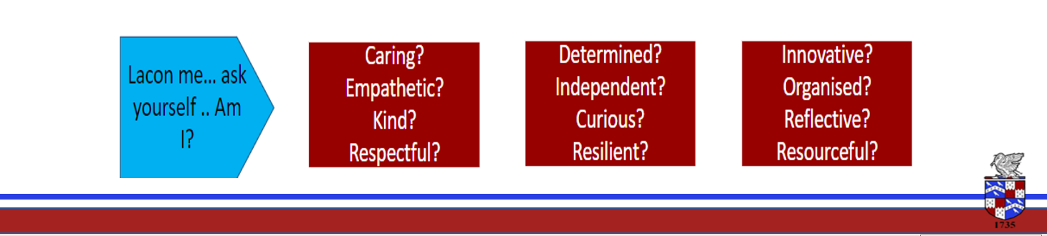
Lesson Intention
- To understand orthographic projection
- To Remember the key points of a 3rd Orthographic projection

Slide 43
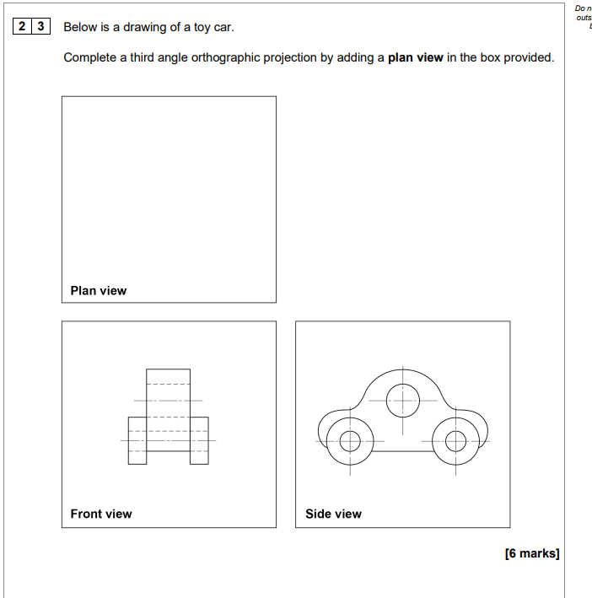


Slide 44
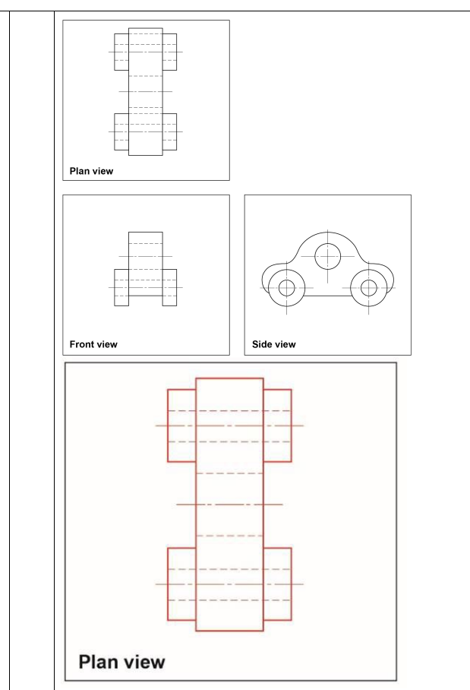
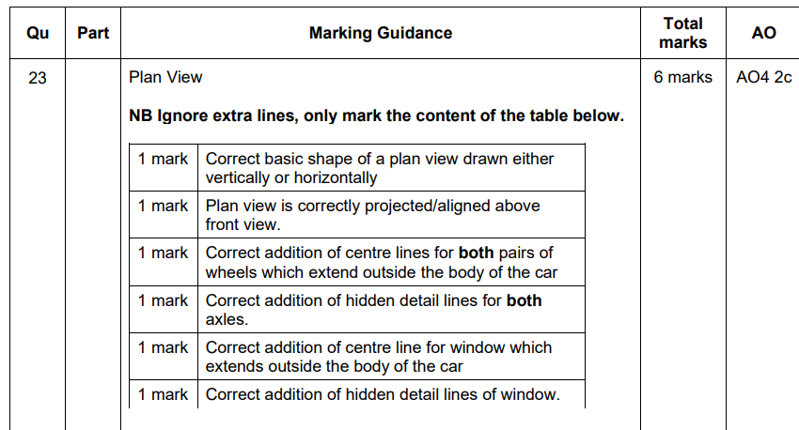

Slide 45
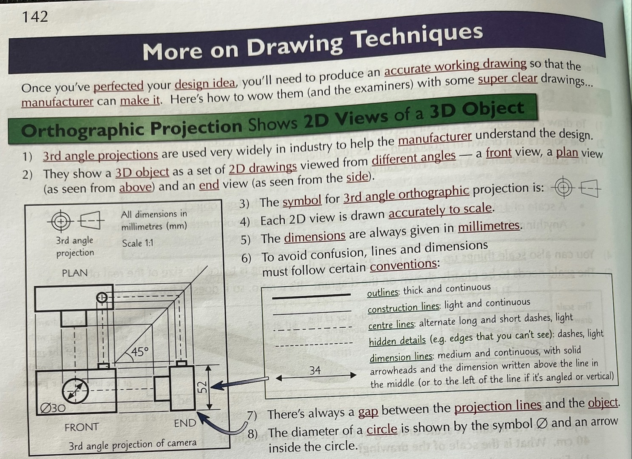

Slide 46
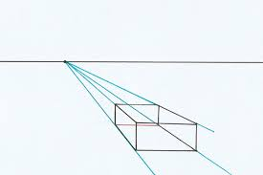
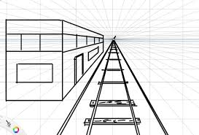

Slide 47
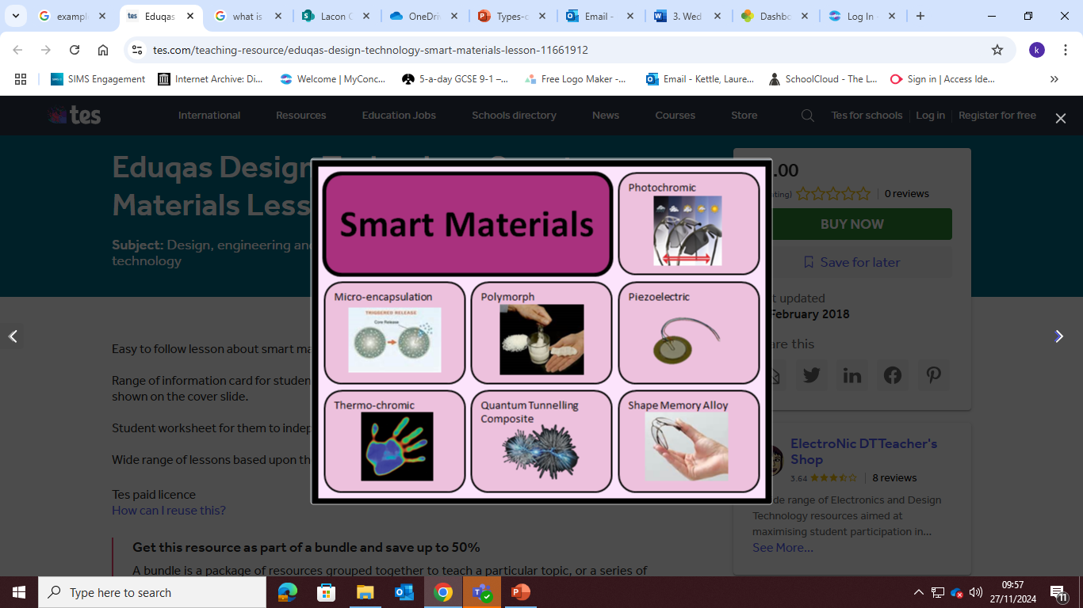
Smart materials
Change their properties in response to stimuli e.g temperature, light and then they return to their original state
Pg 39

