Slide 1
Explain what is meant by the terms ‘ergonomic’ and why it is important for designers to consider them (4marks)
Explain what is meant by the terms ‘anthropometric’ and why it is important for designers to consider them (4marks)

Slide 2
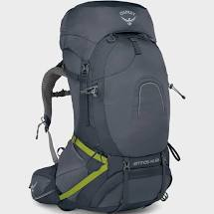
Specification
Base zip entry/Top lid access
Light weight : 2.19kg
Stretch front pocket
Integrated & detachable rain cover
mesh back panel
Large Capacity: 65L
Padded arm straps
Evaluate the product for it :
Ergonomic features( 4marks)
Aesthetics qualities (4marks)
Suitability for a weekend camping/hiking (4marks)
Suitability to for a user who is traveling around the world( 4marks)

Slide 3

Name two anthropometric measurements that might be used to help design the rucksack. Explain why each is appropriate.
1. ( 2 marks)
2 (2marks)

