Slide 1

crowdfunding
Crowdfunding is the practice of funding a project or venture by raising many small amounts of money from a large number of people, typically via the internet. Crowdfunding is a form of crowdsourcing and of alternative finance. in 2015, it was estimated that worldwide over $34 billion was raised this way. People who invest in crowd funding are called backers.

Slide 2
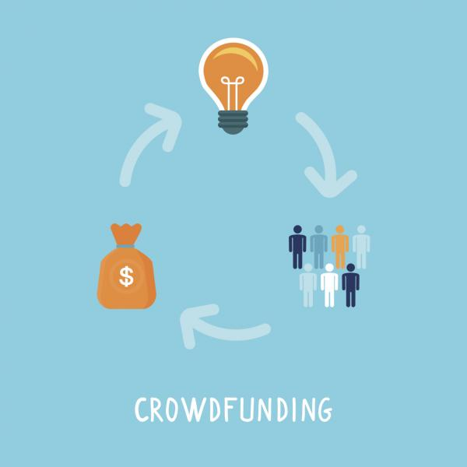
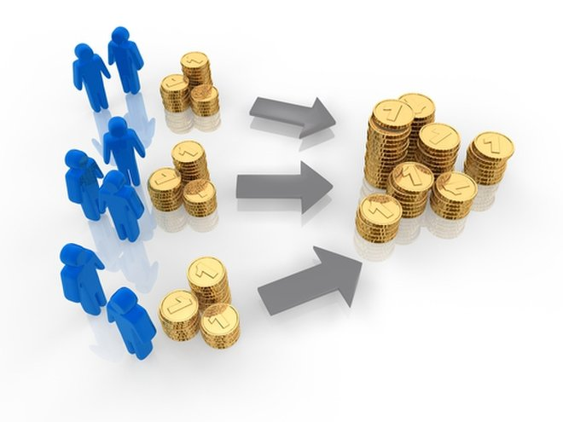
Why?
To try to raise/fund large business ideas or charities.
Asking a small amount of money from a very large amount of people can generate huge amounts.

Slide 3
Crowdfunding usually uses the internet to promote an idea or venture to thousands of potential investors, who have the option of making much smaller individual investments. Those looking for funds will typically use a recognised website platform to set up a profile of their project, and then use social media as well as their network of family, friends and business contacts to raise the necessary money.

Slide 4
The main types of crowdfunding - Donation or reward crowdfunding relies on people investing in a project or creative process because they believe in the cause; donors have a social or personal motivation for putting their money in, and expect no financial return, although they may receive rewards such as exclusive access to content or material, or tickets to events. Although there is no financial investment potential in donation or reward crowdfunding, it can offer a source of sustainable income, particularly for those in creative fields.

Slide 5
Equity crowdfunding offers people the chance to invest in a venture in exchange for equity or shares in the business. As with most other share investments, the value of the shares can go up or down (and the rise or fall in value can be much larger than traditional share investments). Equity crowdfunding grew significantly in the wake of the global financial crisis, and the resulting reluctance on the part of the banks to offer loans to start-up businesses.

Slide 6
Recent high profile examples of successful crowdfunding campaigns include BrewDog (craft brewer now valued at over $1bn), the Pebble smart watch, Oculus Rift (a virtual reality startup that went on to sell to Facebook for $2bn) and Le Col – a designer and manufacturer of cycling apparel having raised £1m

Slide 7
Crowdfunding
Traditionally, new businesses would borrow money from a bank to raise enough funds to develop a project.
This is risky and, with interest payments, can be expensive. Crowdfunding uses websites to advertise products as investment opportunities, where people can choose to back a project with a financial donation if they think it will be viable.
Backers are often rewarded with free gifts, discounts or a pre-agreed part of any profits if the product is successful.

