Slide 1
Fabrics

Slide 2
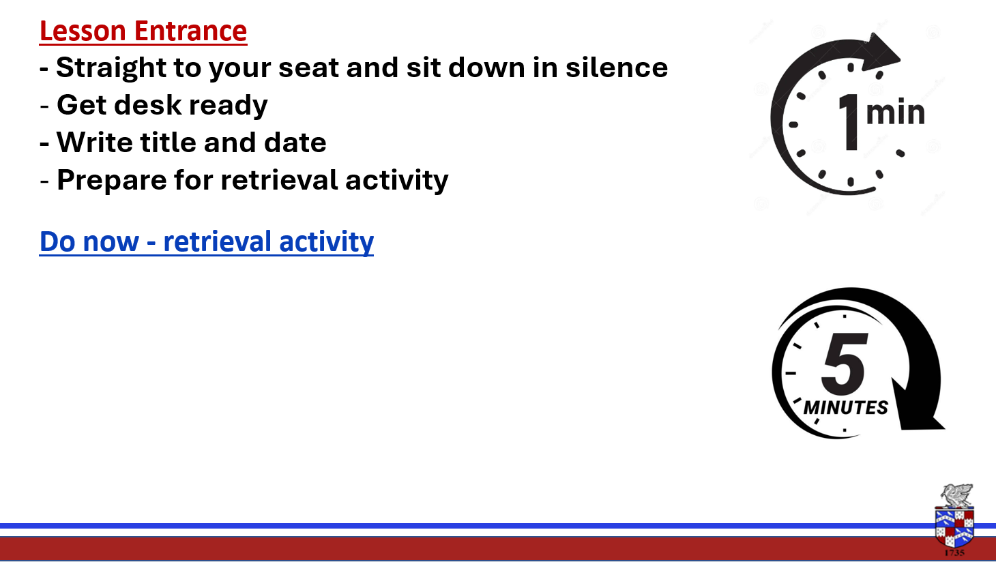
What is fairtrade?
What is the fairtrade premium?
What do the farmers need to ensure their product does?

Slide 3

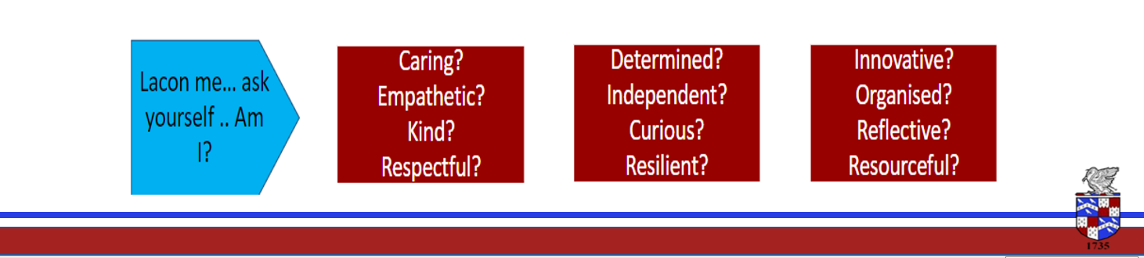
Lesson Intention - Learn about a variety of different Textile materials and their properties. - Be able to give examples of appropriate fabrics for specific products - Understand where different fabrics come from.
Keywords
Fibres
Properties

Slide 4
Lesson 1 Learning Objectives: -Know a variety of different Textile materials. -Understand where fabric comes from.

Slide 5
How many fabrics can you think of?
Rayon
Nylon
Cotton
Acrylic
Fabrics
Wool
Polyester
Linen
Silk
Objectives: -Know a variety of different Textile materials. -Understand where fabrics comes from.

Slide 6
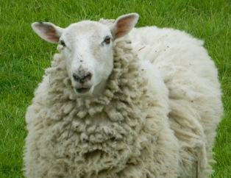
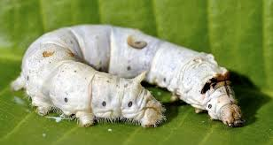
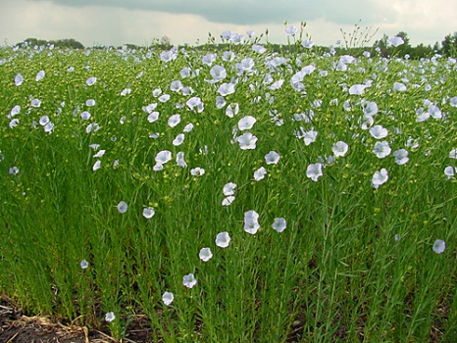
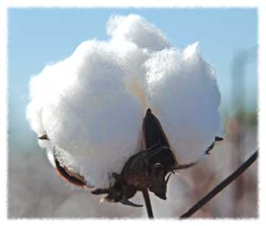
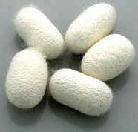
Natural Fibres
Natural fibres come from plants and animals. For example:
Silk
Cotton
Wool
Linen
Objectives: -Know a variety of different Textile materials. -Understand where fabric comes from.

Slide 7
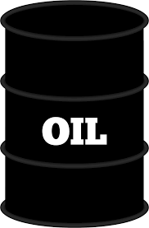
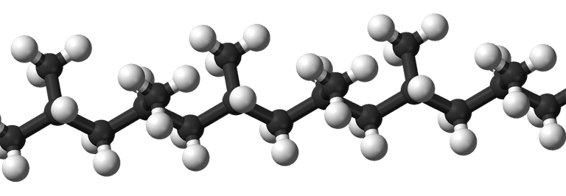
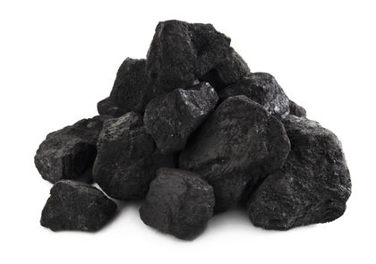
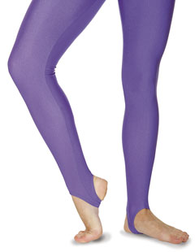
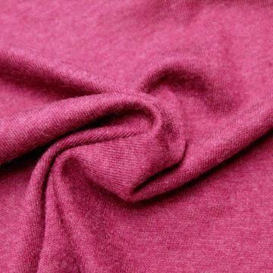
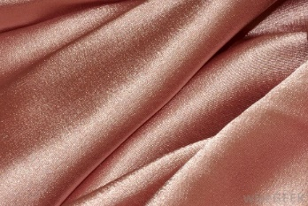
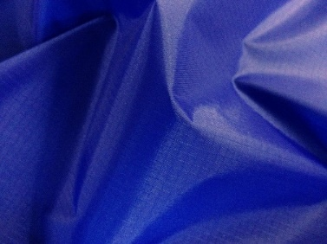
Synthetic Fibres
Synthetic fibres are made from polymers (long chain of molecules) that come mostly from coal and oil. For example:
Polyester
Polyamide (Nylon)
Acrylic
Elastane (Lycra®)
Objectives: -Know a variety of different Textile materials. -Understand where fabrics comes from.

Slide 8
Textiles can be made from either natural or
synthetic (man made) fibres.
Natural
Synthetic
These come from nature.
These are also known as man made fabrics. These are made from polymers (long chain of molecules) that come mostly from coal and oil.
Plants
Cotton from a cotton plant
Linen from a flax plant
Animals
Wool from a sheep
Silk from a silk worm
Polyester
Acrylic
Polyamide (Nylon)
Elastane (Lycra®)
Objectives: -Know a variety of different Textile materials. -Understand where fabrics comes from.

Slide 9

What fabric properties can you think of?
What different ways can you think about how you could test these properties?
Strong
Elastic
Waterproof
Insulating
Crease resistant
Hardwearing
Fire retardant
Stain resistant
Absorbent
Colour fast
Itchy
Coarse
Silky
Smooth
Cool to wear
Washable
Objectives: -Know a variety of different Textile materials. -Understand where fabrics comes from.

Slide 10
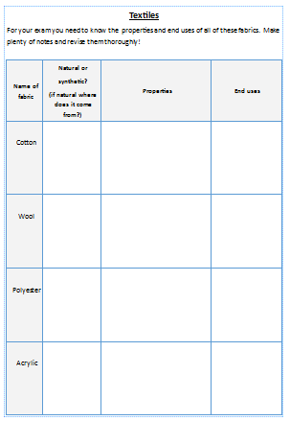
For your exam you need to know the properties and end-uses of 4 fabrics. Make notes in the grid.

Slide 11
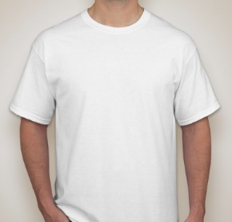
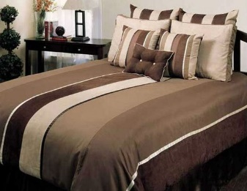
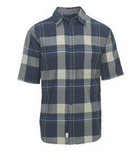
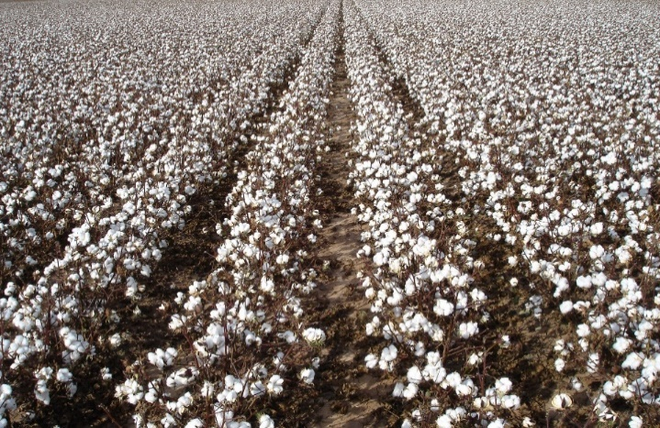
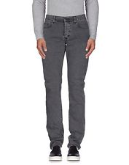
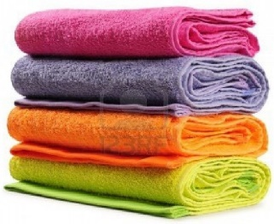
Cotton (plant based fibre)
Properties:
Soft
Strong
Absorbent
Takes dye readily
Cool to wear
Easily washable
Cotton comes from a cotton plant.
Uses:
Shirts
Underwear
Denim
Towels
bedsheets
Cotton is most commonly grown in China, India, USA and Pakistan.

Slide 12
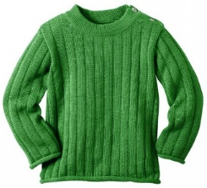
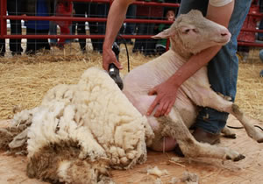
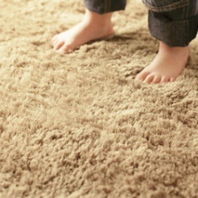
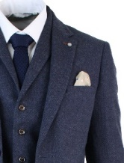
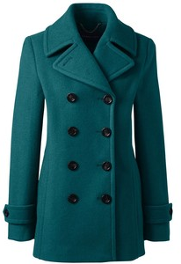
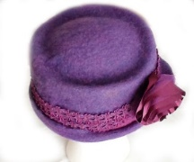
Wool (animal based fibre)
Properties:
Can be fine and soft or thick and coarse
Warm
Crease resistant
Shrinks when washed
Can feel itchy
Wool comes from a sheep.
Uses:
Jumpers
Coats
Suits
Carpets
Sheep are most commonly bred for their wool in Australia, New Zealand, China, USA and UK

Slide 13
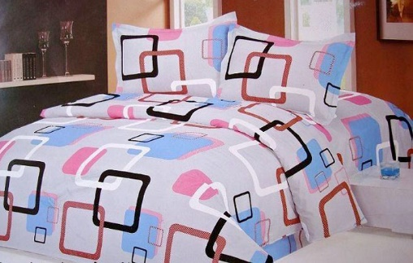
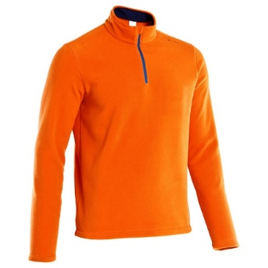
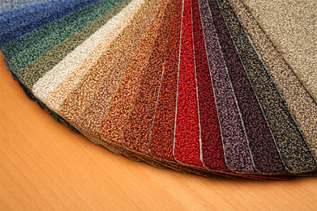
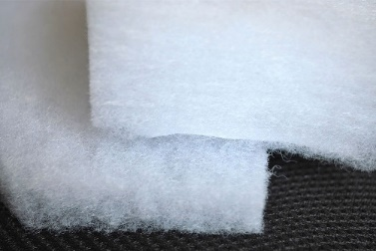
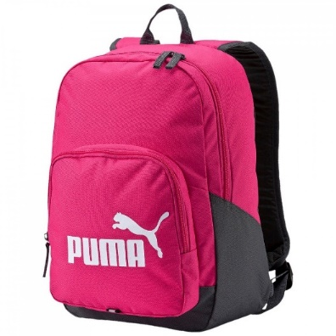
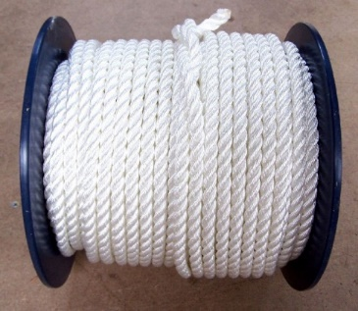
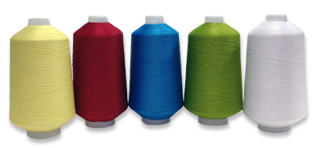
Polyester (synthetic fibre)
Properties:
Tough
Strong
Hardwearing
Holds colour well
Non-absorbent
Easy wash
Uses:
Fleece garments
Bedsheets
Carpets
Wadding
Rope
Threads
Backpacks
Simple chemical molecules (monomers) are joined together by polymerisation.

Slide 14
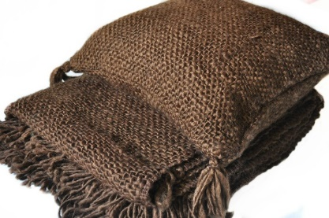
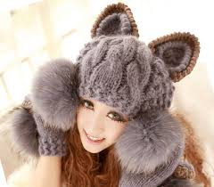
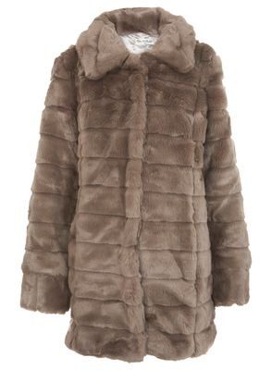
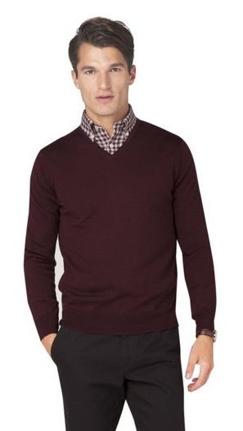
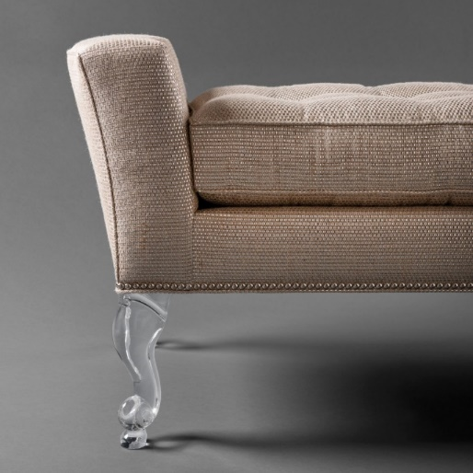
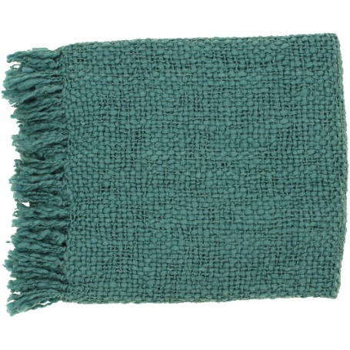
Acrylic (synthetic fibre)
Properties:
Strong (but not when wet)
Soft
Warm and insulating
Good elasticity
Crease resistant
Uses:
Fake fur
Knitted clothes
Furnishings
Upholstery
Blankets

Slide 15
What do the following terms mean?
a) Absorbent ____________________________________________________
b) Colour-fast ___________________________________________________
c) Crease- resistant________________________
d) Elastic ____________________________________________________

Slide 16
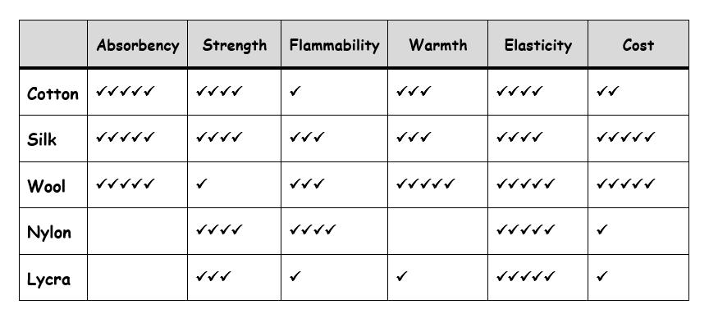
What fabric would you choose to make a school shirt from? Explain your answer.
What fabric would you choose to make an evening dress (prom dress) from? Explain your answer.

Slide 17
Questions
What are the two different categories of fibres?
Name two natural fibres
Name two different types of fabric construction
Which threads travel up and down the fabric?
Name a property of polyester

Slide 18
What are the two different categories of fibres?
Name two natural fibres
Name one property of polyester fabric?

Slide 19
Lesson Intention - Understand the process of turning fibres into fabrics. - Know the three main methods of constructing fabrics. - Understand the process of constructing a piece of woven fabric. -To be able to identify a woven fabric. - Create a sample of woven fabric
Keywords
Woven
Knitted
Bonded/non-woven
Fibres
Yarn
Warp
weft

Slide 20

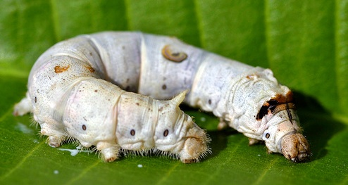
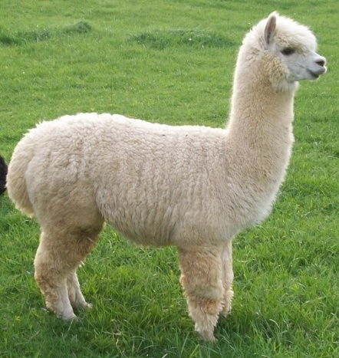
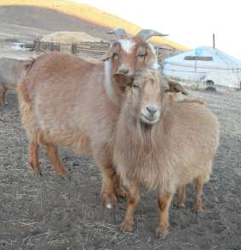
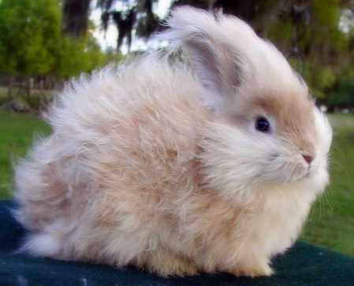
What do all these animals have in common?
They can all be used to create fabric!
Silk worm- silk
Sheep- wool
Alpaca- alpaca
Goat- cashmere
Rabbit- angora

Slide 21
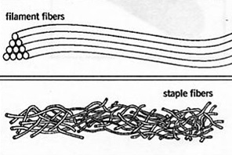
Fibres are either short (staple) or long (filament):
Key information – record in your book
Staple fibres are short and sometime course in texture.
Filament fibres are long and smooth in texture
Staple fibres
Staple fibres are spun (twisted together) to produce yarns.
Usually natural fibres)
Filament fibres
Filament fibres are long and smooth. They can be kept long or cut into staple length fibres.
(synthetic fibres EXCEPT SILK- natural)
Objectives: -Understand the process of turning fibres into fabrics. -Know the three main methods of constructing fabrics.

Slide 22

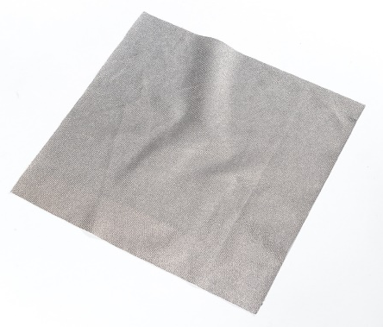
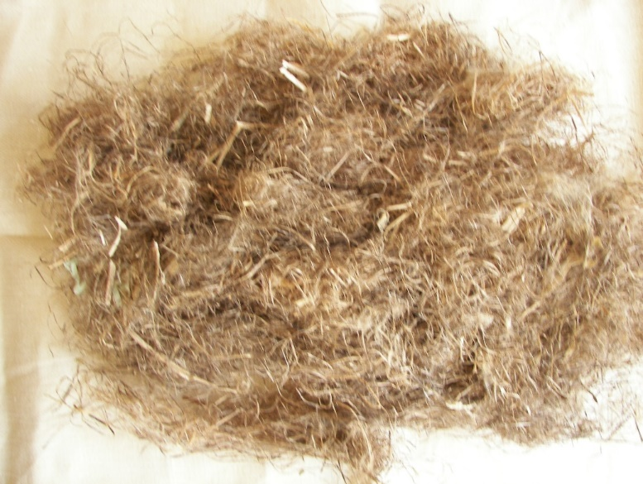
How are fibres turned into fabric?
?
Objectives: -Understand the process of turning fibres into fabrics. -Know the three main methods of constructing fabrics.

Slide 23
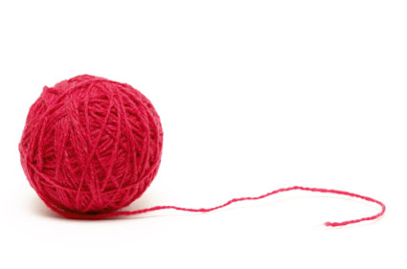

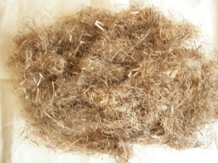
The flow map below shows the order in which fabrics are made:
FIBRES
YARNS
FABRICS
Twist
and
pull
Woven
Knitted
Non-woven
Objectives: -Understand the process of turning fibres into fabrics. -Know the three main methods of constructing fabrics.

Slide 24



Fabrics can be constructed in 3 main ways…..
Woven
Knitted
Non-woven
Objectives: -Understand the process of turning fibres into fabrics. -Know the three main methods of constructing fabrics.

Slide 25


Woven fabrics are made up of 2 sets of yarns- some vertical and some horizontal. These can be the same yarn or different to create different patterns.
Objectives: -Understand the process of constructing a piece of woven fabric. -To be able to identify a woven fabric.

Slide 26
These vertical and horizontal yarns have different names:
WARP
Remember
‘warp’
WEFT
Remember:
‘Weft goes left’
SELVEDGE
This is where the weft wraps around the end warp.
Objectives: -Understand the process of constructing a piece of woven fabric. -To be able to identify a woven fabric.

Slide 27




These are the 2 main woven fabrics you need to know:
Plain weave
The weft goes ‘under, over, under, over’ so creates a checker board pattern.
Twill weave
The weft goes ‘under two, over one/two’.
This creates a diagonal pattern on the surface.
Objectives: -Understand the process of constructing a piece of woven fabric. -To be able to identify a woven fabric.

Slide 28
Plain Weave
Applications
Shirts
Bags
Bedding
Textile crafts
Advantages
Strong, hardwearing
Cheapest weave
Same on both sides
Hangs well
Good surface for printing on
Disadvantages
Firm
Varied qualities
E.g calico
Objectives: -Understand the process of constructing a piece of woven fabric. -To be able to identify a woven fabric.

Slide 29
Twill Weave
Applications
Jeans
Jackets
Curtains
Bedding
Soft furnishings
Advantages
Strong, hardwearing
Hangs well
Less stiff than plain weave
Interesting design
Disadvantages
Frays easily
Thickness makes it hard to use
E.g denim
Objectives: -Understand the process of constructing a piece of woven fabric. -To be able to identify a woven fabric.

Slide 30


Task: Using the equipment provided, create a sample of woven fabric.
Objectives: -Understand the process of constructing a piece of woven fabric. -To be able to identify a woven fabric.

Slide 31
Stick your sample neatly into your book (the correct way up!) and label the warp, weft and selvedge.
Objectives: -Understand the process of constructing a piece of woven fabric. -To be able to identify a woven fabric.

Slide 32


Slide 33








There are several different types of weave. These are all made up of warp and weft yarns but they go ‘over and under’ in different patterns. You have just created a PLAIN WEAVE.
Objectives: -Understand the process of constructing a piece of woven fabric. -To be able to identify a woven fabric.

Slide 34

Industrial Weaving Looms
https://www.youtube.com/watch?v=E__Jrh5Pnhs
Objectives: -Understand the process of constructing a piece of woven fabric. -To be able to identify a woven fabric.

Slide 35

Woven Fabrics: Complete the diagram with the missing words.
These are yarns which travel up and down on the fabric.
These are yarns which
travel from left to right
across the fabric.
This is the edge of the fabric where the yarn wraps around. It does not fray.

Slide 36
Label this diagram:
WARP
2.
1.
WEFT
3.
SELVEDGE
Objectives: -Understand the process of constructing a piece of woven fabric. -To be able to identify a woven fabric.

Slide 37
Lesson 4 Learning Objectives: -Understand the process of constructing a piece of knitted fabric. -To be able to identify a knitted fabric.

Slide 38
Numeracy thinking questions
You are knitting a child’s jumper. You will use 5 balls of wool, each is 100m long. Calculate the total length of the wool that you will use.
How long is this in cm (centimetres)?
Each ball of wool costs £3.99. How much will the jumper cost to make?
You decide to make a woolly hat to match the jumper. It will need 225m of wool to make it. How many wools of wool must you buy? How much will this cost?
500m
50,000cm
£19.95
3 balls, costing £11.97

Slide 39


Slide 41

Knitted Fabrics
Knitted fabrics are made up of loops. The loops can either travel horizontally or vertically across the fabric.
Remember:
Warp
Remember: ‘weft goes left’
Weft knitting
Warp knitting
Objectives: -Understand the process of constructing a piece of knitted fabric. -To be able to identify a knitted fabric.

Slide 42




Weft Knitting
Applications
T-shirts
Tops
Jumpers
Socks
Advantages
Stretchy
Comfortable
Fast production
Disadvantages
Ladders easily
A single yarn creates interlocking loops across the fabric.
If a loop breaks, a hole forms and it can ladder.
Made by hand or machine.
Objectives: -Understand the process of constructing a piece of knitted fabric. -To be able to identify a knitted fabric.

Slide 43





Warp Knitting
Applications
Swimwear
Geotextiles
Lace
Nets
Fleece
Advantages
Fairly stretchy
Retains heat
Does not unravel
Disadvantages
Can lose shape
Curls at the edges
Formed by vertical loops like a series of chains.
Can only be produced on a machine.
Objectives: -Understand the process of constructing a piece of knitted fabric. -To be able to identify a knitted fabric.

Slide 44


Practical Task
To learn to knit properly with 2 knitting needles like in the picture above would take months! You are therefore going to learn how to finger knit.
Make a sample of knitted fabric.
Objectives: -Understand the process of constructing a piece of knitted fabric. -To be able to identify a knitted fabric.

Slide 45

Industrial Knitting Machine
https://www.youtube.com/watch?v=NNxgo9Z4Lb4
Objectives: -Understand the process of constructing a piece of knitted fabric. -To be able to identify a knitted fabric.

Slide 46







Create a piece of woven ‘material’ by using found objects. E.g. magazines, fabric, paper, twigs, straws. Anything you can find!
Lesson 4 Homework- Back to weaving..
Hand in lesson 6

Slide 47
I will give 10mins for this section today as we have more to work through for this recall.
Name two synthetic fibres
Name the three different types of fabric construction
Which threads travel up and down the fabric?
Name a type of weave
What are the two different types of knitting that can be created?
Name a fabric that would be suitable for a pair of school trousers.

Slide 48
Lesson Intention - Be able to identify a non-woven/bonded fabric - Understand the process of constructing a piece of non-woven fabric. - Be able to give examples of products that are made from non-woven fabrics.
Keywords
Woven
Knitted
Bonded/non-woven
Fibres
Yarn
Warp
Weft
Fused

Slide 49
The flow map below shows the order in which fabrics are made:
FIBRES
YARNS
FABRICS
Fibres are spun together to form a yarn
Yarns can produce fabrics by either weaving or knitting them together
Non-woven fabrics are the exception- they go straight from fibres to fabrics

Slide 50








Bonding
Felting
Bonded-fibre fabrics are made from webs of synthetic fibres that are held together by glue (adhesives), stitches or heat.
Bonded-fibre fabrics are mainly used for interlining.
They are easy to sew, crease resistant, do not fray and are stable when washing and dry cleaning.
Felt is made from wool (a natural fibre) by combining pressure, moisture and heat to interlock a mat of wool fibres.
Felt has no strength, drape or elasticity but it is warm and does not fray. Wool felt is expensive.
It is used for hats, slippers, carpet underlay, snooker table coverings and in craft materials.
They are both cheap to produce but not as strong as woven or knitted fabrics.

Slide 51
Industrial Non-woven Fabric
Nonwovens: All you need to know in 6 minutes
Objectives: -Understand the process of constructing a piece of non-woven fabric. -To be able to identify a knitted fabric.

Slide 52


Slide 53
Lesson 6 Learning Objectives: -Have an understanding of a range of printing and dyeing techniques and the advantages and disadvantages of each.

Slide 54
Colour and designs can be added to fabrics in several different ways:
The fabric can be constructed with different coloured yarns to produce a pattern (think back to the different weave structures you learnt).
The fabric can be dyed.
Paint or ink can be applied to the surface of fabric.
Objectives: -Have an understanding of a range of printing and dyeing techniques and the advantages and disadvantages of each.

Slide 55
Does anybody know any methods of printing or dyeing?
Objectives: -Have an understanding of a range of printing and dyeing techniques and the advantages and disadvantages of each.

Slide 56






Dip dyeing
Screen printing
Batik
Block printing
Silk painting
Tie dyeing
Objectives: -Have an understanding of a range of printing and dyeing techniques and the advantages and disadvantages of each.

Slide 57



Block Printing
Block printing is a traditional printing method.
The printing block needs to have a raised design and can be made from wood, rubber, sponge or metal.
Advantages:
You can print with different colours using the same block.
You can use several blocks to build up a more complicated design.
You can easily repeat designs.
You can use the same block many times before it wears out.
Disadvantages:
Making the blocks takes a long time.
It is not a good method for fine detail.
https://www.youtube.com/watch?v=myADva7NOr4
(2:23 to end)
Objectives: -Have an understanding of a range of printing and dyeing techniques and the advantages and disadvantages of each.

Slide 58



Practical Task- Part 1
Produce a sample of block printing and be as creative as you can.
As it would take a long time to create a block from a piece of wood, you are going to use various other materials to build up your design.
Experiment with using different shapes/ colours/ layering/ angles.
Part 1- You will make the block in todays lesson ready to print next lesson.
Objectives: -Have an understanding of a range of printing and dyeing techniques and the advantages and disadvantages of each.

Slide 59
Lesson 7 Learning Objectives: Have an understanding of a range of printing and dyeing techniques and the advantages and disadvantages of each.

Slide 60
Practical Task- Part 2
Produce a sample of block printing and be as creative as you can.
As it would take a long time to create a block from a piece of wood, you are going to use various other materials to build up your design.
Experiment with using different shapes/ colours/ layering/ angles.
Part 2- Using your block made last lesson. Produce several samples of printing. Consider repeat patterns researched for homework
Objectives: -Have an understanding of a range of printing and dyeing techniques and the advantages and disadvantages of each.

Slide 61







Objectives: -Have an understanding of a range of printing and dyeing techniques and the advantages and disadvantages of each.

Slide 62




Introducing Stencils
Sketch some ideas for simple stencils that you could make…
We will start to make these next lesson.

Slide 63
Lesson 8 Learning Objectives: -Have an understanding of a range of printing and dyeing techniques and the advantages and disadvantages of each.

Slide 64

Extension Task: Look at the clothes in front of you.
Why do you think the garments are made from those fabrics written on the care label?
Objectives: -To be able to identify the three main methods of constructing fabrics. -Understand why different textile items are constructed in different ways.

Slide 65
What Am I?
This is the fibre content for a mystery item of clothing. What do you think the item is and why?
72% cotton
25% polyester
3% elastane
A pair of jeans
Objectives: -To be able to identify the three main methods of constructing fabrics. -Understand why different textile items are constructed in different ways.

Slide 66



Screen Printing
Screen printing is done with a screen which is a frame with fine mesh covering it.
A stencil is cut out by either hand or using CAD/CAM and put beneath the screen and on top of the fabric.
Printing ink is poured over the screen and a squeegee is pressed down and drawn across the screen forcing the ink through the fine holes in the mesh.
Advantages:
-Can produce intricate patterns that can be repeated accurately.
-Good for printing large areas of colour.
-Easy to use many colours by using different screens.
-Printing is quick to do once set up.
Disadvantages:
-Making the screens/ stencils takes a long time.
Each colour has to be applied separately.
Objectives: -Have an understanding of a range of printing and dyeing techniques and the advantages and disadvantages of each.

Slide 67




Practical Task
Produce a sample of screen printed fabric and be as create as you can.
You will need to make a stencil first- remember when making a stencil you cannot have islands and you need to remove the paper wherever you want ink.
Experiment with using different colours/ layering/ positions.
Objectives: -Have an understanding of a range of printing and dyeing techniques and the advantages and disadvantages of each.

Slide 68


Commercial Screen Printing
Low to medium runs
Rotary screen printing
High runs
https://www.youtube.com/watch?v=o_CNBCcNW2U
https://www.youtube.com/watch?v=m8W2g-YvjPw
Objectives: -Have an understanding of a range of printing and dyeing techniques and the advantages and disadvantages of each.

Slide 69


Screen printing
Block printing
Objectives: -Have an understanding of a range of printing and dyeing techniques and the advantages and disadvantages of each.

Slide 70
Homework
Complete the mid-module question recap.
Answer the questions in the colour you have been given.

Slide 71
Lesson 9 Learning Objectives: -Have an understanding of a range of printing and dyeing techniques and the advantages and disadvantages of each.

Slide 72
Resist Dyeing
Tie dye and batik are both methods of resist dyeing because they both use a ‘resist’. A resist is something which prevents the dye from reaching the fabric- it is applied in a pattern before dyeing.
Tie dye uses elastic bands, string, marbles, bulldog clips etc which are then removed after dyeing.
Batik uses wax which is then ironed out after dyeing.
Objectives: -Have an understanding of a range of printing and dyeing techniques and the advantages and disadvantages of each.

Slide 73




Practical Task
Tie Dye
Create some different samples of tie dye using the equipment provided.
These will stay in the fabric dye overnight and then the objects will be removed next lesson.
Objectives: -Have an understanding of a range of printing and dyeing techniques and the advantages and disadvantages of each.

Slide 74






Practical Task
Batik
Experiment using the technique batik to create some creative samples.
These will stay in the fabric dye overnight and then the wax will be ironed out once the fabric is dry.
Objectives: -Have an understanding of a range of printing and dyeing techniques and the advantages and disadvantages of each.

Slide 75
Lesson 10 Learning Objectives: Have an increased understanding of different textiles available including technical textiles.

Slide 76
Technical Textiles
Technical textiles have been developed with enhanced properties to withstand specific uses. The function is often vastly more important than the aesthetic qualities of the material.
Many technical textiles perform their function owing to the special way they have been manufactured and in many cases, the way they have been spun and woven.

Slide 77



Argo Textiles
-May be made from nylon, polyester, polyethene, polypropene or natural materials like jute and wool.
-Often biodegradable.
These are specialist textiles which are manufactured for agricultural purposes.
Examples:
Shading
Thermal insulation
Netting
Wind-breaks
Weed suppression
Advantages:
-Durable.
-Reduces the need for weed killers and pesticides.
-Can be cheap.
Disadvantages:
-Could change ecosystems by altering natural circulating of water, carbon and other nutrients.

Slide 78




Construction Textiles
These are developed to improve construction appearance and longevity.
Examples:
Structures:
Waterproof membrane, concrete reinforcement.
During construction:
Hoardings nets, awnings, tarpaulins, canopies.
Advantages:
-Strong and light.
-Resistant to degradation by chemicals, sunlight and acids.
-Stable in different heat conditions.
Disadvantages:
-May be expensive or hard to source.
-May degrade over time.

Slide 79



Geo-Textiles
Examples:
-Non-woven or woven mats for reinforcing banks or draining flat land.
Used in civil engineering where soil, rock or other geotechnical material needs to be stabilised, filtered, drained or reinforced.
Advantages:
-Do not rot.
-Deal well with water.
-Cost effective.
Disadvantages:
-Easily blocked by sediments and organic matter.
-Ineffective if damaged.

Slide 80





Domestic Textiles
Examples:
-Cleaning wipes
-Furnishings
-Wadding
-Linings
-Carpets
-Flooring
Used domestically even if developed for other purposes.
Advantages:
-Hardwearing.
-Stain resistant.
-Absorbent.
Disadvantages:
-Can be expensive.
-Fire risk for some textiles.
-Can be difficult to clean.

Slide 81




Environmentally Friendly Textiles
Use organically grown fibres such as hemp, wool, cotton or bamboo or recycled materials.
Examples:
-Geotextiles
-Argotextiles
-Fashion
Advantages:
-Processed with fewer chemicals and naturally more resistant to mould and pests.
Disadvantages:
-Can be expensive.

Slide 82







Protective Textiles
Examples:
-Heat protection for firefighters.
-Molten metal protection for welders.
-Tents for severe weather.
-Parachutes and mountain safety ropes.
-Disposable chemical protection chemicals.
Provide protection against heat, harmful chemicals, gases, pesticides and even bullets.
Advantages:
-Can be resistant to many external inputs but still breathable and light.
Disadvantages:
-Expensive.
-Not environmentally friendly.

Slide 83





Sports Textiles
-Streamlined and breathable.
-Remove moisture.
-Sense heart rate.
-Control bacteria.
-Block UVA/UVB rays.
-Resist impact.
Examples:
-Running shoes
-Cycling shorts
-Rugby tops
-Swimsuits
Combine function with comfort for high performance.
Advantages:
-can improve athletic performance.
Disadvantages:
-Expensive.
-Not environmentally friendly.

Slide 84
Finishes
Finishes can also be applied to fabrics to improve their performance. These include:
Microencapsulation
Stain resistance
Water repellent
Flame retardant

Slide 85





Micro-encapsulation
Chemicals / Fragrances are captured in microscopic polymer bubbles which are added to natural or microfibres.
When the fabric is rubbed or comes into contact with the skin, the bubbles slowly burst to release their content.
Notes:
Micro encapsulation has been developed in textiles, to allow fibres & fabrics to be impregnated with microscopic bubbles of perfumes, anti-bacterial properties, anti-allergens, mosquito repellents & carbon digesters to absorb unpleasant fumes.
The diagram shown shows a molecule bursting open to release its chemical contents.
Uses for this include anti allergic covers for pillows, bed-linen for children impregnated with calming lavender to help them sleep, tights which have active ingredients that claim to combat cellulite, & holiday clothing impregnated with mosquito repellent.
It is this technology that is used in perfume samples in magazines & scratch & sniff dyes & printing inks in books & children’s clothing.
Hand round the scratch & sniff fragranced embroidery silks & swatches / lavender pot on the hot-water bottle.

Slide 86
Lesson 10 Homework Task
Revise for examination next week to check your understanding of the Textiles module.
Think back over the last 10 lessons. Produce an A4 page full of notes that could help you revise all of the content learned so far….
Things like types of fabric, properties of fabric, blended fibres, how fabrics are constructed….
Teacher note. The following SAM Learning task could be set to help students to see what they know/don’t know with the module.https://platform.samlearning.com/content/activities#folder:-39189274/exercise:5000192355

Slide 87
Lesson 11 Learning Objectives: -To show your understanding of the knowledge learnt within the textiles module. -To be able to recall information in an examination context. -To be able to answer examination questions confidently.

Slide 88
Numeracy thinking questions
You are making a pair of curtains. Each will measure 150x150cm. You will need a seam of 2cm all round. By area, how much fabric will you use overall?
The fabric is sold in a width of 160cm. How much will you need to cut off to give you a 2cm seam top and bottom?
The fabric is only sold in metres. How many metres will you need to ask for (don’t forget your side seams)?
You have a lot of fabric left over and decide to make cushion covers too (2 sides). The covers will measure 30x30cm and have a 2cm seam all around. How many cushions will you be able to make?
47,432 cm sq
6cm
4
4

Slide 89
Starter
Using your A4 page of revision from your homework. Spend 10 minutes reading through your page.
You will not be able to see this when completing the end of module test!

Slide 90

Examination
35 mins in examination conditions.

Slide 91
Lesson 12 could be used before you mark the papers or as an extension task afterwards.

Slide 92
Lesson 12 Learning Objectives: -To have an understanding of what applique is.

Slide 93



Appliqué
Appliqué means ‘to apply’ in French.
It is the technique of sewing one piece of fabric onto another piece of fabric.
It can be hand or machine sewn.

Slide 94


Practical Task
Produce a sample of appliqué.
Keep it simple because complicated or very small shapes are hard to sew around on the machine and the quality will suffer.

Slide 95
Lesson 13

Slide 96
End of Module Feedback
Your teacher will hand back your exam paper and go through the answers.
Use purple pen to make any amendments.

Slide 97

Numeracy thinking questions
You need to buy a sheet of fabric to cut 2 halves of a chair cover from. Each will be 600x500mm size (including the seam allowanges). What overall size will you need to order? WITH NO WASTE!
You have a length of ribbon to make chair bows, measuring 45m and you need to cut each to 1500mm. How many bows will you be able to make?
The sides of each bow will need to be perfectly
symmetrical, so it must be folded in half to start.
Where will the middle measurement be?
The chairs measure 30cm across, once you have tied the ribbon around the chair, how much is left to tie into a bow?
1200x1000mm
30
750mm/ 75cm
900mm / 90cm

Slide 98

Homework- Fibres and Fabrics

