Slide 2
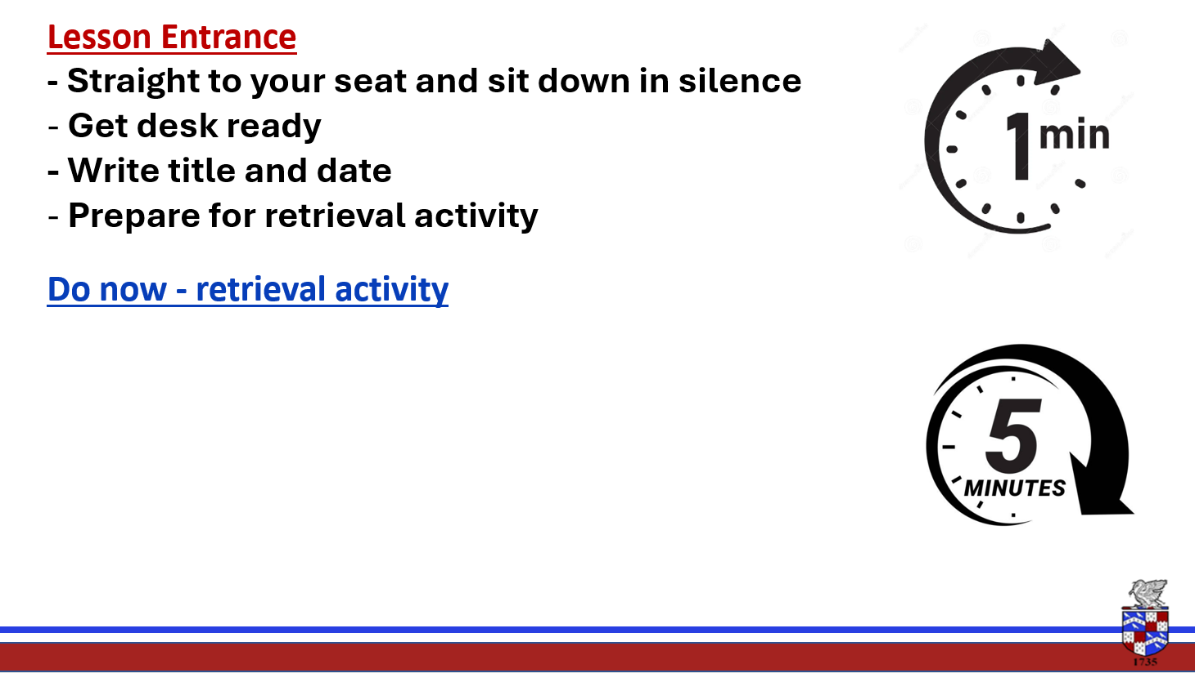
What does CAD stand for?
Name two advantages of using CAD

Slide 4

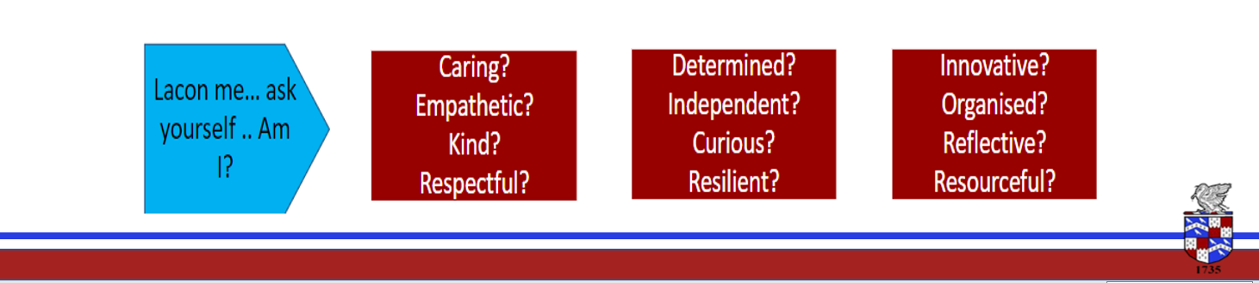
Lesson Intention - To understand what fair trade is? -To gain an understanding of the principles of the fairtrade cooperative and it entails. - To be able to give real examples of the benefits and disadvantages for the farmers and their communities. Key words – Farming, quality, fair, wages, premium, community, benefits Remember: follow instructions first time

Slide 5

Fairtrade

Slide 6

As a group we will watch the clips first.
After the clips we will have a discussion on what we think about fairtrade and give examples of how it helps.
Unravelling the Thread | The Story of Fairtrade Cotton
https://www.youtube.com/watch?v=mbFBP35rOcw
https://www.youtube.com/watch?v=c9R-5OjUPT4

Slide 7

Create a mind map all about fairtrade
What is it?
What does it involve?
What do the farmers need to do differently?
How does the community benefit?
Include a drawing of the fairtrade logo.
Use the next slide to help you with the mindmap

Slide 8
Fairtrade principles
Fairtrade producers must meet certain standards. This gives benefits to workers, the environment and the producers themselves.
Fairtrade makes sure that workers get a fair price/fair working conditions.
Environmental standards aim to reduce the environmental impact in ways such as-
Reducing the small-scale of pesticides used
Reducing the greenhouse gas emissions
Protecting biodiversity.
Social standards provide –
Fair terms of trade – Higher prices for the produce of small-scale farmers and workers, allowing them to earn a better income so that they can afford to feed their families.
Safer working conditions
Fairtrade premiums – Money for farmers and workers to help their community in an area they wish to improve, e.g. schools, roads, healthcare etc.
For these reasons designers may deliberately choose to use Fairtrade materials in their product over those with fewer social and environmental benefits.

Slide 9
Questions
What is fairtrade?
How does fair trade help the farmers and their communities?
How does fair trade help the environment?
Why might a designer/company choose you buy fairtarde materials to make their product even though they may be more expensive and have less choice?

