Slide 1

The Study of Religion: Paper 1
Christianity Beliefs
Revision Cards

Slide 2
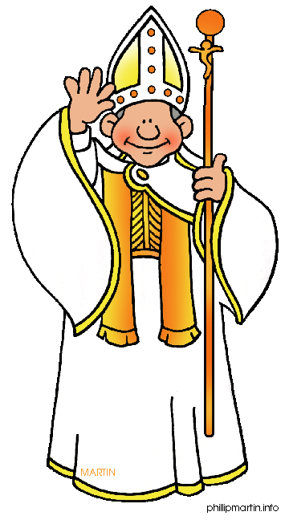
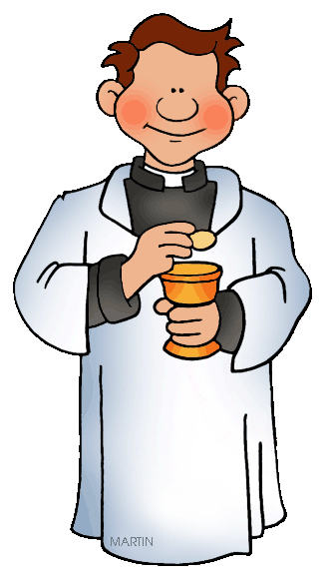

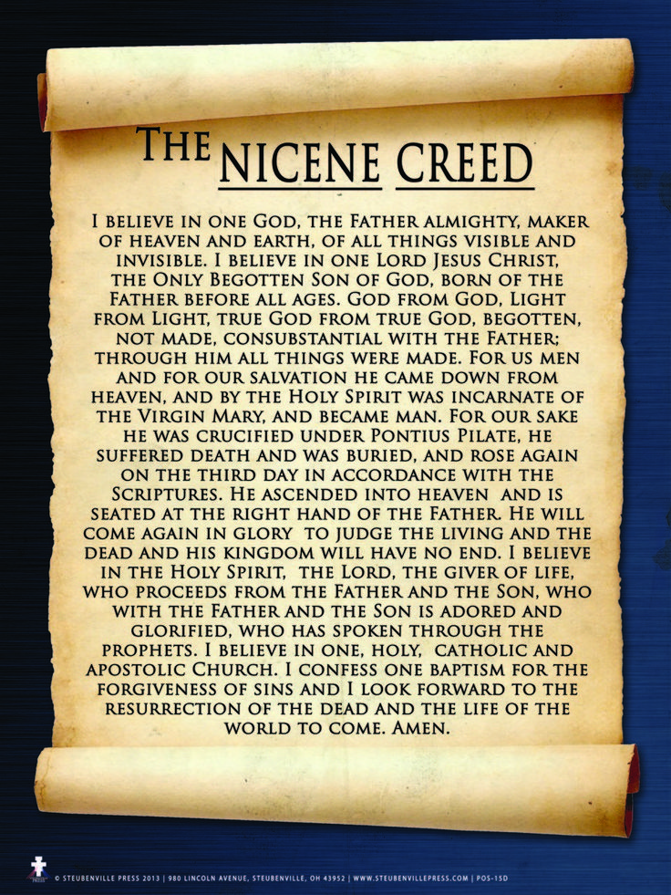
The Nature of God
Christianity
Protestant
Split from the Catholic Church in the 16th Century. e.g. Methodist, Baptist, Church of England
Catholic
Based in Rome (Vatican City) and led by the Pope
Orthodox
Split from the Catholic Church in the Great Schism (1054). Generally practised in Eastern Europe.
Christian beliefs about God
There is only one God.
God is the creator of all that exists.
People have a relationship with God through prayer.
Neither male nor female but has qualities of both.
God is holy (worthy of worship)
Jesus is the Son of God.
“We believe in One God.”
The Nicene Creed

Slide 3


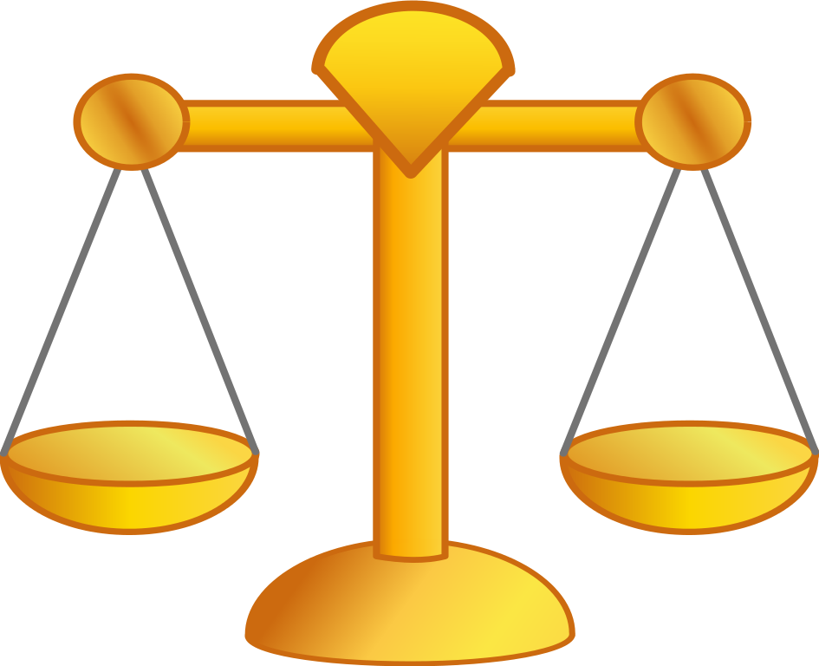

God as Omnipotent, Loving and Just
Omnipotent | Benevolent | Just
God is the supreme being who is all powerful. God has unlimited authority. God shows his power when he created the world. “Anything is possible with God.” When the Angel Gabriel told Mary she was pregnant even though she was a virgin. | God uses his power to do good. Showed his live by creating humans and caring/ giving his love to them. Showed his love by sending Jesus, his son to earth to die so humans could gain salvation. “God so loved the world that he gave his one and only son.” | God is a just (fair) judge on humanity. God will never support injustice or prejudice. God will judge the living and the dead on judgement day (the end of the world) and decide whether people will go to heaven or hell.
The Problem of Evil and Suffering:
If God is loving- why does he allow people to suffer?
If God is powerful- why does he not prevent evil and suffering?
If God is just- why does he allow injustices to take place?
Responses to the Problem of Evil and Suffering:
David Hume’s Triangle- He cannot be both loving and all powerful.
Human’s free will- take responsibility for our own actions.
The Devil- Tempts us into going against God and committing sins.
Life is a test- we need to show God we are worthy of heaven.

Slide 4
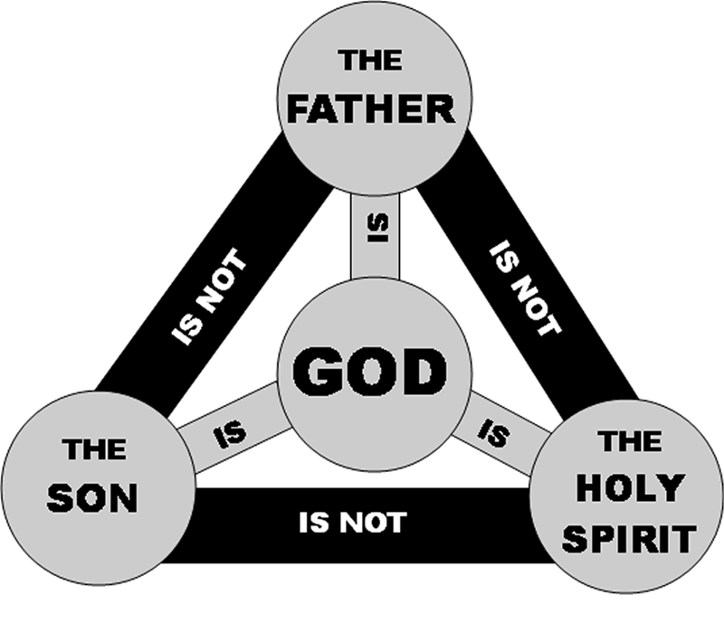
The Oneness of God and the Trinity
God the Father
Creator of all life
Father to his children
Omnipotent, omnibenevolent, omniscient and omnipresent.
God the Son
God incarnate (in flesh form) Jesus.
Fully human and fully divine (God) at the same time.c
God the Holy Spirit
Unseen power of God at work in the world.
Influences, guides and sustains life on earth.

Slide 5



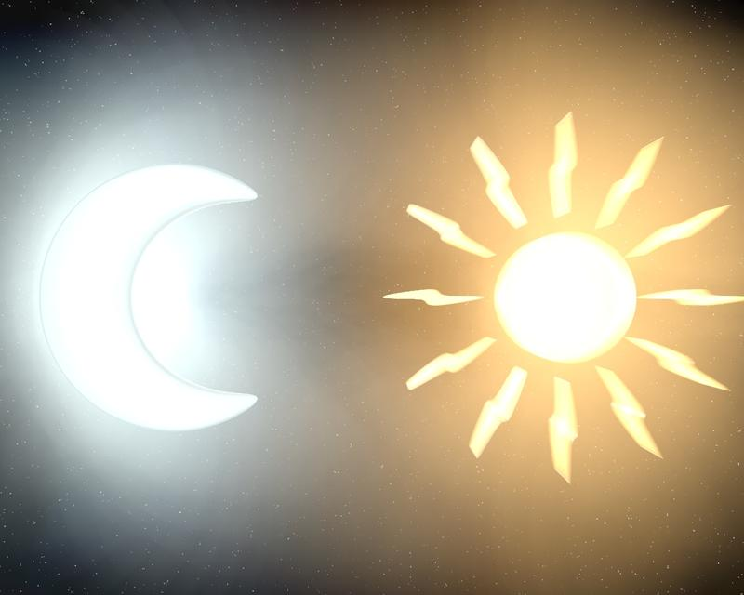
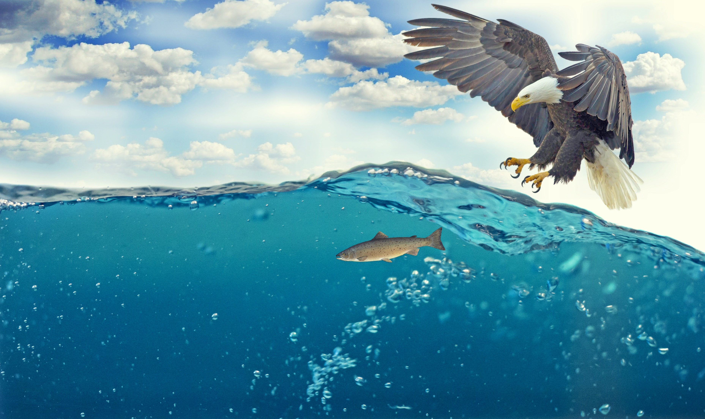
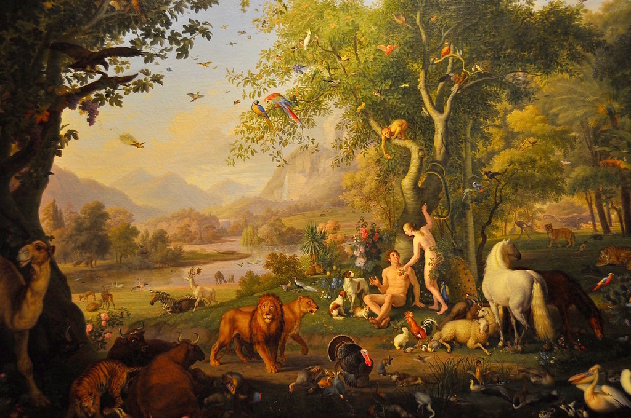


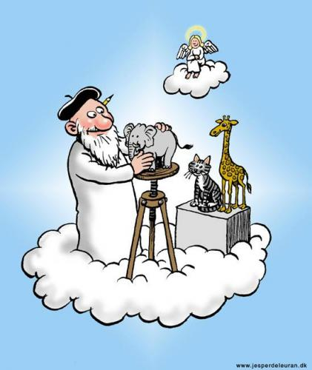


Creation
Genesis account of creation
Day 1: Day and Night | Day 2: The Sky | Day 3: The seas, land and all vegetation and plants | Day 4: The lights in the sky; the sun, moon and stars | Day 5: Fish of the sea and birds of the sky | Day 6: Animals of the Land and Humans (Adam and Eve) | Day 7: God rested and said it was good.
Different Christian responses to Genesis:
“In the beginning was the Word and the Word was with God and the Word was God.”
John 1:1-3
“In the beginning, God created the heavens and the earth… and the spirit of God was hovering over the waters.”
Genesis 1:1-3c
Literal | Linguistic | Mythical | Scientific
The creation story happened exactly as it is described in the Bible, so a day is ‘24 hours’. Fundamental Christians | There may be misunderstandings in the language of the story e.g. ‘day’ in Hebrew doesn’t mean a day in English | It is a myth- the Bible explains that God made the world and why, but it does not fully explain how. | Science can work in conjunction with the Christian creation story in Genesis.
This means…
Although God the Father is seen as ‘creator’, the Holy Spirit was active in creation.
This means…
The Word means Jesus, the Son of God (the Word of God) Jesus was too involved in creation.
Notes:
5

Slide 6
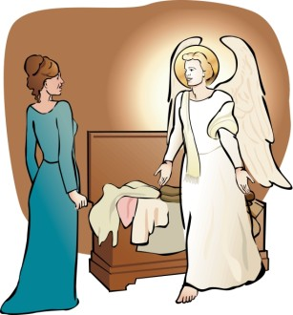
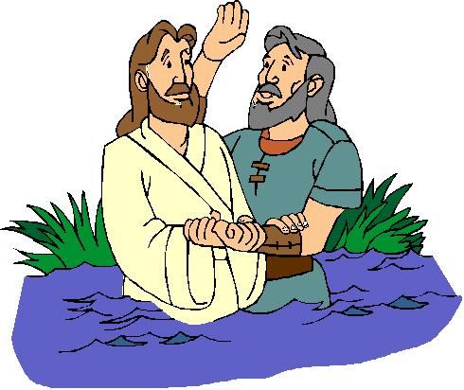
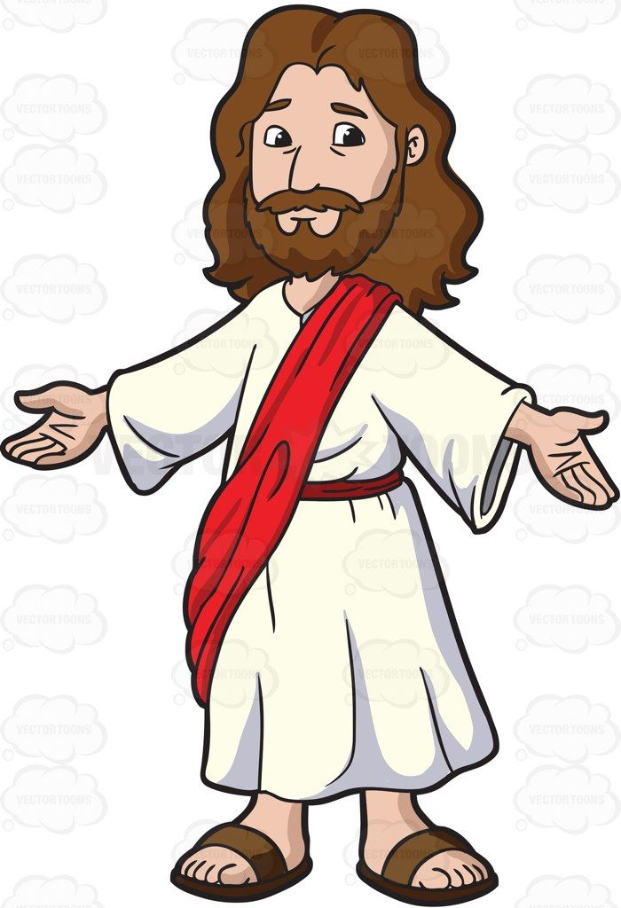
The incarnation of Jesus, the Son of God
The Incarnation
Angel Gabriel appeared to Mary to tell her that she was pregnant. Mary was a virgin. This had occurred through the Holy Spirit. The virgin conception is evidence that Jesus was the Son of God and part of the Trinity. Jesus lived for around 30 years.
Where else do we see Jesus as the Son of God?
When Jesus was baptised a voice from heaven spoke and a dove (the Holy Spirit) appeared. “This is my Son with Whom is am pleased” He also was called the Messiah by his disciples (although he told them not to say it many times- so he didn’t get arrested until his mission was over) He finally admitted to being the Messiah when the High Priest asked on his trial before his death.
Son of God, Messiah, Christ:
Jesus was fully human and fully God. This explains his powers (e.g. miracles) His teachings have authority because they are the word of God. “ The Word became flesh and is dwelling among us.” Most Jews expected the Messiah who was a warrior king; they did not believe this to be Jesus. Christians accept that Jesus is the Messiah. He is often called Christ (‘anointed one’)

Slide 7
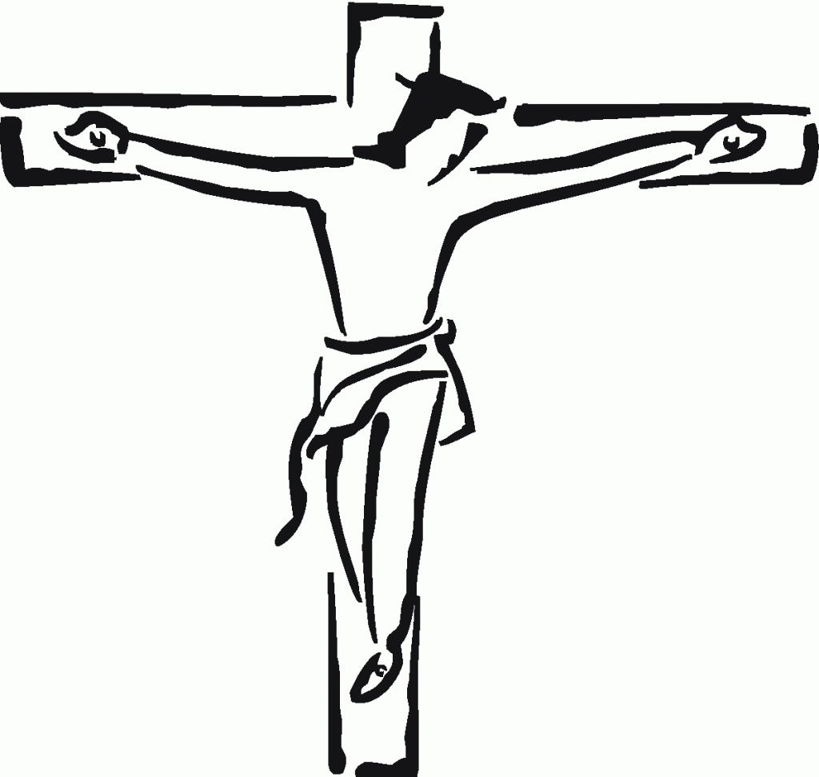
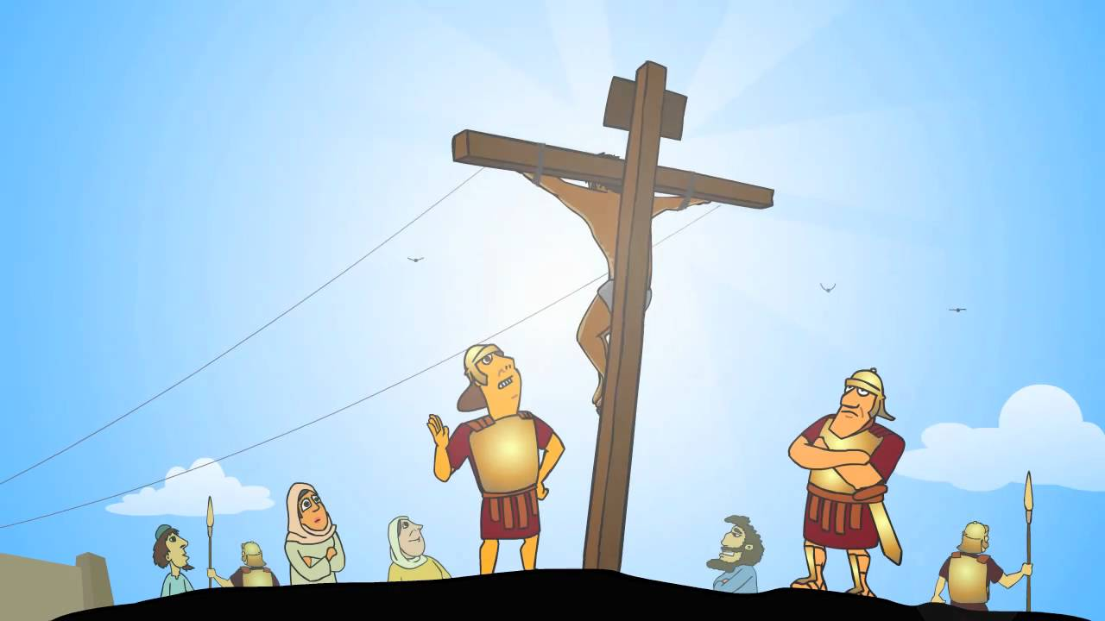
The Crucifixion
What happened?
Being fully God but also fully human, Jesus suffered pain. A centurion accepted that Jesus was the Son of God. The guards made sure Jesus was dead. His body was put in a cave before the Sabbath day.
Why is it important?
It shows that Christians will be forgiven for their sins if they are truly sorry. God understands human suffering because of the suffering of his son, Jesus. Suffering is a part of human life, just as it was part of Jesus’ life. It shows that Jesus was fully God and fully man. It teaches Christians that forgiveness is possible- Criminals on the cross. Teaches Christians that God loves them
“Surely this man was the Son of God!”
Mark 15:39
“Jesus called out with a loud voice, ‘Father, into your hands I commit my spirit.’ When he had said this, he breathed his last.”
Luke 23:46

Slide 8
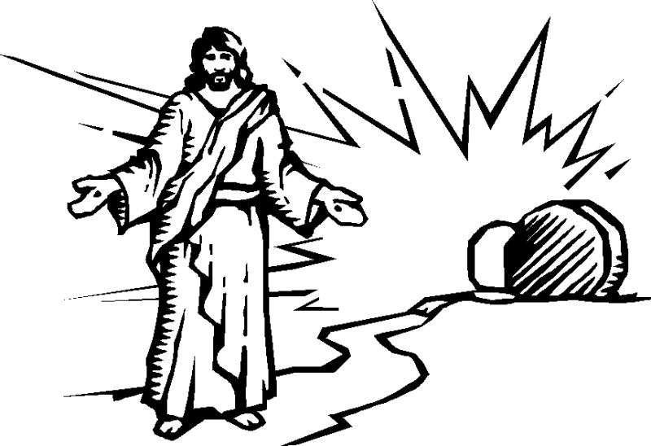
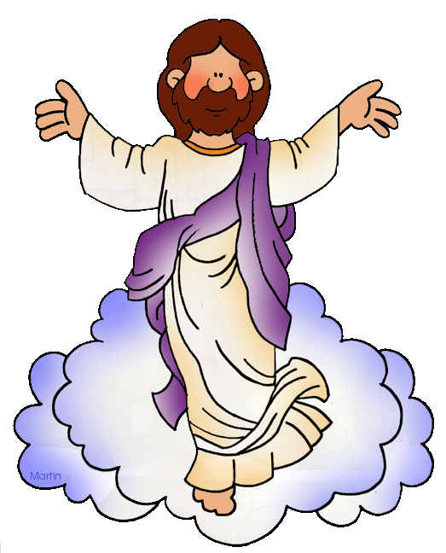
The Resurrection and Ascension
What happened?
On the Sunday morning, some of Jesus’ female followers visited the tomb. Jesus’ body was not there. The women were told by a man that Jesus had risen from the dead. Over the next few days, Jesu appeared to several people as he had prophesised.
It is significant because…
Shows the power of good over evil and life over death.
Means sin will be forgiven.
Christians will too be resurrected if they accept Jesus.
Shows that there is life after death.
The Ascension
After meeting with his disciples and asking them to on his work, Jesus left them for the last time. He returned to the Father in Heaven. This was 40 days after the resurrection. When Jesus ascended into Heaven the Holy spirit came to the disciples. This was known as Pentecost. The Holy Spirit gave the disciples the gifts to spread the word for example- Speaking in tounges.
It is significant because…
Shows that Jesus is with God in heaven.
Prepare for God to spend the Holy Spirit to provide comfort and guidance.

Slide 9
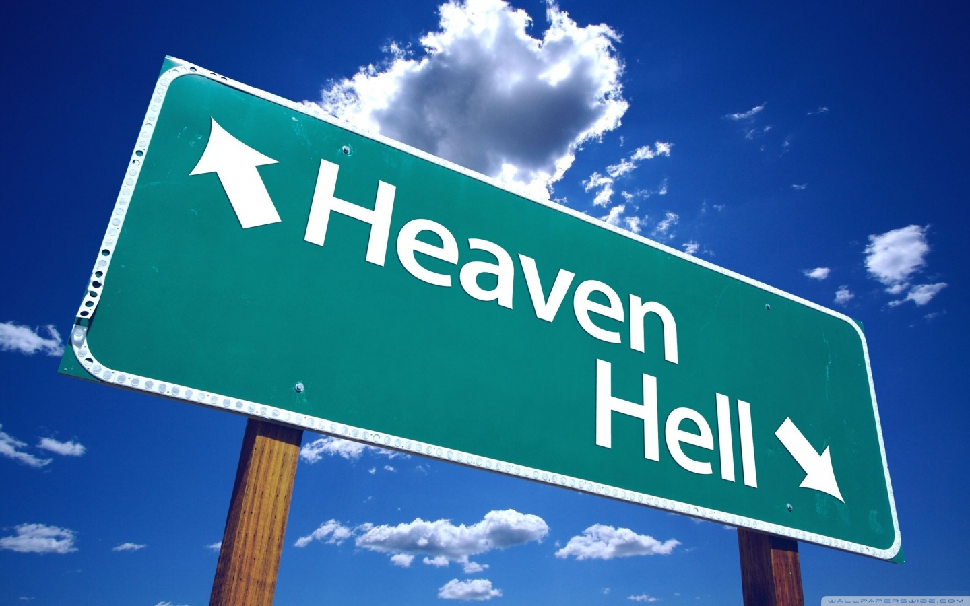
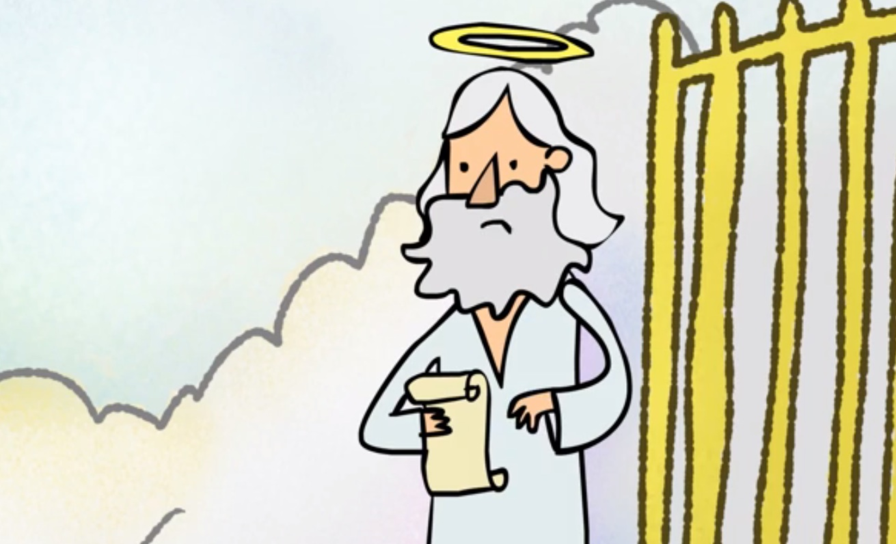
Resurrection and Life after Death
When will resurrection happen?
Some Christians believe a person’s soul is resurrected soon after death. | Other Christians believe the dead will be resurrected on the Day of Judgement.
How will the resurrection happen?
Catholic and Orthodox Christians believe in physical (bodily) resurrection – this will be a transformed body. (The best version of itself) | Other Christians believe that resurrection will just be spiritual (resurrection of the soul) rather than physical.
Gives hope of a future life with Jesus
Gives confidence in the face of death
Inspires Christians to live their life as God expects
A belief in the resurrection
Means life after death is real
Shows Christians how much God loves them.
Notes:
9

Slide 10
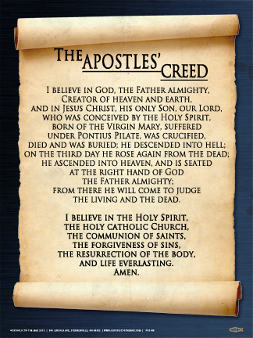
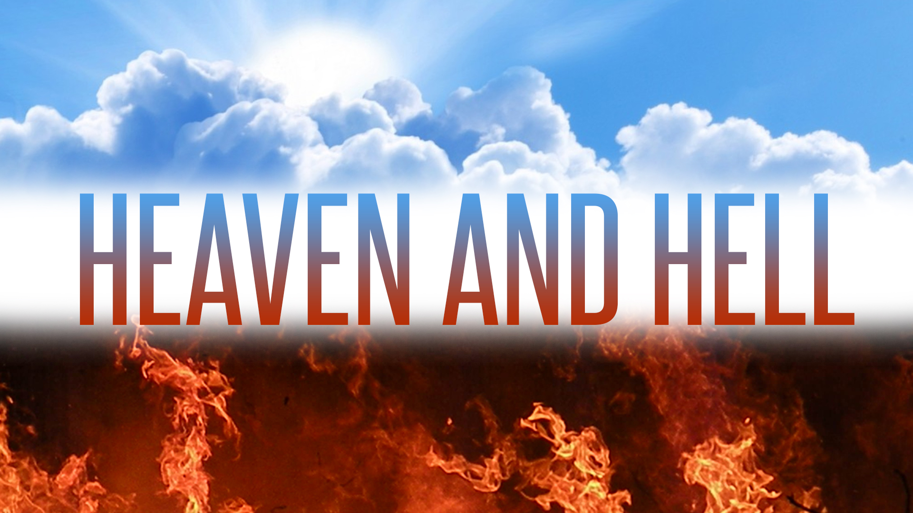


The afterlife and judgement
The Afterlife
Christians believe they will be resurrected and receive eternal life. This is a gift from God and is dependant upon faith (belief) in God. They will be judged by God, being sent to Heaven or Hell (or purgatory). Some believe judgement will happen soon after death. Others believe judgement will occur on the Day of judgement.
“Jesus will come against to judge the living and the dead… I believe in the resurrection of the body and the life everlasting.”
The Apostles Creed
Judgement
Christians believe that after they die, God will judge them on their actions as well as their faith in God. The Parable of the sheep and goats describes how God will judge people. This parable teaches Christians that in serving others, they are serving Jesus. Jesus said that having faith in him and following his teachings is essential for being able to reach heaven.
“I am the way, the truth and the life. No one comes to the Father except through me.”
John 14:6

Slide 11
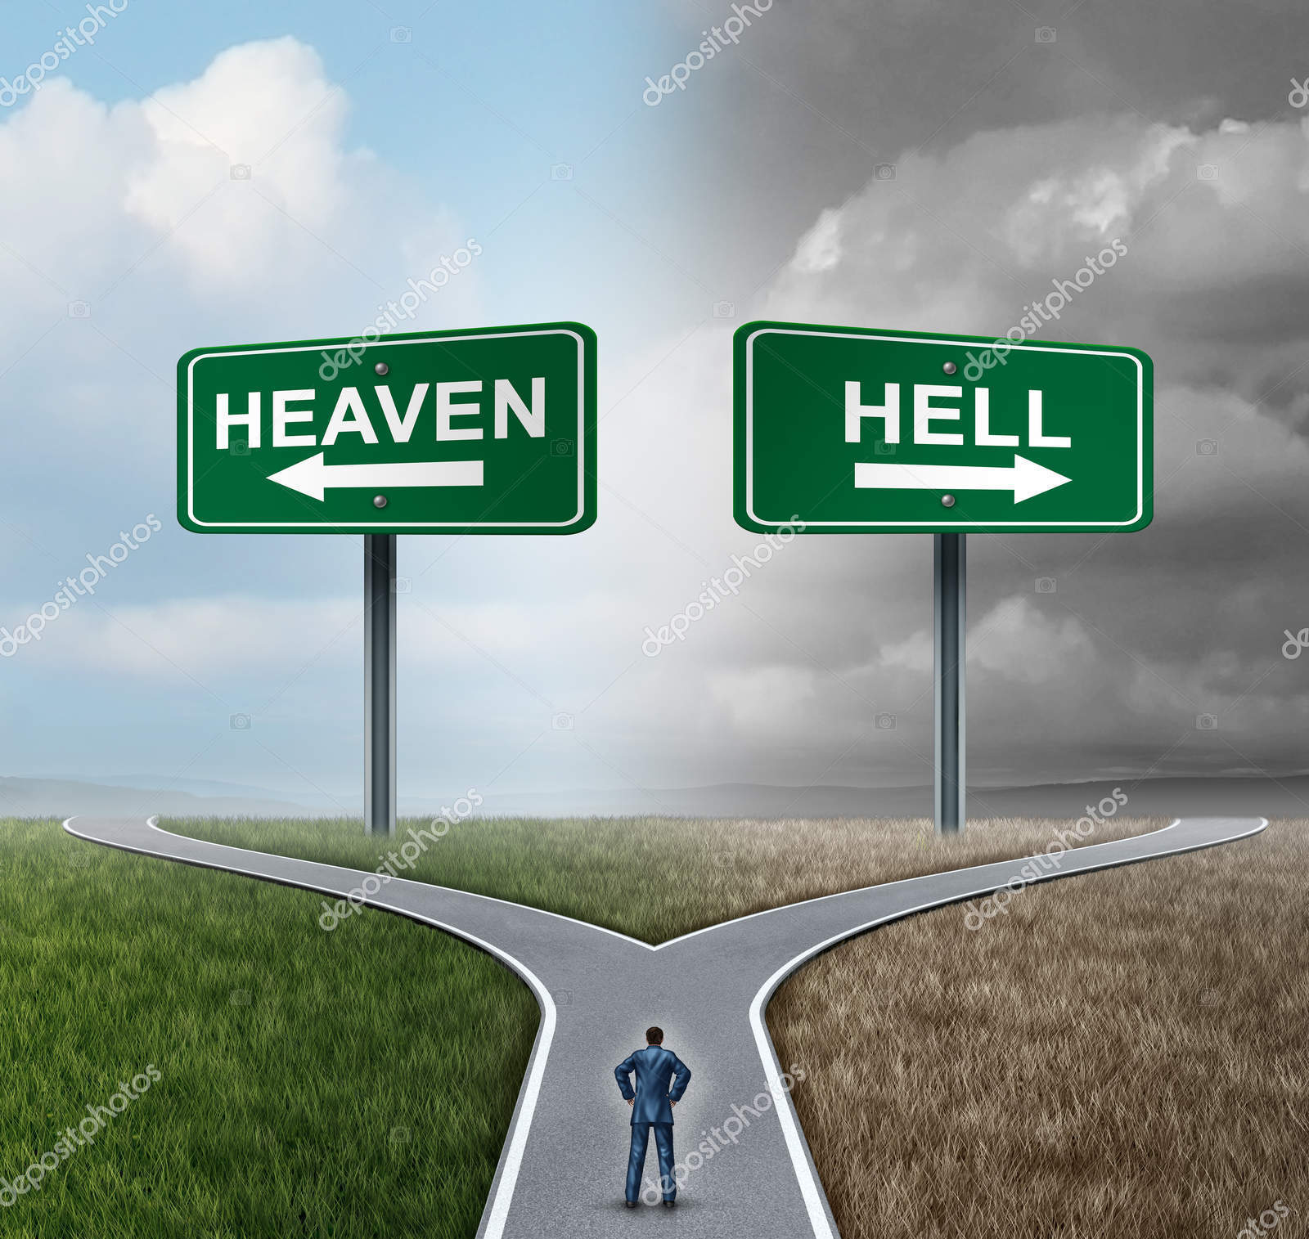
Heaven and Hell
Judgement
Heaven
Thought to be either a physical or a spiritual place.
Traditional images show God on a throne with Jesus and angels.
A reward for both faith (believing in God) and actions (doing what God has asked.)
Purgatory
An in-between state where should are cleansed in order to enter heaven.
Only a belief for Catholic Christians.
Hell
A state of existence without God.
A place of eternal torment ruled over by Satan (the Devil).
Being cut off from the possibility of God.
Awaits people who did not worship God or follow the teachings of God.
Teachings about Judgement, Heaven and Hell:
Parable of Lazarus and the Rich Man A rich man does not help a poor man called Lazarus. Lazarus goes to heaven whilst the rich man goes to hell. Once dead the rich man cannot go back to right his wrong. Christians should follow the teaching of Jesus, and care for other people, in order to get to heaven after death. | Parable of the Ten Bridesmaids At a wedding five bridesmaids have brought extra oil for their lamps whilst the other five have forgotten. Whilst they wait for the groom they begin to run out of oil and up locked out of the party. This teaches Christians that they should always be prepared for judgement.
Parable of the Fishing net Jesus taught that Judgement Day is like a fishing net that fishermen put out to the sea which catches all types of fish; the fishermen then separate the good fish from the bad. This teaches that the good will be separated from the bad. | Parable of the Prodigal Son A man had two sons, one asked for this share of the inheritance and left home leading a foolish life. When he ran out of money he returned to his father, who celebrated his return. God welcomes anyone who has turned away and wants to return showing sorrow and asking for forgiveness

Slide 12



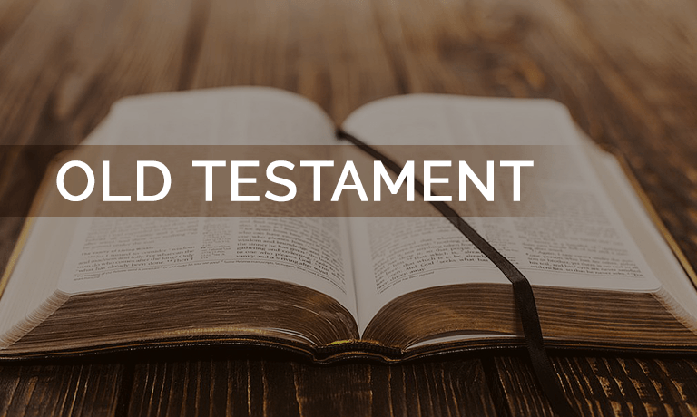
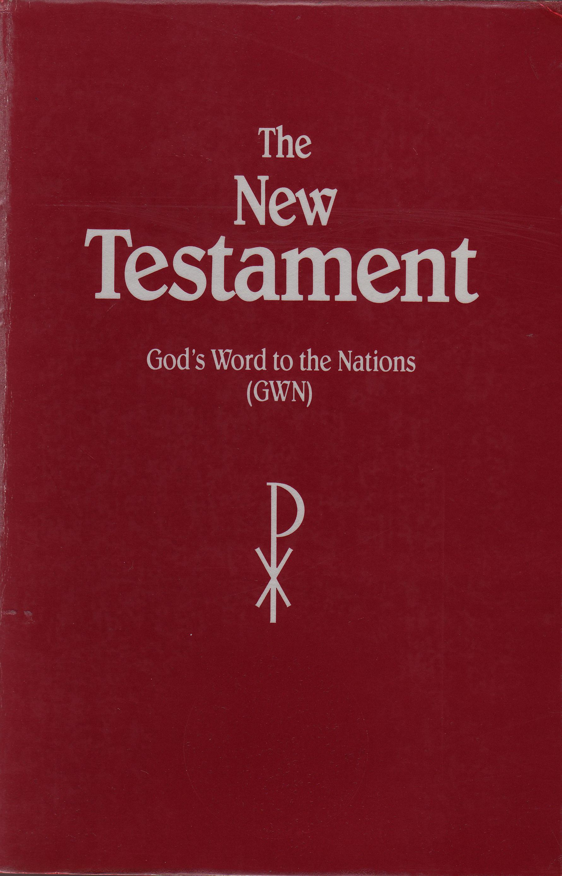
Sin and Salvation
Sin:
Thoughts or actions that separates humans from God.
Some sins are illegal (e.g. murder)
Others are legal but against the laws of God (e.g. adultery)
Original Sin:
The belief that we are born with a built in tendency to sin.
Come from Adam and Eve who committed the first sin.
Caused separation from God.
Free Will:
Humans should use freedom to make choices God approves of.
God provides guidance on how to live, for example, the Ten Commandments.
Salvation:
To be saved from sin and its consequences and to be granted eternal life with God.
Salvation repairs the damage caused by sin.
Salvation
There are two main Christian ideas about how salvation comes about:
Salvation through Good work
The Old Testament makes it clear that salvation comes through faith in God and obeying God’s laws set out in the Bible
Salvation through Grace
Salvation is given freely by God, through the Holy Spirit, through faith in Jesus. It is not deserved but is a free gift of God’s love.
“Faith without action, is dead.”
James 2:17
“For it is by grace that you have been saved…”
Ephesians 2:8

Slide 13
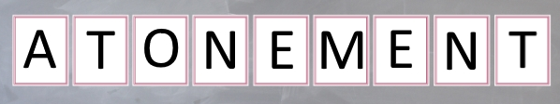
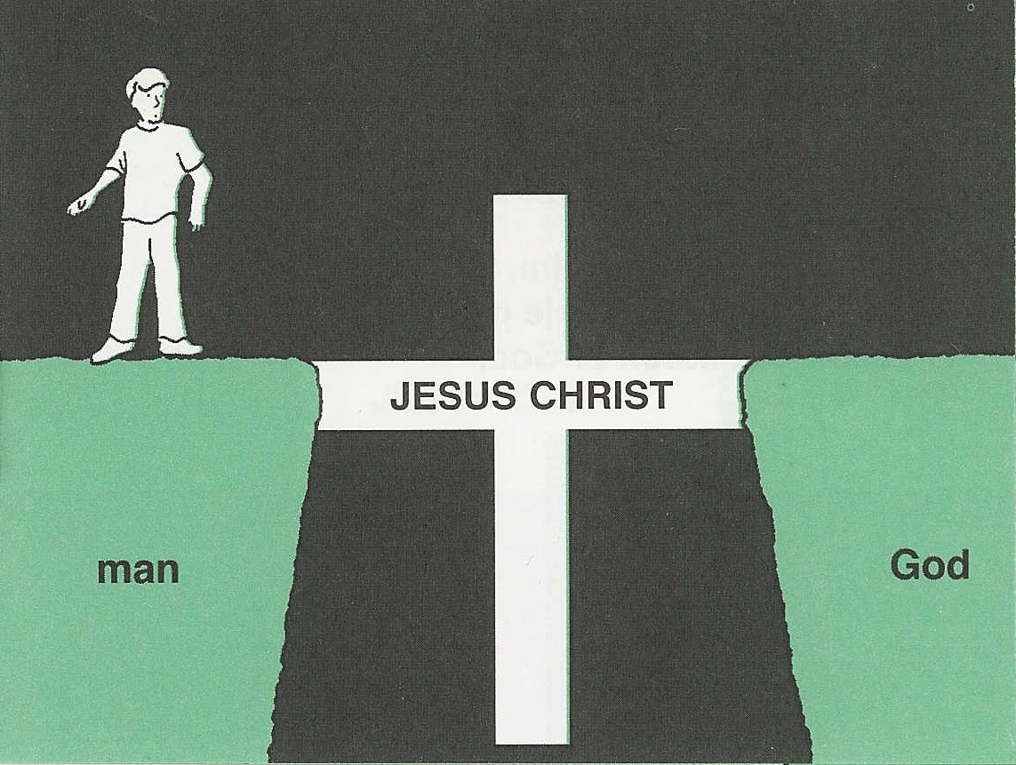
The Role of Christ in Salvation
The Role of Christ in Salvation
Jesus’ crucifixion made up for the original sin of Adam and Eve. The death of Jesus was necessary to restore the relationship between God and humanity. Jesus’ resurrection shows the goodness of Jesus defeated the evil of sin. God accepted Jesus’ sacrifice on behalf of humanity. Jesus’ resurrection means humans can now receive forgiveness for their sins. Jesus’ death and resurrection made it possible for all to receive eternal life.
“For God so love the world that he gave his one and only son that whoever believe in him shall not die but have eternal life.”
John 3:16
Atonement
Atonement removed the effects of sin and allows people to restore their relationship with God. Through his sacrifice, Jesus took the suns of humanity on himself and paid the debt. He atoned for the sins of humanity. This sacrifice makes it possible for all who follow Jesus to receive eternal life.
“Jesus is the atoning sacrifice for our sins and not only for ours but for the sins of the whole world.”
1 John 2:1-2

