Slide 1

GCSE English Literature/ Language
Information for Parents

Slide 2
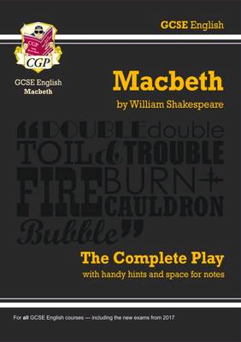
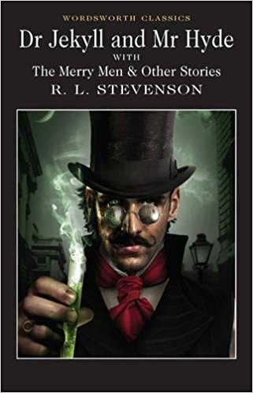
GCSE English Literature
For this year the papers will be…
Paper 1 Shakespeare and 19th century prose 17th May 1 hour 45mins
Section A: Shakespeare – ‘Macbeth’ 30 marks + 4 for SPAG (extract provided)
Section B: ‘Dr Jekyll and Mr Hyde’ OR ‘A Christmas Carol’ 30 marks
For both questions, an extract is provided and students have to make references to elsewhere/ know quotations)
Paper 2 Modern Play and Poetry 24th May 2 hours 15 mins
Section A: A choice of 2 questions on: ‘An Inspector Calls’ or ‘Blood Brothers’. Closed text, no extract. 30 marks + SPaG 4 marks
Section B: Poetry Anthology Power and Conflict poems. One question, one poem given and students choose another to compare. 30 marks
Section C: Unseen poetry analysis 24 marks
Comparison with second poem 8 marks

Slide 3
GCSE English Literature AOs
The Assessment Objectives are the same for each paper but may be weighted differently.
A01: Read, understand and respond to texts – whole text, task and quotations
A02: Analyse the language, form and structure (methods) used by writers to create effects, using appropriate subject terminology
A03: Show understanding of the relationships between texts and the social/ historical contexts in which they were written.
A04: use a range of vocabulary and sentence structures for clarity, purpose and effect, with accurate spelling and punctuation (only 4 marks for both questions on P 2)
.

Slide 4
There are two possible ways to approach this question.
Approach A: Linking extract to whole text throughout
Highlight key words in the question.
Annotate the passage for ideas/ methods/quotes to explore.
Identify links to elsewhere in the text – could be similar ideas/ methods or contrasting to show change.
Write a paragraph on the extract followed by a linked paragraph on the whole text.
Go back to the extract again and aim to do this 3 times.
Approach B: Extract first, then whole text
Highlight key words in the question.
Annotate the passage for ideas/ methods/ quotes.
Cover at least 2 paragraphs based on ideas/ methods in the extract.
Cover at least 2 paragraphs based on ideas/ methods elsewhere in the play.
 | Approaching the question. In each paragraph aim to include:
Method/ AO2 | The writer uses …Method used - linked to language, imagery or dramatic devices
Q | Quotation or even better …
EQ | Embedded quotation (integrated in a sentence)
Effect | An effect of the quote/ word level analysis
AO1 links | Links to ideas in another part of the text
AO3 | Link to context e.g. ideas linked to kingship, the suoernatural, women
So/ therefore/ thus | ‘So’ sentence reflecting on the effect on the audience
Dev comment | Ideas developed in detail - go one step further.

Slide 5

Our approach to the extract questions
Questions likely to be about character or theme
Students will be given an extract from each text to start them off
In this extract from Act 1 King Duncan is receiving news regarding the battle against the Norwegians
MALCOLM
This is the sergeant
Who like a good and hardy soldier fought
'Gainst my captivity. Hail, brave friend!
Say to the king the knowledge of the broil
As thou didst leave it.
Sergeant
Doubtful it stood;
As two spent swimmers, that do cling together
And choke their art. The merciless Macdonwald--
Worthy to be a rebel, for to that
The multiplying villanies of nature
Do swarm upon him--from the western isles
Of kerns and gallowglasses is supplied;
And fortune, on his damned quarrel smiling,
Show'd like a rebel's whore: but all's too weak:
For brave Macbeth--well he deserves that name--
Disdaining fortune, with his brandish'd steel,
Which smoked with bloody execution,
Like valour's minion carved out his passage
Till he faced the slave;
Which ne'er shook hands, nor bade farewell to him,
Till he unseam'd him from the nave to the chaps,
And fix'd his head upon our battlements.
DUNCAN
O valiant cousin! worthy gentleman!
Question: Starting with this extract how does Shakespeare present Macbeth as both a hero and a villain in the play?
Section A Paper 1: ‘Macbeth’
30 marks plus 4 on offer for SPaG
55 minutes(5 mins for proofreading)
Our approach to the extract question:
Read through all of the information given and the text and aim to pinpoint where in the play the extract is from
Start to highlight and annotate the extract based on the AOs
Begin to make links between other parts of the play (jotting down relevant quotations from memory)
Plan 3 well developed paragraphs to answer the question using EXTRACT, WHOLE, WHOLE structure
We also teach them to follow a formula for each paragraph them to hit all of the individual criteria
subject terminology; recognising the writers’ methods; using quotations; exploring the effect of individual words; considering the effects on the audience/ reader and making links to the context.

Slide 6

Literature Paper 1 Section B: ‘Jekyll and Hyde’ OR ‘A Christmas Carol’
For example: Starting with this extract, how does Stevenson create a sense of horror within ‘Jekyll and Hyde’?
…as he lay and tossed in the gross darkness of the night and the curtained room, Mr. Enfield's tale went by before his mind in a scroll of lighted pictures. He would be aware of the great field of lamps of a nocturnal city; then of the figure of a man walking swiftly; then of a child running from the doctor's; and then these met, and that human Juggernaut trod the child down and passed on regardless of her screams. Or else he would see a room in a rich house, where his friend lay asleep, dreaming and smiling at his dreams; and then the door of that room would be opened, the curtains of the bed plucked apart, the sleeper recalled, and lo! there would stand by his side a figure to whom power was given, and even at that dead hour, he must rise and do its bidding. The figure in these two phases haunted the lawyer all night; and if at any time he dozed over, it was but to see it glide more stealthily through sleeping houses, or move the more swiftly and still the more swiftly, even to dizziness, through wider labyrinths of lamplighted city, and at every street-corner crush a child and leave her screaming. And still the figure had no face by which he might know it; even in his dreams, it had no face, or one that baffled him and melted before his eyes;
‘Dr. Jekyll & Mr Hyde’ Or A ‘Christmas Carol’
30 marks
50 minutes
Our approach to the extract question:
Read through all of the information given and the text and aim to pinpoint where in the novel the extract is from
Start to highlight and annotate the extract based on the AOs
Begin to make links between other parts of the story (jotting down relevant quotations from memory)
Plan 4-6 paragraphs to answer the question using EXTRACT, WHOLE, EXTRACT, WHOLE structure
We also teach them to follow the same formula for each paragraph

Slide 7



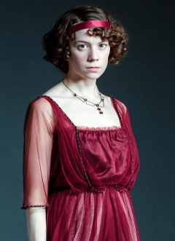

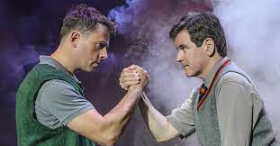
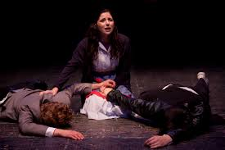
Literature Paper 2 :‘An Inspector Calls’ J.B Priestley or ‘Blood Brothers’ Willy Russell
45 mins 30 marks + SPaG 4 marks
One question from a choice of two (character / theme based)
Our approach to this question:
Students need to be confident with the playwright’s ideas, themes, characters and devices used
They will need to know key quotations and be confident with citing evidence from across the text, both through speech and stage directions.
They should plan 3-5 key moments / methods used within the play to explore that relate to the question they select
They will be taught a formula for each paragraph that ensures they hit the mark scheme

Slide 8
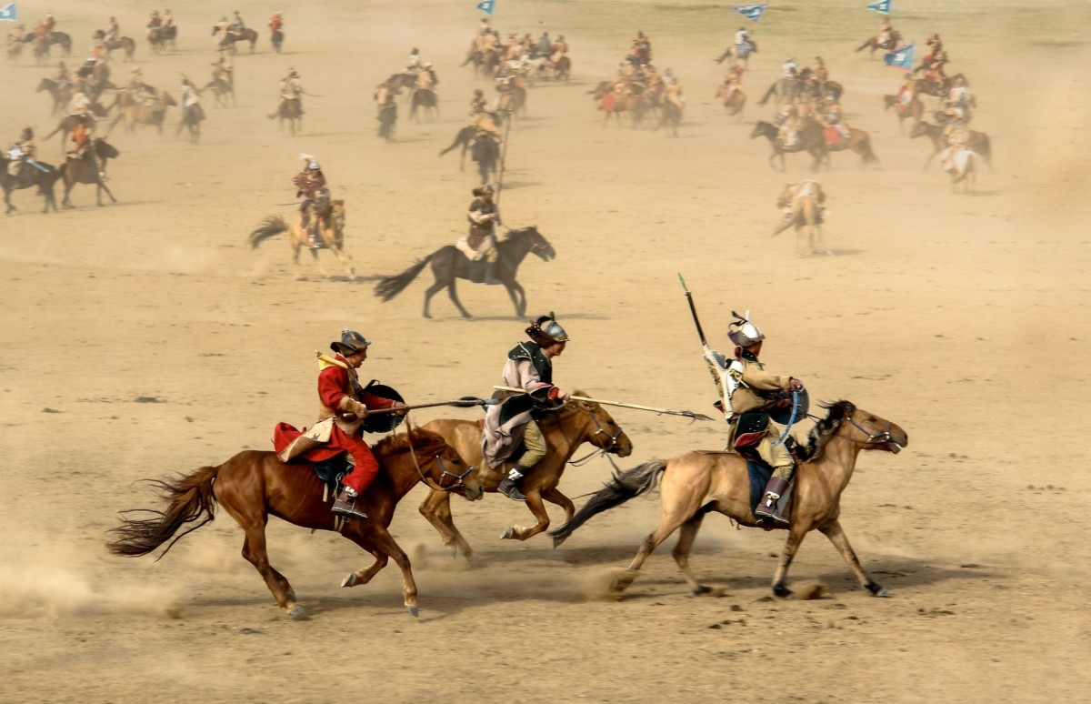
Literature Paper 2 : Section B Poetry Anthology (prepared poetry from Power and Conflict section of the anthology)
45mins 30 marks
One question. One poem given. Students will choose a second poem to compare with the first depending on the question and the named poem.
Our approach to this question:
Students need to be confident with at least 6 poems from across a variety of themes: identity, power, war, nature, places, conflict.
They will need to know key quotations and be confident with citing evidence from across a range of poems and exploring the methods used by poets
They will need to know the background about each poem, too.
They must remember it is a comparison and so should focus on using comparative words throughout each paragraph.
They will be taught a formula for each paragraph that ensures they hit the mark scheme

Slide 9

Literature Paper 2: Section C Unseen Poetry 45mins (2 questions)
Nettles
My son aged three fell in the nettle bed.
'Bed' seemed a curious name for those green spears,
That regiment of spite behind the shed: It was no place for rest.
With sobs and tears The boy came seeking comfort and
I saw White blisters beaded on his tender skin.
We soothed him till his pain was not so raw.
At last he offered us a watery grin,
And then I took my billhook, honed the blade
And went outside and slashed in fury with it
Till not a nettle in that fierce parade
Stood upright any more.
And then I lit A funeral pyre to burn the fallen dead,
But in two weeks the busy sun and rain
Had called up tall recruits behind the shed:
My son would often feel sharp wounds again.
Vernon Scannell
Advice to a Teenage Daughter
You have found a new war-game called Love.
Here on your dressing-table stand arrayed brave ranks of lipsticks brandishing swords of cherry pink and flame.
Behold the miniature armies of little jars packed with the scented dynamite of flowers.
See the dreaded tweezers; tiny pots of manufactured moonlight, stick-on stars.
Beware my sweet; conquest may seem easy but you can’t compete with football, motor cycles, cars, cricket, computer-games, or a plate of chips.
By Isobel Thrilling
Unseen Poetry
a) 24 marks 30 minutes
b) 18 marks 15 minutes (plus SPAG 4 marks)
Two unseen poems
For the unseen poetry students need to have the independent skills and confidence to annotate an unseen poem in relation to ideas, structure and language devices.
Our approach:
Annotate poems based on AO1 and AO2
Look for wider themes and ideas
Cover 3 main points / paragraphs
For comparison use Both, however
a) In ‘Nettles’ how does the poet present ideas linked to a parent wanting to protect a child? 24 marks
b) What is similar or different in the methods poets use to convey ideas in ‘Nettles’ and ‘Advice to a Teenage Daughter’? 8 marks

Slide 10
GCSE English Literature
What your child can do to revise
Practise annotation of extracts;
Trace development of main characters and themes in a text through a visual plan/ poster;
Research background and context, reading others’ responses to the text;
Write plans and paragraphs based on essay questions, rather than the full answer;
Create mind maps and text maps, revision posters on plot, themes, characters, methods, quotations, historical/ social context;
Learn quotations with a partner – ‘Quote-offs’ on social media have worked well
Open the texts at random, with a partner summarise what happens just before and just after this point in the text;
Timed exam practice questions – using passages provided but also selecting your own passages and writing questions;
Get a partner to give a key theme from the text and see if you can speak about it for a minute without stopping;

Slide 11
GCSE English Literature
Ideas for how you can support your child
Encourage frequent testing of quotations (copied and put somewhere prominent around the house)
Talk about the texts and ask about themes/ characters/ context.
Watch film versions together and talk about how the text compares/ what is different? (Be aware merely watching films and understanding the plot of texts gives a basic level of understanding. It is knowledge of the actual language and structural devices in the text itself examiners will be rewarding).
Ensure their own copies of the text are re-read/ skim read and annotated
Re-read sections together and discuss
Test them on their revision cards on characters, themes, methods, context
Look at some unseen poems and discuss ideas and features they can spot

Slide 12
GCSE English Literature
Resources and revision material
Class notes and PowerPoints
Copies of the text – annotated
Audio versions of texts
Bitesize
Genius website
CGP books/ snap revision guides
Revision booklets with extracts provided by the department
You Tube – Mr Bruff/ Mr Sales in particular
Spark notes
Cliffsnotes
No fear Shakespeare

Slide 13

AQA English Language
2 Papers: 160 marks total
50% reading 50% writing
( they need to be hitting roughly half marks across the questions 2-5 for a 4, above this the grades are more concentrated )
Grade boundaries: 127 – 9, 117 – 8, 113 – 7, 98 – 6, 86 – 5, 76 – 4, 56 – 3, 36 – 2, 16 – 1
Key Messages
Read the sources - annotate
Follow the formula for the reading questions and know the skills rewarded on the mark scheme
Plan and develop writing sufficiently
Practise writing under pressure
Notes:
Students to apply their knowledge of caesura to their writing.
As a plenary: Get students to read out what they have written and to highlight the use of caesura to the class.

Slide 14
Key Messages
Work smart – under timed conditions (as in the exam) when it gets closer
Know the approach - prepare and practise – complete full responses to get out of the habit of giving up half way through
Vocabulary – experience it and use it
Use the writing booklet, build up vocabulary banks, lists of words linked to expressing viewpoint
Methods – key term we use referring to language and structural devices – they need to identify these and use in their own writing
Confidence – with literacy skills and developing extended writing
Be a critical reader – think about the writer’s intentions and the viewpoint – the bigger picture

Slide 15
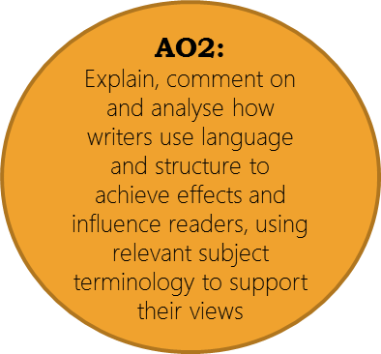
The ASSESSMENT
OBJECTIVES
Reading AO3
Compare writers’ texts and ideas (also links to context for Literature)
Reading
AO1:
Identify and interpret explicit and implicit information;
Select and synthesise evidence from different texts
Evaluate texts critically and support this with appropriate textual references
Reading AO4
Writing
AO6
use a range of vocabulary and sentence structures, with accurate spelling and punctuation
Writing
AO5:
Communicate clearly and imaginatively
Organise ideas

Slide 16
Questions will be phrased in a similar line to the this:
The ‘WHAT?’ | Q1 AO1 | Read specified lines in the Source. List four things from this part of the source … | Skills: a retrieval task: find specific information relating directly to the questions and the lines specified. Do not process information. Students may quote directly, use own words or paraphrase. Needs to include subject and be a clear statement. | 2.5% 5 mins 4 marks
The ‘HOW?’ | Q2 AO2 Lang | Read the specified lines in the Source. How does the writer’s use of language … | Selecting best use of language (words/ phrases, LFs, sentence forms); state the LF; quote; analyse the effect on the reader. Comment on how the use of language shapes your response. It is the quality of the analysis of language which moves students up the mark scheme. | 5% 15 mins 8 marks
The ‘HOW?’ | Q3 AO2 Structure | Whole of the Source. How has the writer structured the text to interest you as a reader? | Skills: beginning and ending; shifts in focus; widening or narrowing of focus; repeated motif; short para/sentence for specific dramatic; changing perspectives; changing focuses. | 5% 15 mins 8 marks
The ‘WHY?’ | Q4 AO4 Evaluate | A statement will be made. The question will start: ‘To what extent do you agree …?’ | Consider the how (methods) and the why (writer’s intentions). Needs a sense of critical detachment. Expressing an opinion evidenced through references to the text. Analyses the effects of the writer’s methods ( lang or structural devices). Include a range of relevant quotations and justify opinions. Interrogate the text and ask questions leading from the what to the how to the why. Students can agree/ challenge the statement or do a bit of both. Use of topic sentences and connectives to build a structured argument across paragraphs beneficial e.g. Furthermore, Conversely, On reflection. | 12.5% 25 mins 20 marks
 | Q5 AO5 & 6 Writing | Either: Write a description/narrative suggested by this picture. Or: Describe/narrate … | PLAN for structure and effect. Communicate clearly; organise information; LFs to suit purpose; range of vocabulary; range of sentence forms; accurate spelling and punctuation. There will always be a colour image linking to the reading source. Use the reading source for ideas if need be e.g. structural effects, complex vocabulary. Proof read for your 5 easy ways and make changes. Quality not quantity. | 25% 45 minutes 40 marks

Slide 17
Questions will be phrased in a similar line to the this:
The ‘WHAT?’ | Q1 AO1 | True and False statements. Choose four statements which are true. | Skills: a retrieval task: find specific information relating directly to the questions and the lines specified. Some inference for understanding may be required. | 2.5% Up to 5 mins 4 marks
The ‘WHAT?’ | Q2 AO1 | Use details from both sources to write a summary of the differences or similarities. | Select, synthesise and make inferences. Will be based on a specific focus in the texts. Marks are for the quality of summary and inference not for the number of points selected. PEI and Link x 2 needed. Higher level responses will move more fluently between the two texts to synthesise and will give perceptive inferences. | 5% Up to 15 mins 8 marks
The ‘HOW?’ | Q3 AO2 Structure | Refer to Source B – read specified lines. How does the writer’s use of language…? | Skills: analysis of language; selection of a well-judged range of quotations; use subject terminology appropriately. PEA (analysis rather than explain for higher students, exploring effects and how these link to the writer’s intentions). | 7.5% 15-20 mins 12 marks
The ‘WHY?’ | Q4 AO4 Evaluate | Refer to the whole of both Sources. Compare how the writers have conveyed … | Focus here is on comparing the writer’s views/ perspectives and how these are conveyed through methods. Methods could include: structural features, sentence types and language features. Could be a focus on similarities or differences. | 10% 20 -25 mins 16 marks
 | Q5 AO5 & 6 Writing | Question will specify the format e.g. letter, speech, article. No choice. A statement will be given then the student writes in the form for the purpose and audience to express their point of view. EG: Write an article to your local newspaper in which you argue for or against this statement. | Communicate clearly; organise information; LFs to suit purpose; range of vocabulary; range of sentence forms; accurate spelling and punctuation. Use the magic list to generate ideas e.g. global, historical, personal, cultural perspectives. Use connectives (furthermore, in addition) to signpost progression of argument. Proof read for 5 easy ways and check evidence of form, audience and purpose. | 25% 40 -45 minutes 40 marks

Slide 18
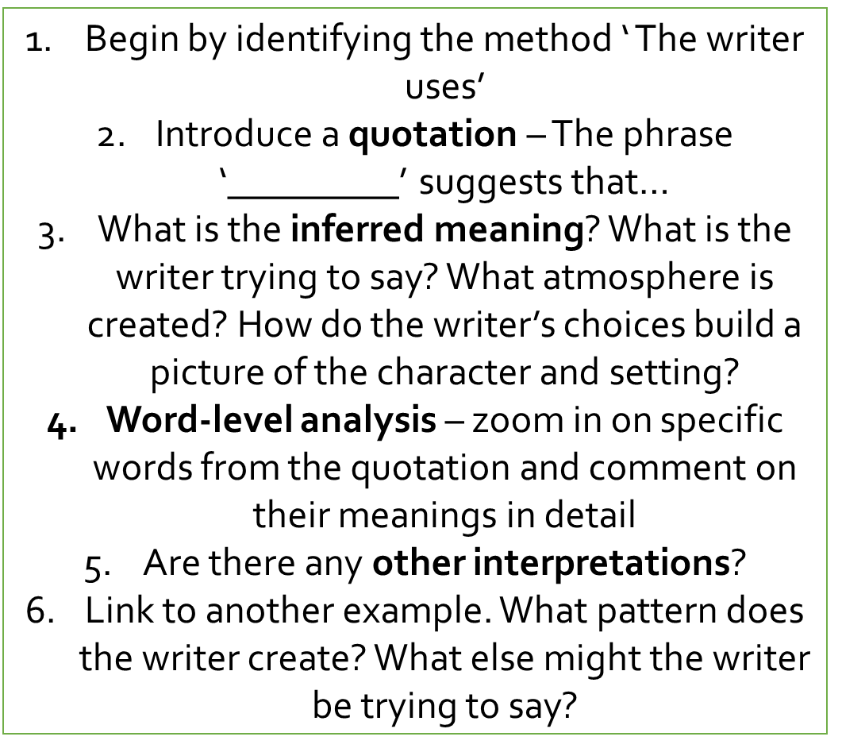
e.g. The writer employs an extended metaphor of power and strength to describe the Tyrannosaurus Rex. He says it ‘towered’ over the trees, the verb ‘towered’ suggesting that the huge creature is imposing itself on its jungle surroundings from a great height, and intimidating everything beneath it. It is personified as a ‘great evil god’, implying the Tyrannosaurus Rex is an all-powerful being without mercy, and also a ‘terrible warrior’, an image that conveys to the reader the idea of an invincible fighting machine destroying everything in its wake.
Paragraph sequence for language
Notes:
Read ‘Cat’ aloud and students must pause when the see and hear the pause within the line due to the punctuation.

Slide 19
Working towards success
Complete writing little and often.
Use sample papers and spend time crafting higher level responses at this stage, using more time if needed.
Closer to the exam test yourself by working under tighter time constraints.
Get feedback from your teachers.
Know what you need to focus on for each of the reading questions and strategies you can use for using time efficiently (e.g. annotating for q2 and 4 on Paper 2 at the same time)
Use YouTube tutorials for a fresh look at each question.
Plan descriptive writing you could perhaps use in the actual exam – description linked to the weather, a persona you could write from the perspective of.
Read editorial articles expressing viewpoints to become familiar with the style and practise writing opinion pieces yourself.
Use revision materials provided e.g. the writing booklet, breakdown of reading questions, past papers and mark schemes, sample answers in your books
Be Proactive - Know the questions you need to practise – questions 4 and 5 carry the most marks. Can you move up a few marks on past papers?
How will you address your areas of weakness? You need to actually write responses to get better – not just watch videos/ attend revision sessions.
Address literacy skills – use the literacy booklets to build confidence with punctuation and word classes. Learn key spellings. Learn and use vocabulary.
Notes:
Students to apply their knowledge of caesura to their writing.
As a plenary: Get students to read out what they have written and to highlight the use of caesura to the class.

