Slide 1



We want every single one of you to achieve both your personal and academic potential
Lacon ME advocates that four personal characteristics, four learning characteristics and four learning skills are key to unlocking your potential to enable you to do this
Lacon ME

Slide 2
Personal Characteristics
Am I…
Caring?
Empathetic?
Kind?
Respectful?

Slide 3
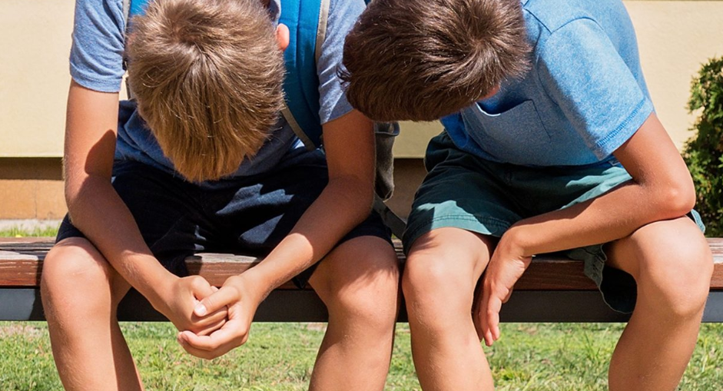
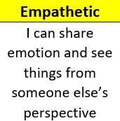

Slide 4
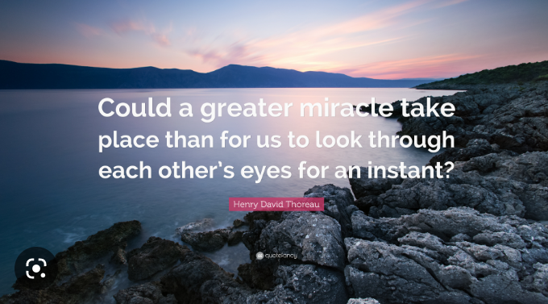
Empathy is defined as: “the ability to understand and share the feelings of others”. It’s essentially taking the time to place yourself in another person’s shoes – to try and feel what they’re feeling.
It is important that we sometimes see things differently – to think beyond what is immediately apparent.
To recognise that there is often more going on than meets the eye. To consider this before we speak/act.

Slide 5
Reflecting on this academic year, there have been times where we’ve been disappointed by some behaviour. Times where we have not been convinced individuals have stopped to consider how their actions or words might affect another.
Pupils saying unkind things about each other or posting unkind things on social media – without regard for how the victim might be left feeling or consideration for any other things that might be going on in their lives at that time
Pupils leaving food and litter in the food pod – without care for those that have spent time preparing the food or for those pupils who will have to clear their mess up!

Slide 6
BUT…
We have also been hugely encouraged and impressed by those who have clearly taken the time to understand and share the feelings of others:
An email from a member of the public about a Year 8 pupil who picked up her shopping in the street in Cleobury Mortimer when her bag split – rather than walking by and leaving it for someone else to pick up and deal with
The pupils who came to alert us when a friend was upset – for fear of them feeling alone, or when pupils could see someone in a younger year group was feeling ill - and came to find a member of staff as they were keen to get them help
We could go on…
These are the ‘Lacon ME behaviours’ you should be proud to demonstrate.

Slide 7
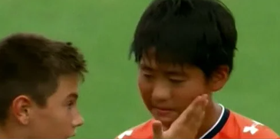
Junior World Soccer's winning team (Barcelona) stop in the midst of celebration to empathise with and comfort the rival Japanese team
https://youtu.be/d12u4P27fto

Slide 8
Learning Characteristics
Am I…
Determined?
Independent?
Curious?
Resilient?

Slide 9
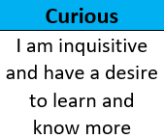


Slide 10
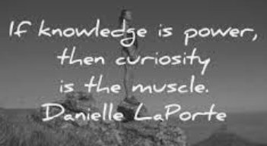
Curiosity examples…
What can you do to demonstrate your own curiosity?
Ask more questions
Admit that you don't know something
Learn something new
Start to learn from other people
Diversify your interests
Challenge traditional ways of thinking

Slide 11
Learning
Skills
Am I…
Innovative?
Organised?
Reflective?
Resourceful?

Slide 12

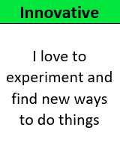

Slide 13

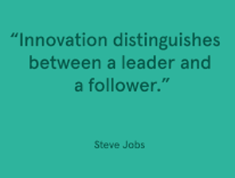
Skills for innovation:
Communication skills
Thinking skills
Leadership skills
Creative problem solving

Slide 14

This half term we will be focusing on being…
EMPATHETIC
CURIOUS
INNOVATIVE
A1’s when you are caught doing these things by staff

Slide 15
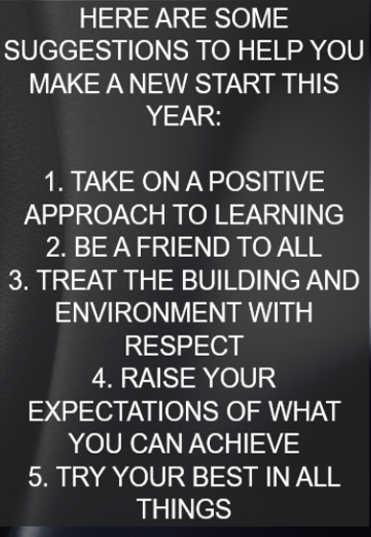


Slide 16
