Slide 1








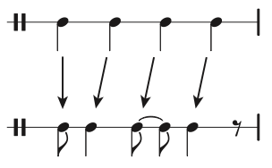


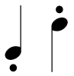








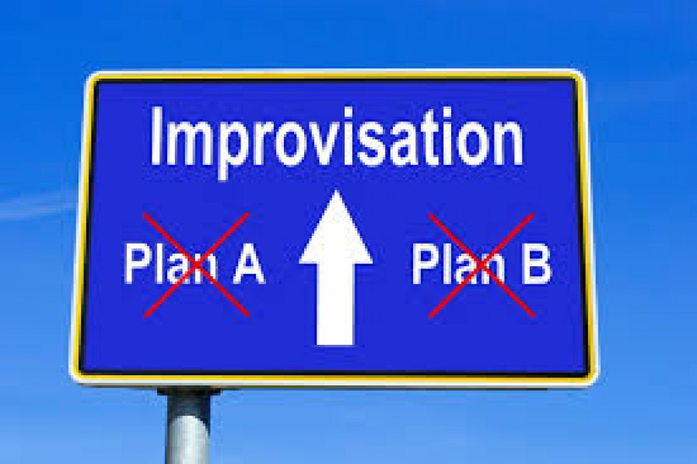

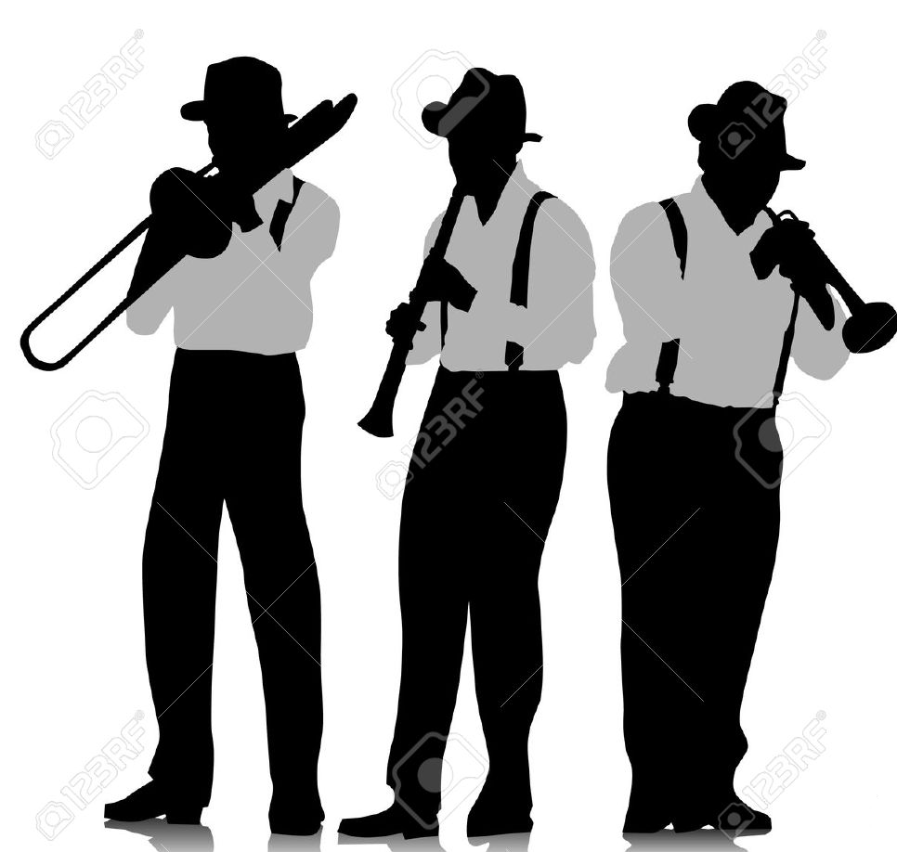
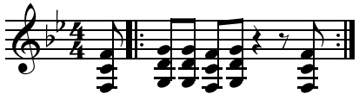


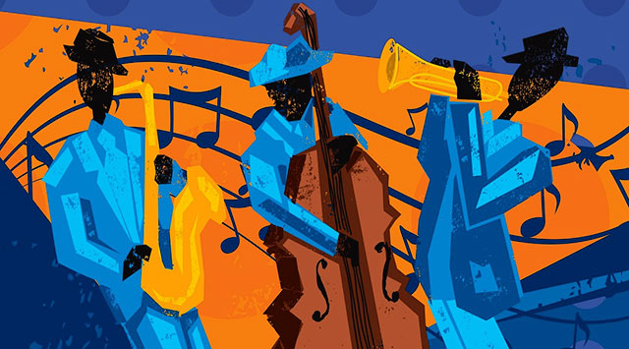
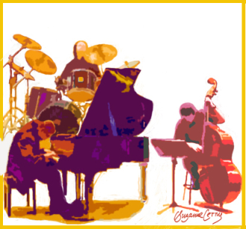
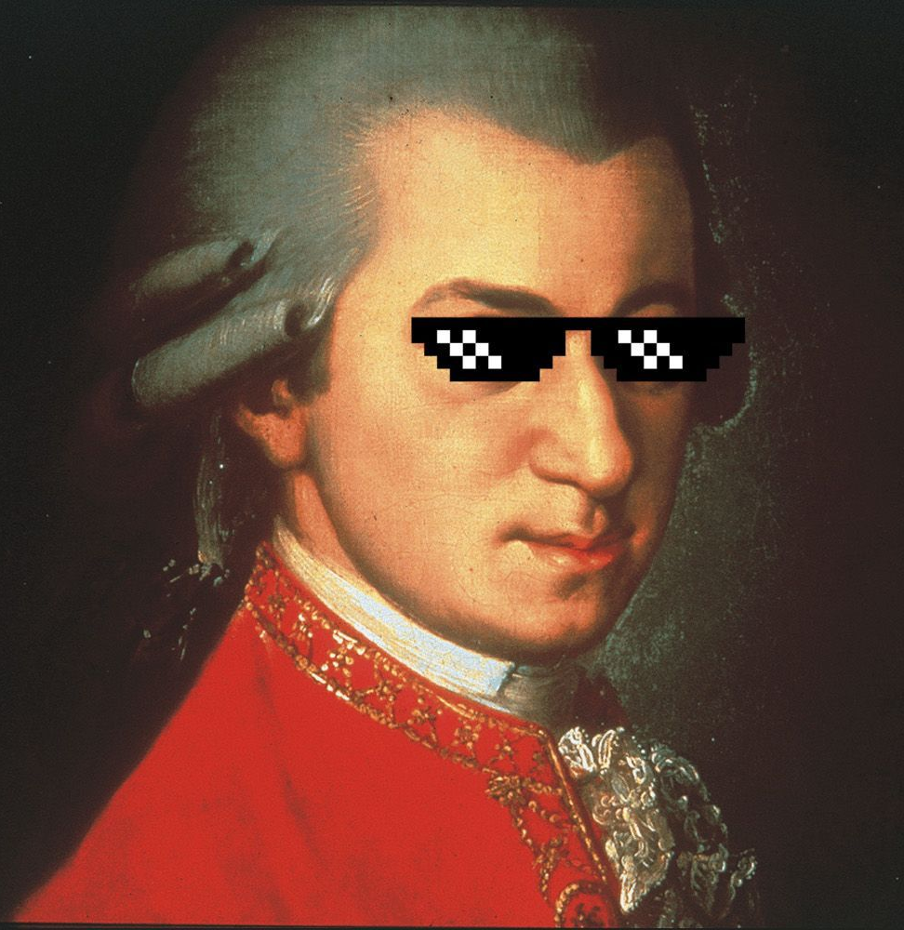



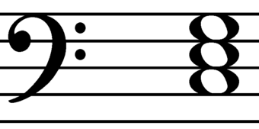
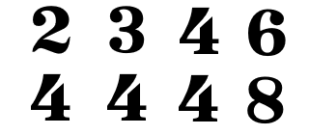




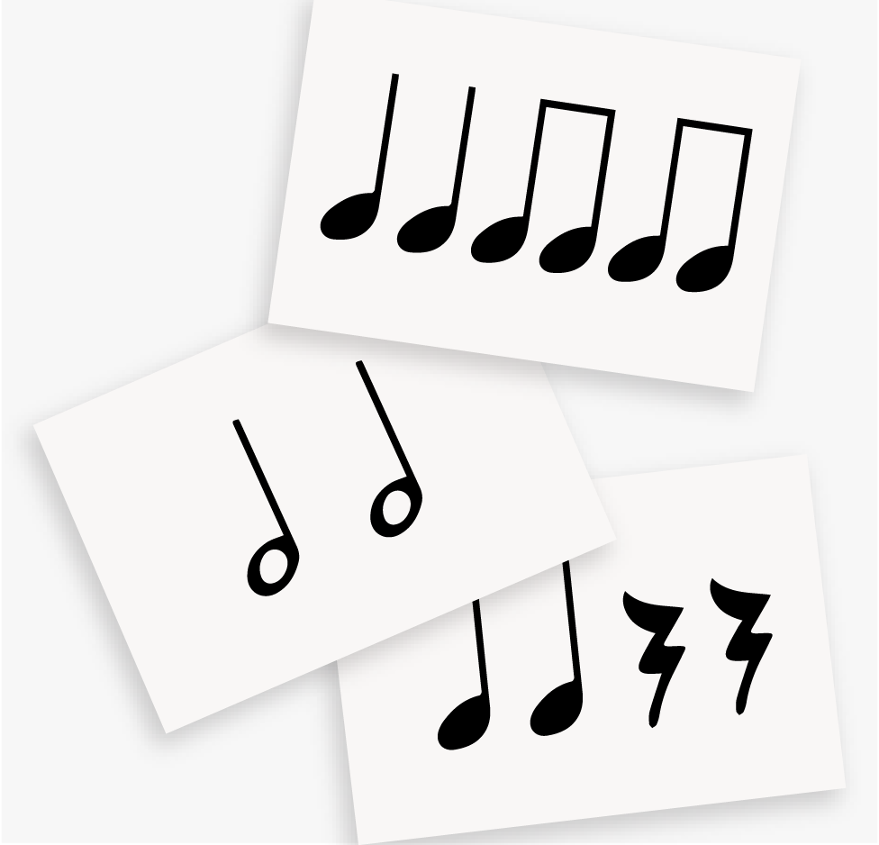
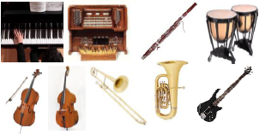
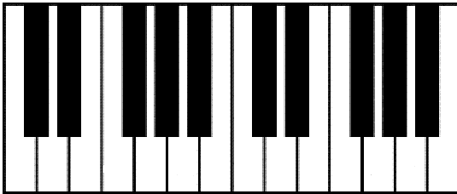




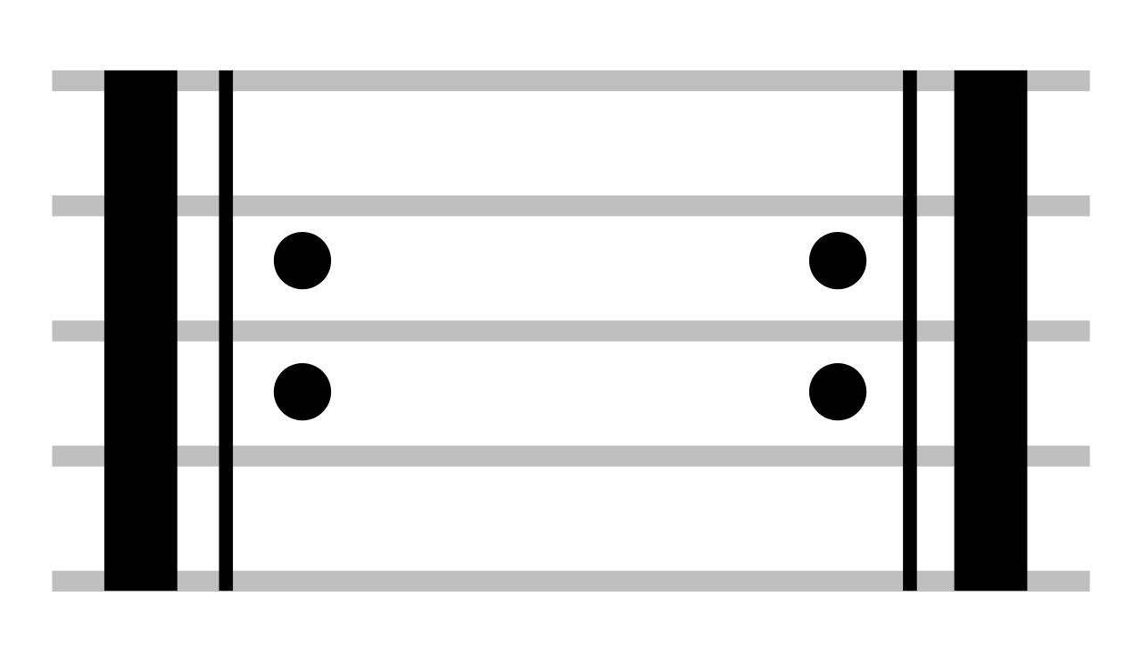

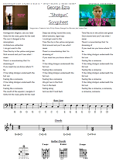
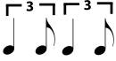

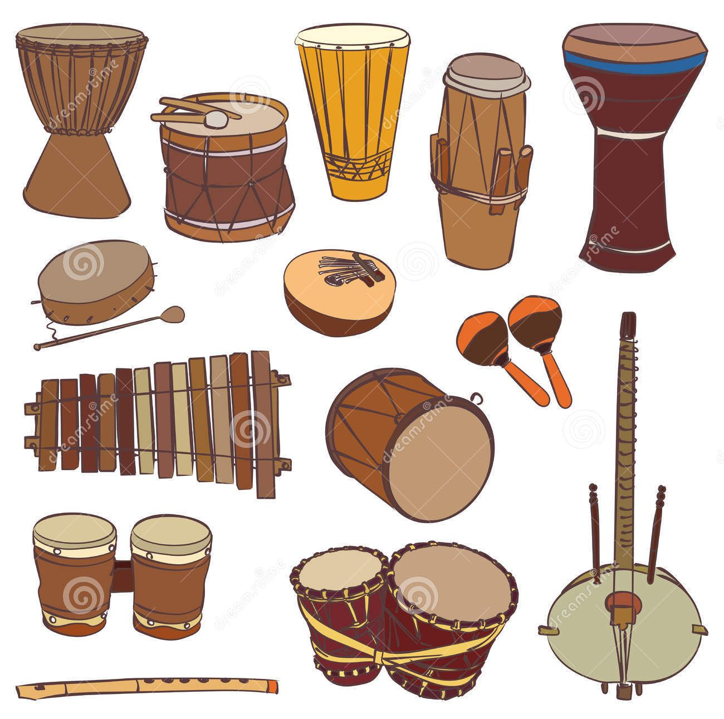
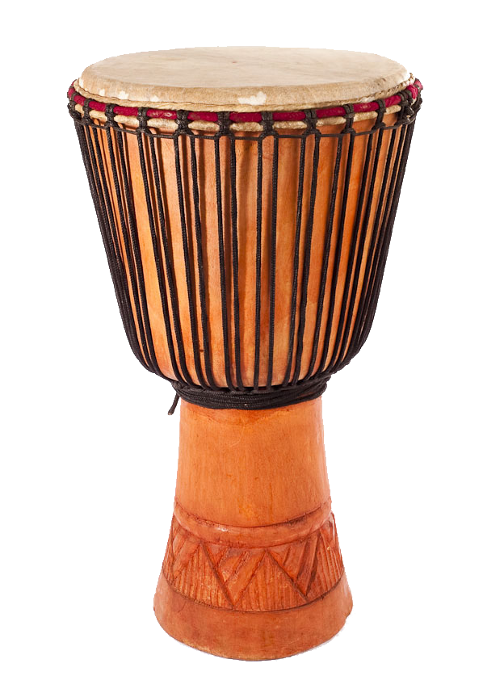

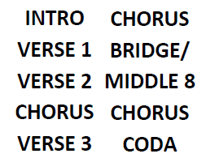
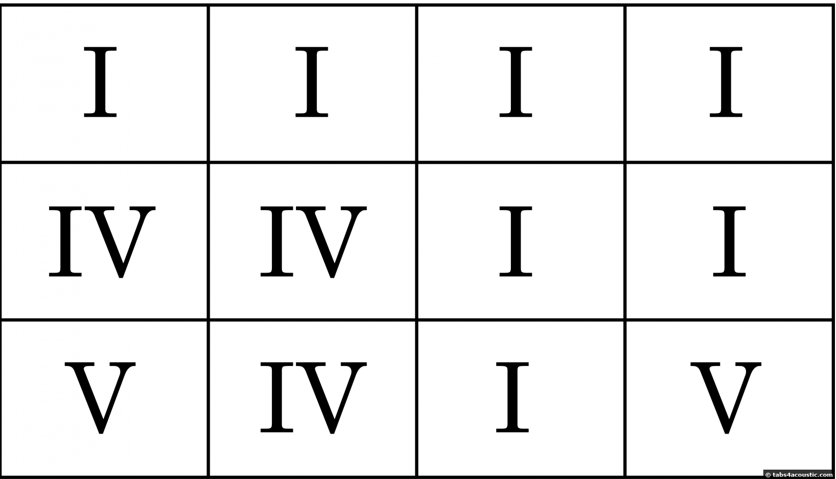
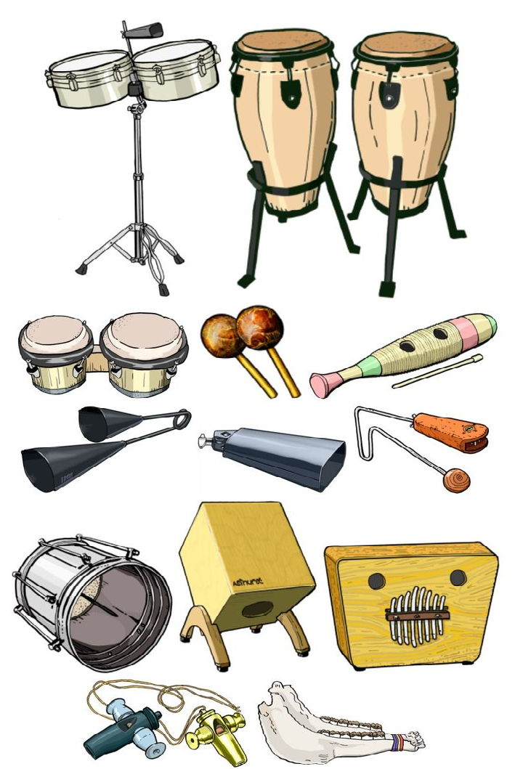
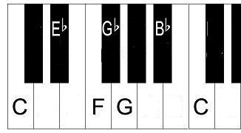
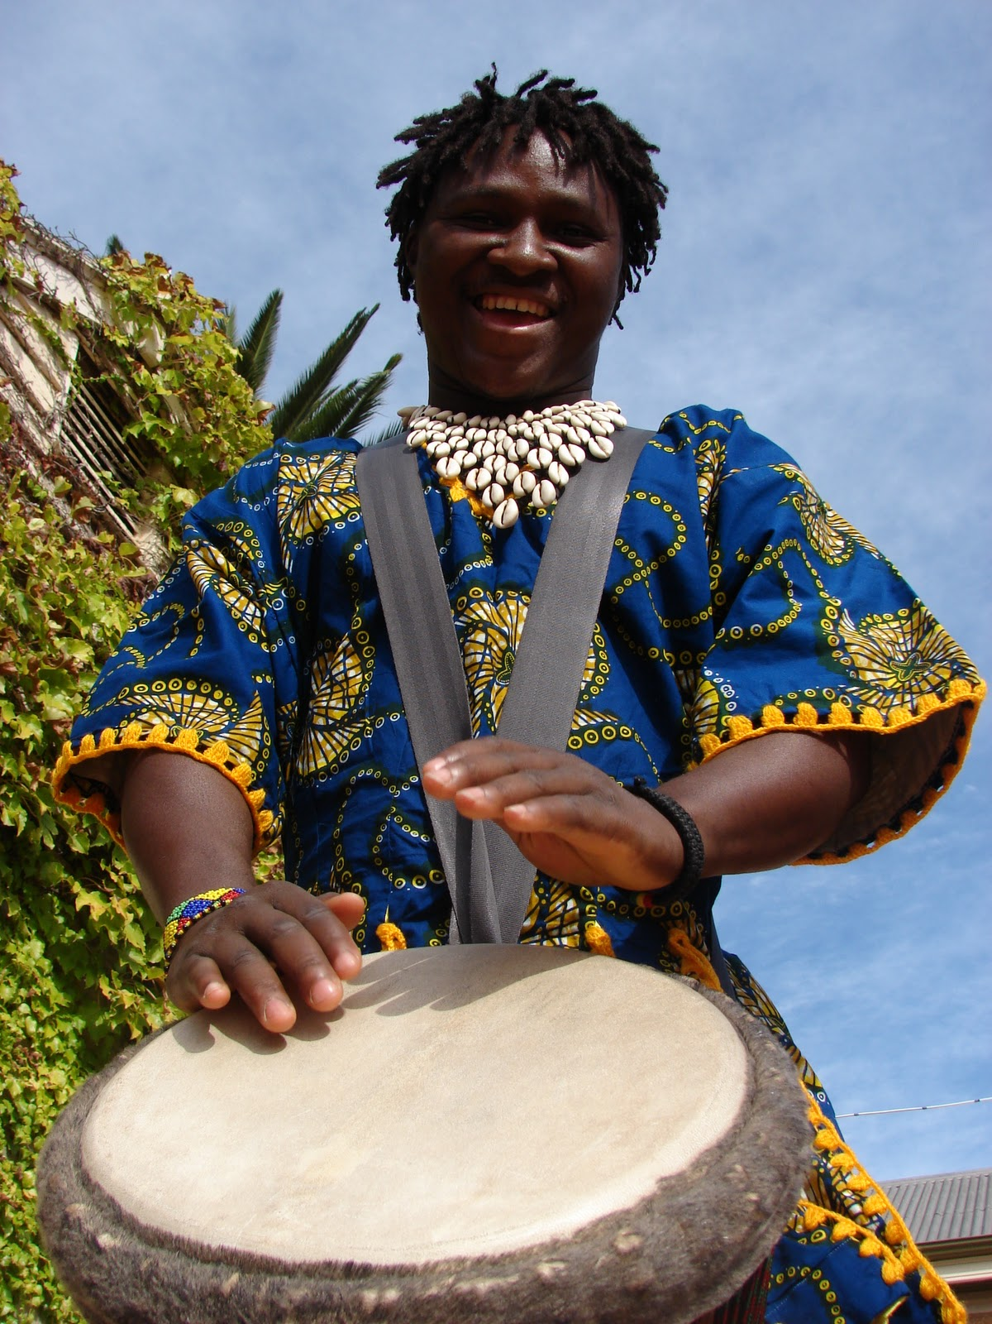
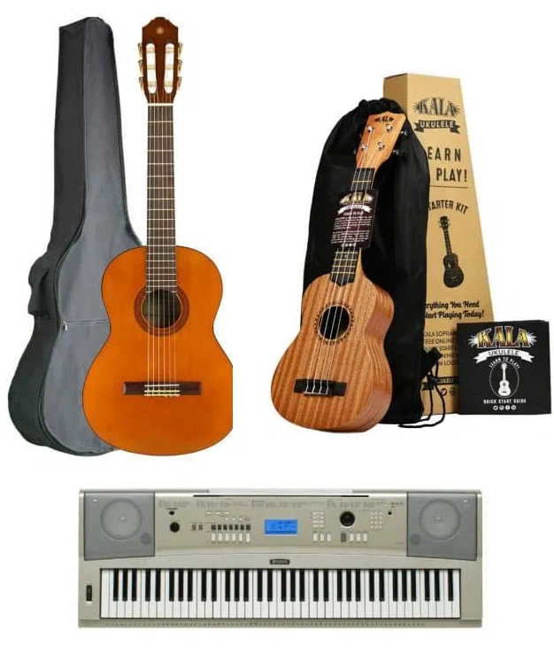
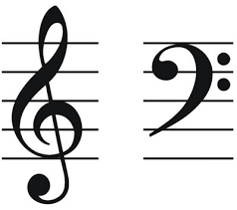

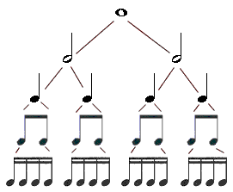
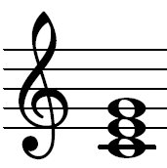





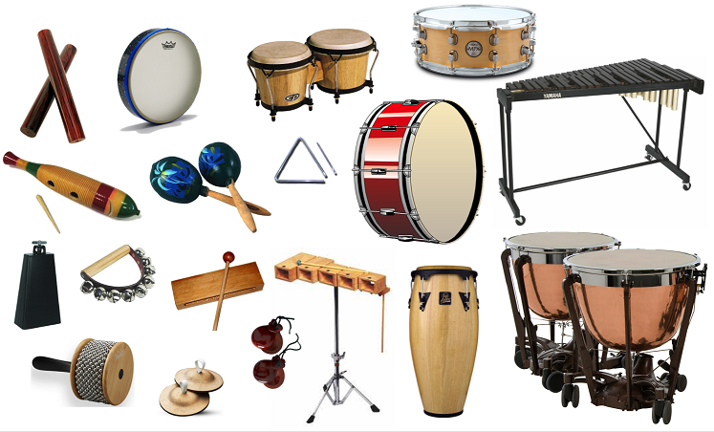
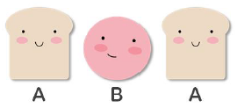
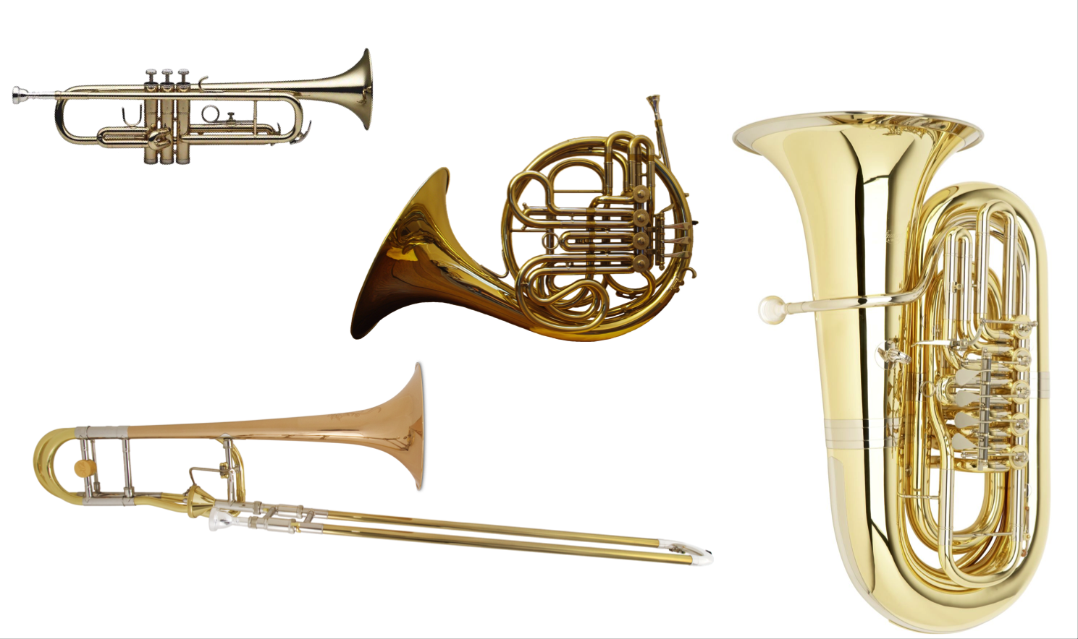



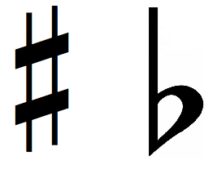
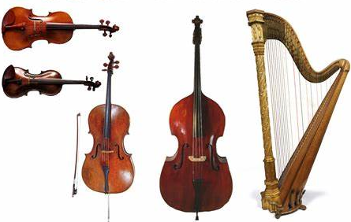
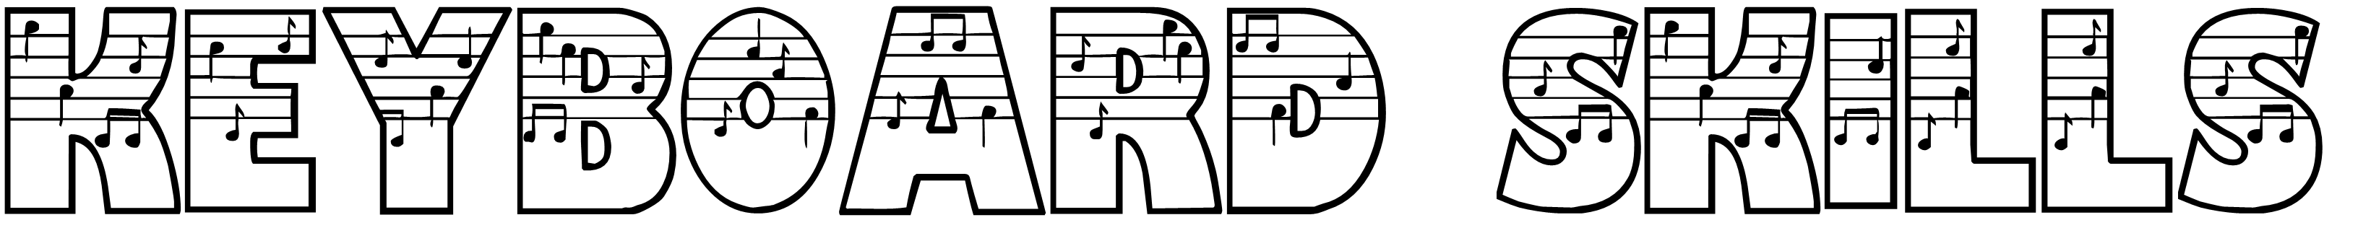
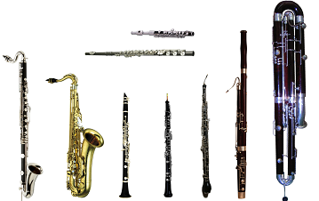
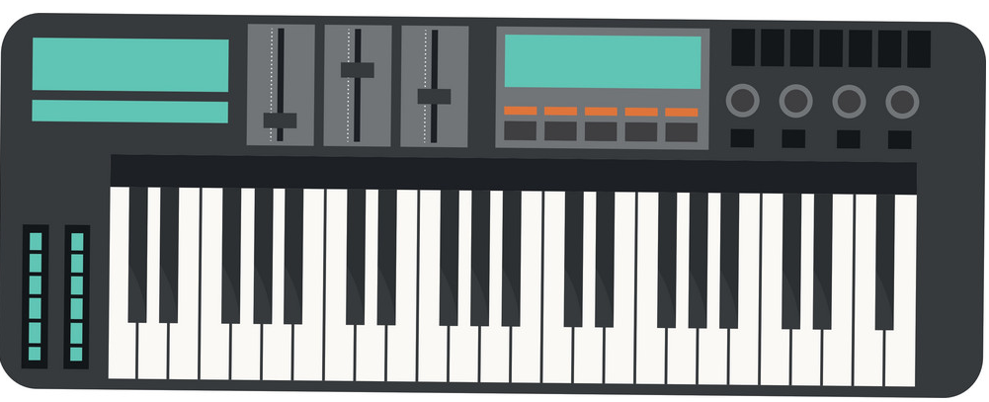
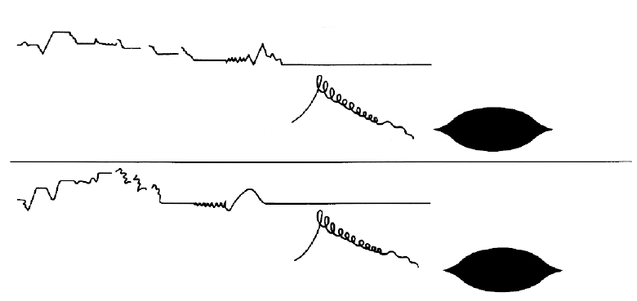
Composition
Music Learning Journey
Performance
Practical end-of-topic assessment every half term.
Ensemble
AOS1 and AOS3 long answer questions
interim assessment
Dynamics
Pitching
Personalized Revision
Exam Prep
Solo Performance
Exam Preparation!!
Post 16 Education
Keyword Terminology and vocabulary
Intonation
Chords
Unfamiliar Listening and appraising
Interval
Expressive detail
Phrasing and articulation
Contrast and development of ideas
Stylistic awareness
canon
Cadences
Modulation
Composition
Interpretation
Expression
Composition
DR T SMITH
Ensemble Performance
Structure and Form
Texture
Rhythm: Cross rhythms, syncopation, dotted rhythms, triplets
Tempo
Fluency
Riff/ostinato
Augmentation
Diminution
Year
11
Textures -
Homophonic, melody dominated homophony,, counter-melodies
Pulse, Beat & Rhythm
Compound time signatures
Imitation Timbre and dynamics
Call and response
Texture – Melody, Counter-Melody, Hooks/Riffs, Chords, Accompaniment, Bass Line
Fluency and timing
Collaboration
Imitation
AOS1 Mozart
AOS3 Paul Simon
Ensemble Performance
Anacrusis
Ladysmith Black Mambazo
African Fusion
Melodic Motion: Conjunct, Disjunct, Range
Chords
musicianship
Instrumentation
Tonality
Simple and Compound Time Signatures
Rondo Form (ABACADA..)
Harmony
Lyrics and Song Words
Baseline Theory Test
Pulse, Beat & Rhythm
Fluency
Free Composition
Intro to GCSE
AQA Specification Overview
Texture – Melody and Accompaniment
Solo Performance
Repertoire
Accuracy
Melody
Improvisation
Inversion
Retrograde
Primary Instrument
YEAR
10
MOZART
History of Western Art Tradition
Chords
Music and Mood
Leitmotif/
Sequencing
Creating a Musical Arrangement
Cover Version
General Knowledge Quiz
Frontline Instruments
(Solos)
Performance skills
Textures and Layers
Chromaticism
Dissonance
Soundtrack
Sound Effect
Western Art Music
Film and Game Music
Live Lounge
Performing as an Ensemble
The Bass Guitar
Hooks and
Riffs
Ostinato, Riffs
Fills & Solos
Ostinato
General Knowledge Quiz
Orchestration
Timbre
Sonority
Musical Clichés
Motif/Cell
Diegetic
Non-Diegetic
Notation – Lead Sheets
I IV
V V7
Q&A/Call and Response
Character Theme
Motif
Swing/Swung Rhythms
I IV V
Texture – Melody, Chords and Bass line
Solo Performance
Master Drummer
12-Bar Blues
Confidence
Chords I, II,
IV & V
African Drumming
Cyclic Rythms
Repetition
Rock and Roll
Melody/Theme
African Musical Instruments
Djembe Performance Technique – Bass, Tone & Slap
I II IV V
Listening and appraising
YEAR
Four Chord Structure
Common Instrumentation
9
BAROQUE MUSIC
Drone/pedal
Popular Song features
Mini Theory Test
Strophic form
Reggae Song Lyrics
Hooks and Bass Line Riffs
General Knowledge Quiz
Syncopation
Off Beats
Repetition
The Elements of Music
Popular Music
Reggae Music
Hooks – Melodic, Rhythmic & Verbal
Instruments, Timbres and Sonorities in Songs
Triadic chords
Four chord formula
C G Am F
Creating a
Reggae
Arrangement
Ostinato
Riffs
General Knowledge Quiz
Western Art Music
Harmony
I IV V
History of Western Art Tradition
Opera
General Knowledge Quiz
Performance techniques
Improvisation
Samba Instruments
Listening test
Blues Chord Sequence
12-Bar Blues
Music for the Stage
The Blues
Chords I, IV & V
and I7, IV7 & V7
Melody and accompaniment
Opera
Dialogue/Drama
Blues Scale
Blues Song Structure
YEAR
Q&A/Call and Response Phrases
Instruments of Folk Music
Folk Song Accompaniments: Pedal, Drone, Ostinato, Alberti Bass, Broken Chord, Arpeggio,
Blues Songs Lyrics
8
General Knowledge Quiz
Chords as an Accompaniment: Keyboard, Guitar, Ukulele
Simple Time
Signatures
Band Breakout
Medieval Music
(Listening, Performing & Composing)
Theory Quiz
Note Durations
Treble Clef Staff Notation
Start of Western Art Music
Creating a Folk Song Arrangement
Listening to Arrangements
The Elements of Music
Dynamics
Rhythm
Timbre
Structure
Melody
Instrumentation
Texture
Harmony
Brass Instruments
Variation
Form
Major vs Minor Listening Tests
Sharps and Flats
Music Theory Quiz
Percussion Instruments
Melody and C Chords (Triads)
Major and Minor
Pulse/Beat
Notation
YEAR
Canon
Round
Instruments of the Orchestra
7
Christmas Performance
Effective Keyboard Performance Technique
General Knowledge Quiz
Graphic Notation & Graphic Scores
Baseline Assessment
String Instruments
Treble Clef Pitch Notation
Woodwind Instruments

