Slide 1
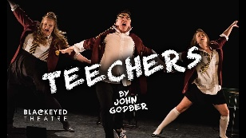
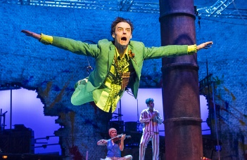
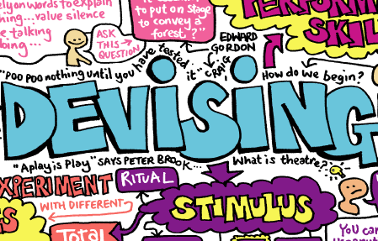
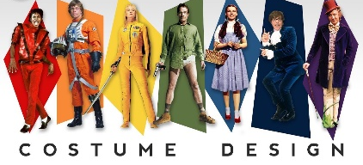
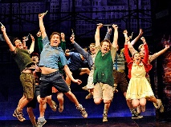
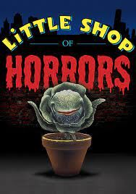
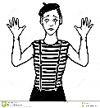
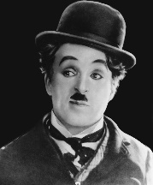
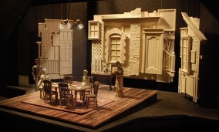
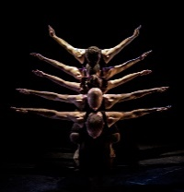
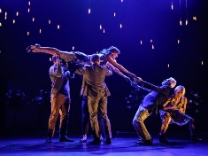
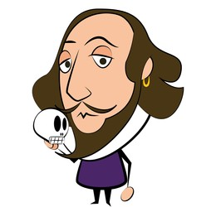
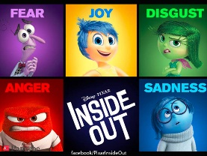
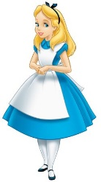
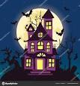
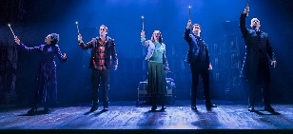
Lacon Childe
Drama Learning Journey Curriculum Map
June - July
Cultural: Performance to a Visiting Examiner
Unit OVERVIEW:
Students develop and apply theatrical skills in acting or design by presenting a showcase of two extracts from a performance text. The chosen extracts must allow sufficient exploration of dialogue, plot and/or subplot, and characterisation for students to work in depth on their acting skills
REVISION &
WRITTEN EXAM
Play Text
Performances
(30%)
Jan - May
DAT FAME
WRITTEN EXAM COMPLETE
PRESENTING AND PERFORMING TEXTS
UNIT COMPLETE
CONCEPT
PRO-FORMA
DUE
Lighting
Set
Sep - Oct
Unit OVERVIEW: Analyse and evaluate a live theatre performance for the final written exam.
Costume
1950s-1980s
Cultural: Theatre Trip
Question: Is it important to stay true to a playwright’s intention? How does this shape a text?
Understanding Drama - Study of set text Blood Brothers.
Y11
Set Text
Exploration: BLOOD BROTHERS (25%)
Live Review:
Theatre Evaluation
(15%)
Nov - Dec
Question: How can we apply physical skills to convey playwright’s intentions? Practical exploration of set text.
May - July
Practical Exploration
Unit OVERVIEW: Students explore practically a whole performance text, and demonstrate their knowledge and understanding of how drama is developed, performed and responded to.
Unit OVERVIEW: Students will explore a range of stimuli & use their knowledge of performance styles, genre & form to devise a piece of theatre.
Set Text
Exploration: BLOOD BROTHERS (25%)
DEVISING DRAMA
UNIT COMPLETE
Jan-
April
Devising
Drama (30%)
PORTFOLIO
COMPLETED AND SUBMITTED
STIMULI
Question: What type of theatre is more powerful, naturalistic or non-naturalistic? Explore a range of performance styles
Oct - Dec
Questions: How can we use key themes of a text to empower the meaning?
What is cross cutting and how can we use it effectively?
Sep - Oct
Cultural: Theatre Trip
MOCK
PORTFOLIO
Scripts:
Intro to
Blood Brothers
Cultural: Script written by prolific play wright
MONOLOGUE
Y10
Introduction to theatre styles and practitioners
DIFFERENT
STAGE
TYPES
FRANTIC
ASSEMBLY
Question: How can we study a performance text to identify additional layers of artistic interpretation ?
Students study a musical, including characters and themes, and use this to create a 3D set design based on a particular stage type. Further analysis and evaluation is also explored.
DUOLOGUE
DV8
Unit OVERVIEW: Students explore practically a variety of the key staging types, alongside key practitioners and their unique style of theatre. This allows them to engage with different performance spaces and styles / artistic intention to prepare them for devising.
Cultural: NEW style of theatre
BRECHT
Set Design:
Musical Theatre
STANISLAVSKI
Devised:
Charlie Chaplin
BARRIERS IN SOCIETY
Devised: Exploring Prejudice and Identity in Society
Y9
Cultural: NEW GENRE
Question: How does prejudice define your identity in society?
‘Refugee Boy’ by Benjamin Zephaniah
Celebrities and Fame – Mental Health
Question: What’s more important dialogue or action? How do we communicate with an audience effectively WITHOUT speaking?
Silent Movies - students develop their physical acting skills by exploring the genre of Silent Movie
Scripts:
Power and Status
ABSTRACT
FACIAL EXPRESSION
Y8
Devised: Physical Theatre
Devised:
Murder Mystery
SOUNDSCAPES
BODY LANGUAGE
Question: How can we convey meaning in performance through physical embodiment?
Alice in Wonderland
The Curious Incident of the Dog in the Night time
Question: How can we build tension and dramatic moments to grip the audience?
Exploration of Soap Operas and reality television
Scripted unit based on Cluedo and Clue.
Exploring murder mystery, cross-cutting and flashbacks.
Question: How can we turn a script into a performance? How can power and status shape character dynamics of heroes and villains?
‘James and The Giant Peach’ by John Wood
The Demon Headmaster
Question: How can we modernise a script?
Students to discover a wealth of modern and Shakespeare texts, exploring a breadth of themes and modernising these with current issues, focusing on emotions as the central focus.
Scripts:
Page to stage: Characterisation Throughout Time
Scripts: Harry Potter & the Cursed Child
Devised:
Introduction to Drama
Darkwood Manor
Y7
Cultural: Prolific Playwright
Cultural: NEW SCRIPT STYLE
Question: How can we turn a script into a performance?
‘Harry Potter and the Cursed Child’ by J.K. Rowling
Exploring characterisation, set design and page to stage creation.
Question: What is Drama? How can we create performance work using a starting point?
Haunted House- Creating simple performance work using basic Drama skills through devising work based on a stimulus.

